Slide 1
PhD Thesis Defense Date: 09/21/2026
Active Modulation of Audio-Visual Perception to Enhance Human Performance and Experience
in Immersive Environments
Daniel Jiménez Navarro

Slide 2
Introduction
Efforts to enhance performance and experience:
  Reduce computational resources
  Improve content quality

Slide 3




Introduction
Efforts to enhance performance and experience:
  Reduce computational resources
  Improve content quality
Devices (latency, refresh rates, resolution)
Algorithms (rendering, memory access)

Slide 4

Introduction
Efforts to enhance performance and experience:
  Reduce computational resources
  Improve content quality
Devices (latency, refresh rates, resolution)
Algorithms (rendering, memory access)
What can we do from the user side? Relying on human perception features

Slide 5
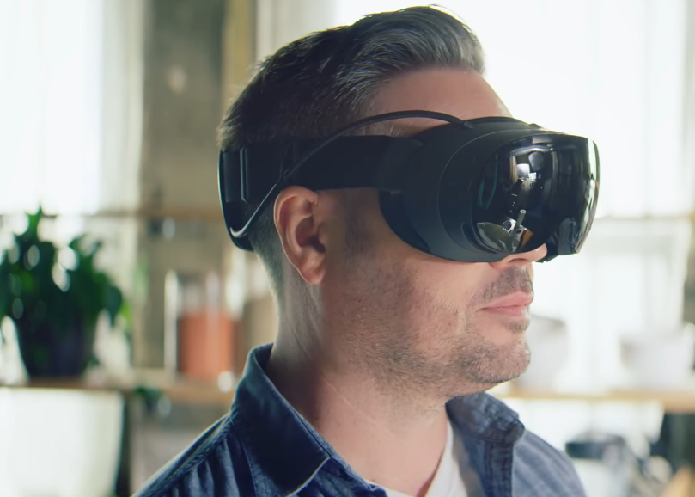


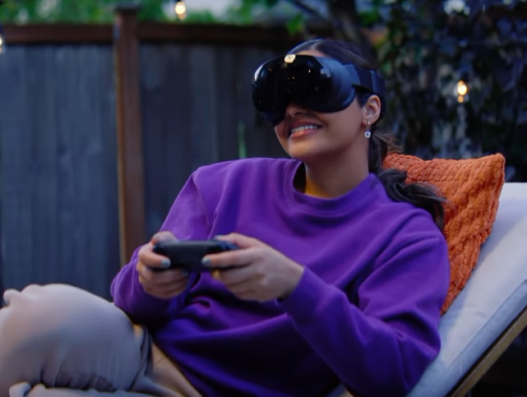
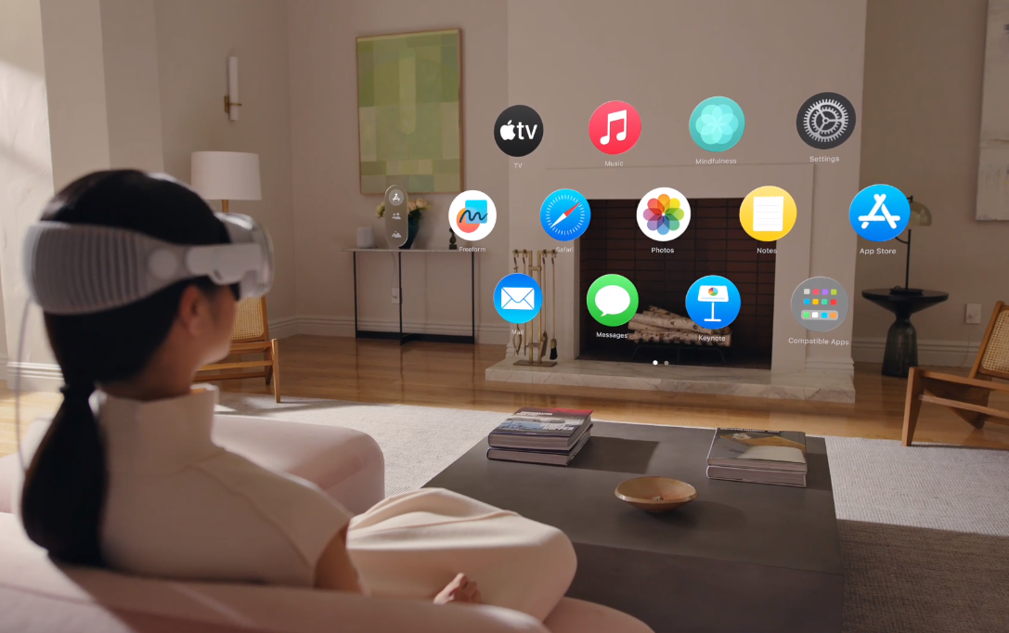

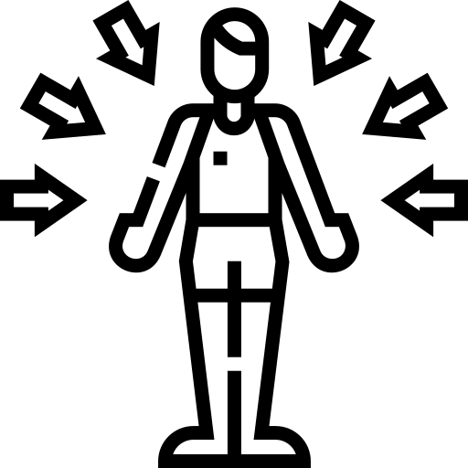
Introduction
Immersive devices to study human perception
  Controllable Content
  Multimodal Information
Apple Vision Pro
(2024)
Steam Frame
(2026)

Slide 6
Introduction
Performance & Experience Goals → Human Perception
Multimodal Perception (Parts I and II): Audiovisual Integration
  Faster Visual Performance
Visual Perception (Part III): Human Visual System
  Improving Computational Performance and User Experience

Slide 7
Overview
Audiovisual Perception:
Accelerating saccadic latency through temporal modulation of the auditory cue
Enhancing depth perception through spatial modulation of the auditory cue
Visual Perception:
Improving foveation through a dynamic eye dominance characterization

Slide 8
Overview
Audiovisual Perception:
Accelerating saccadic latency through temporal modulation of the auditory cue
Enhancing depth perception through spatial modulation of the auditory cue
Visual Perception:
Improving foveation through a dynamic eye dominance characterization

Slide 9
I. Accelerating Saccadic Response through Spatial and Temporal Cross-Modal Misalignments
Published and presented at SIGGRAPH 2024

Slide 10
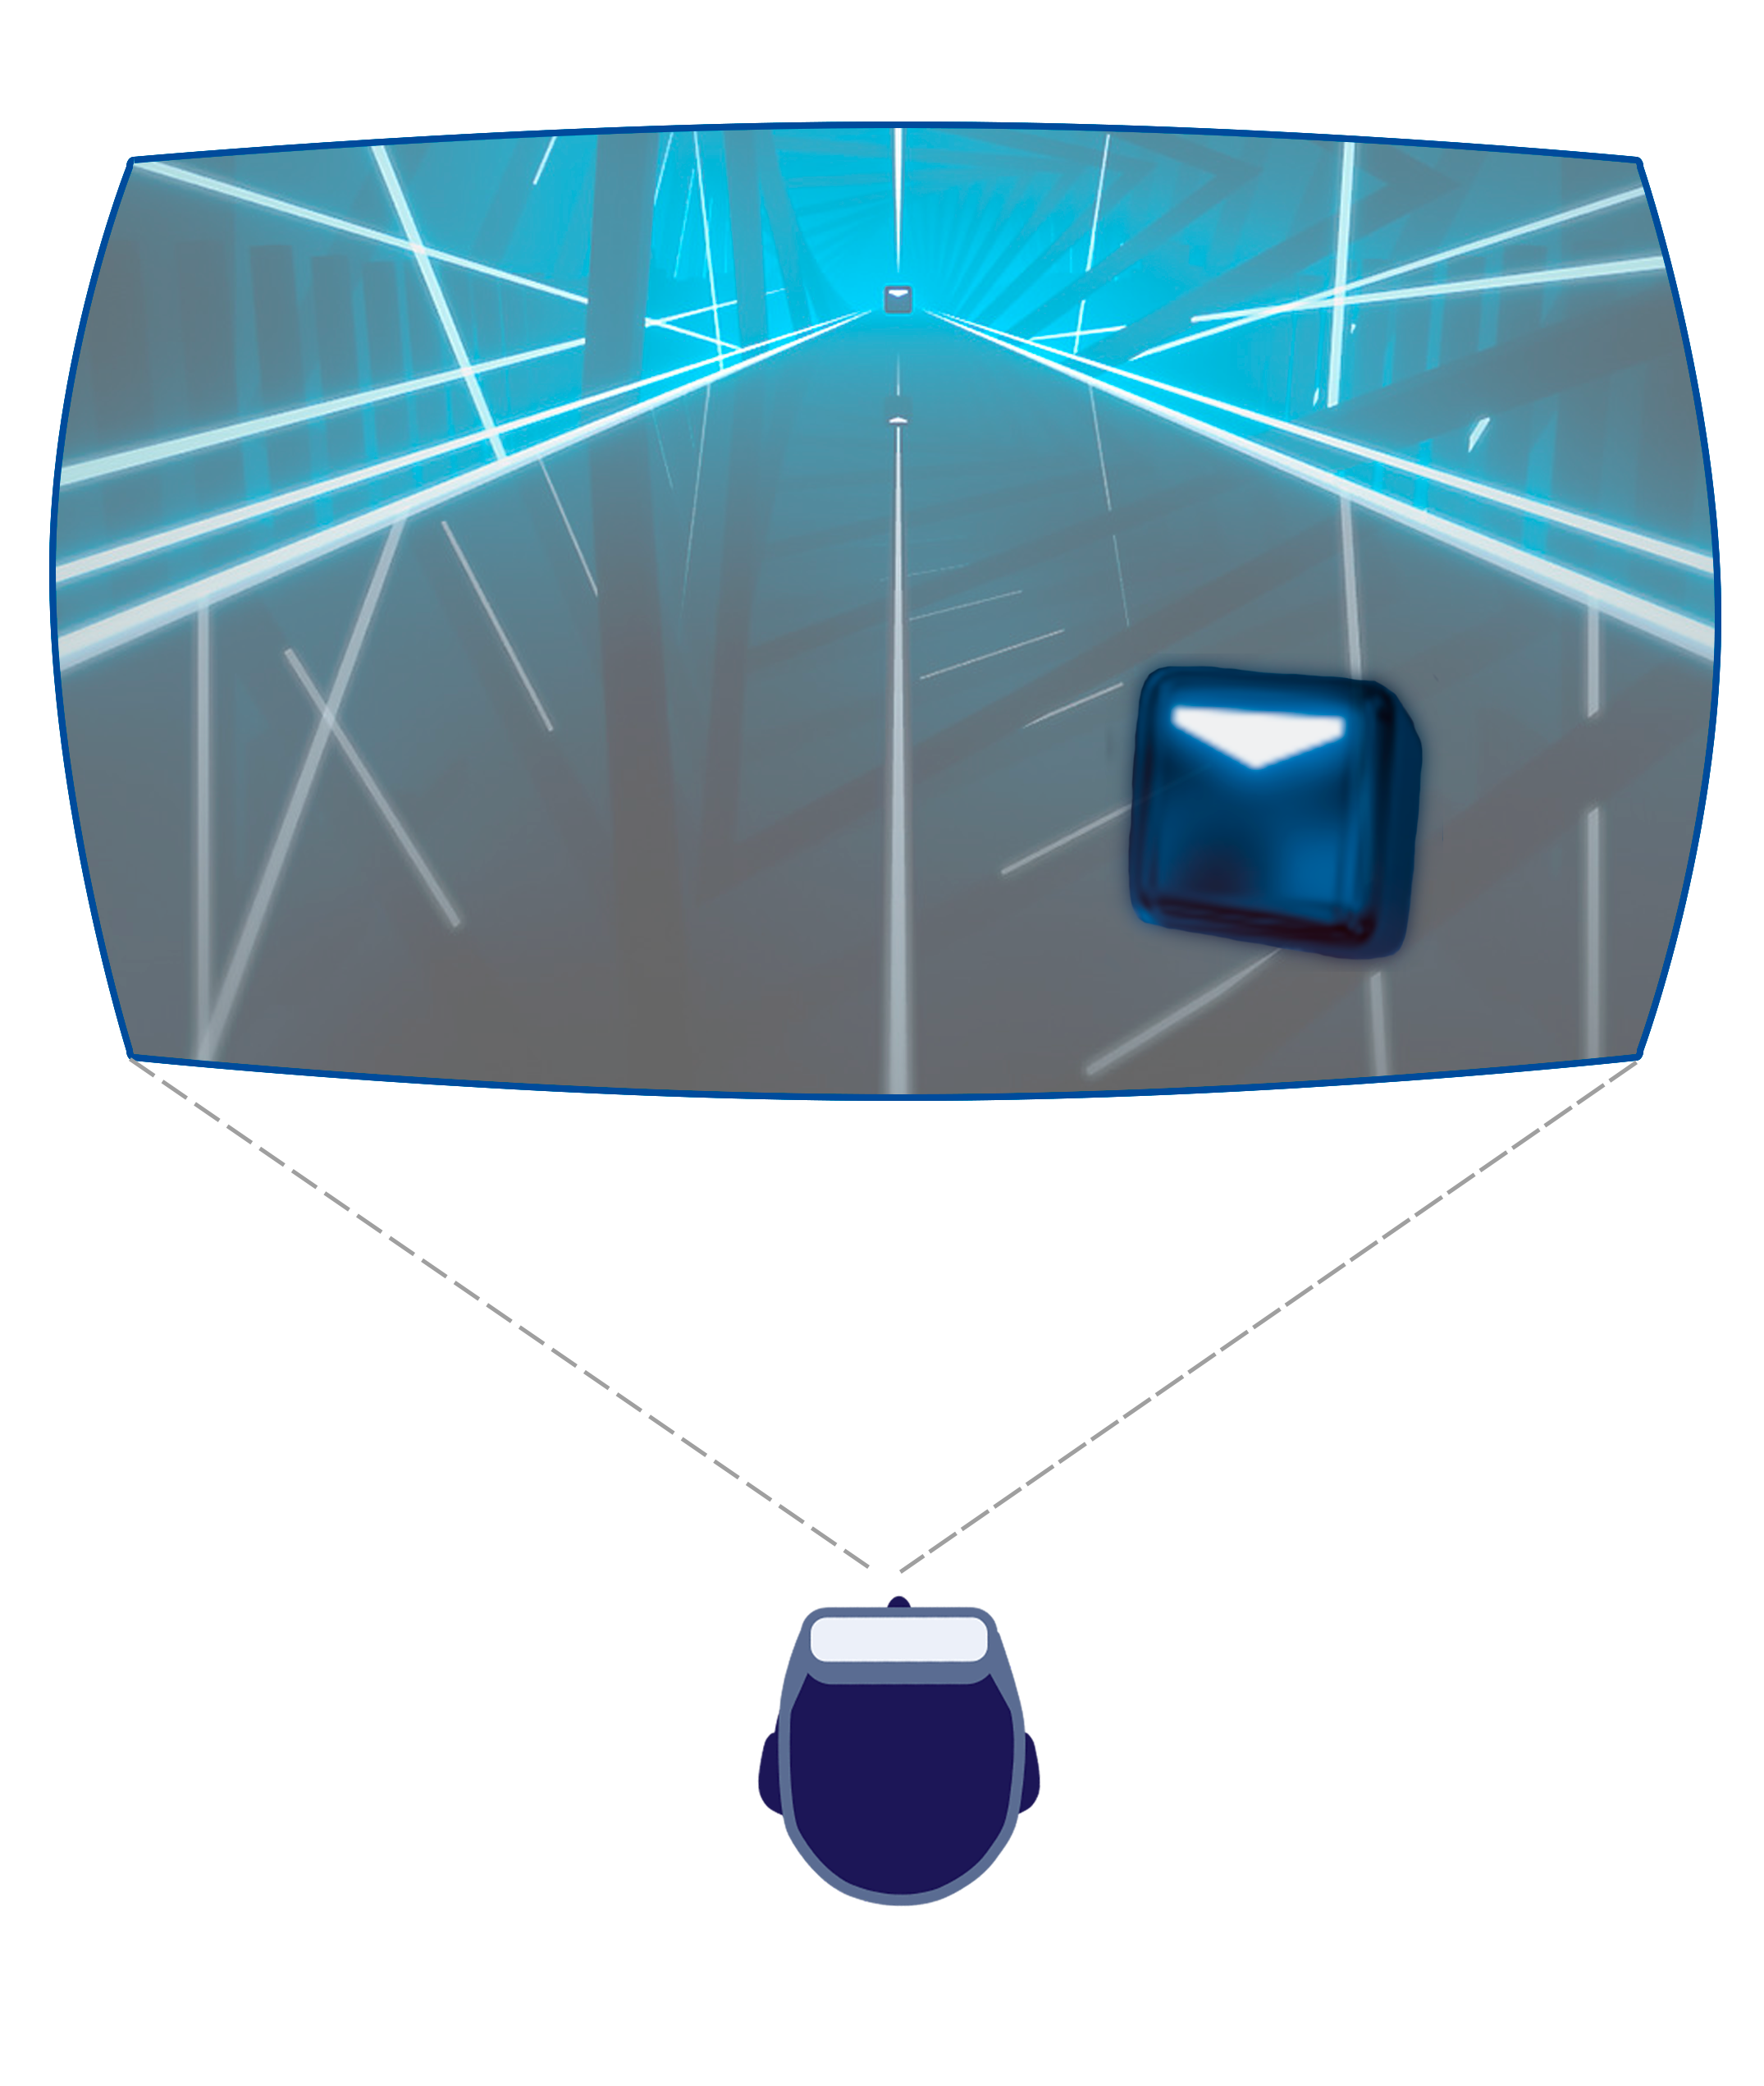
Motivation

Slide 11

Motivation
11

Slide 12
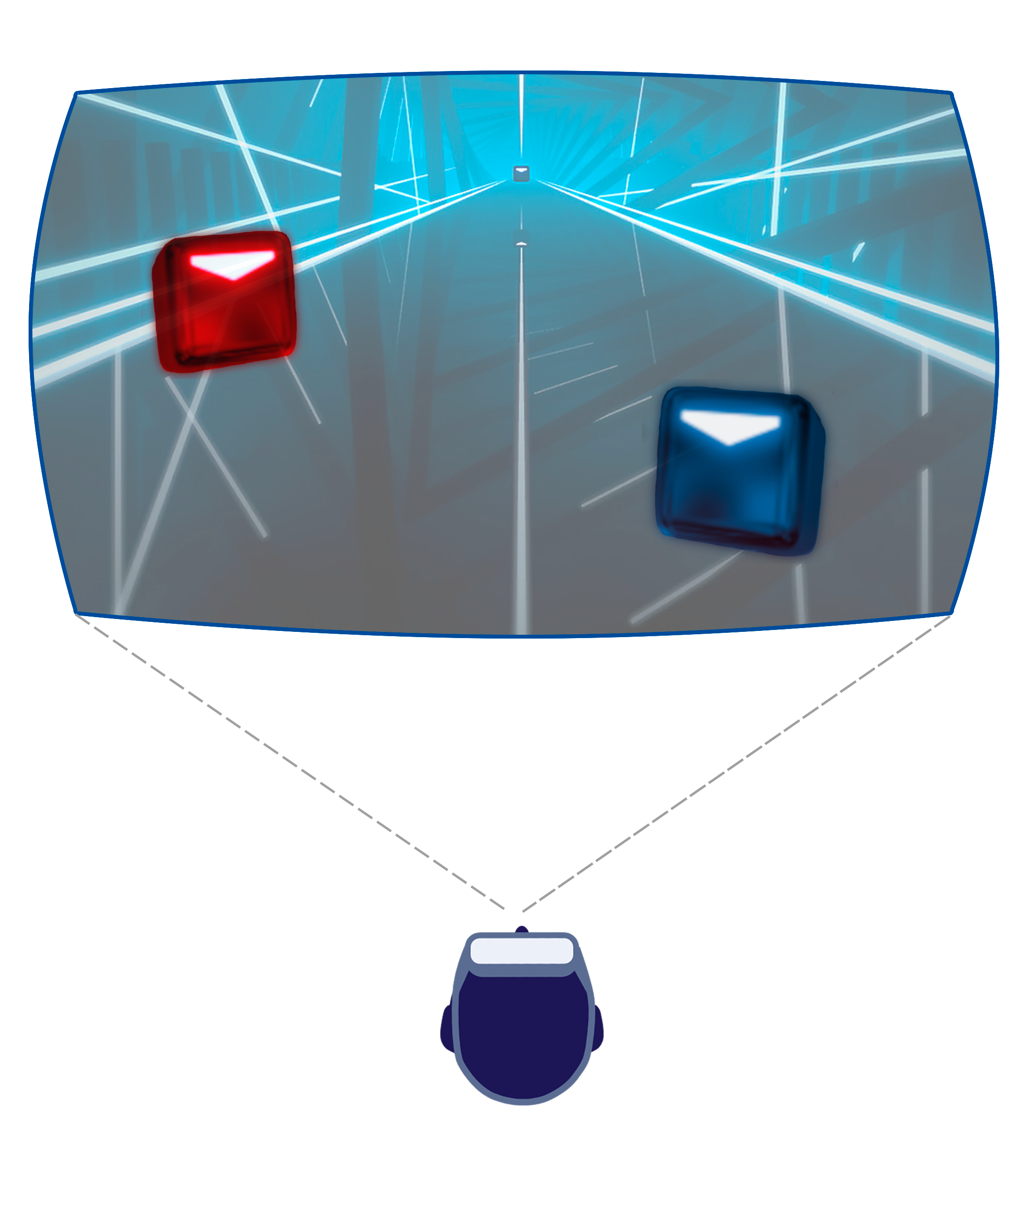
Motivation

Slide 13
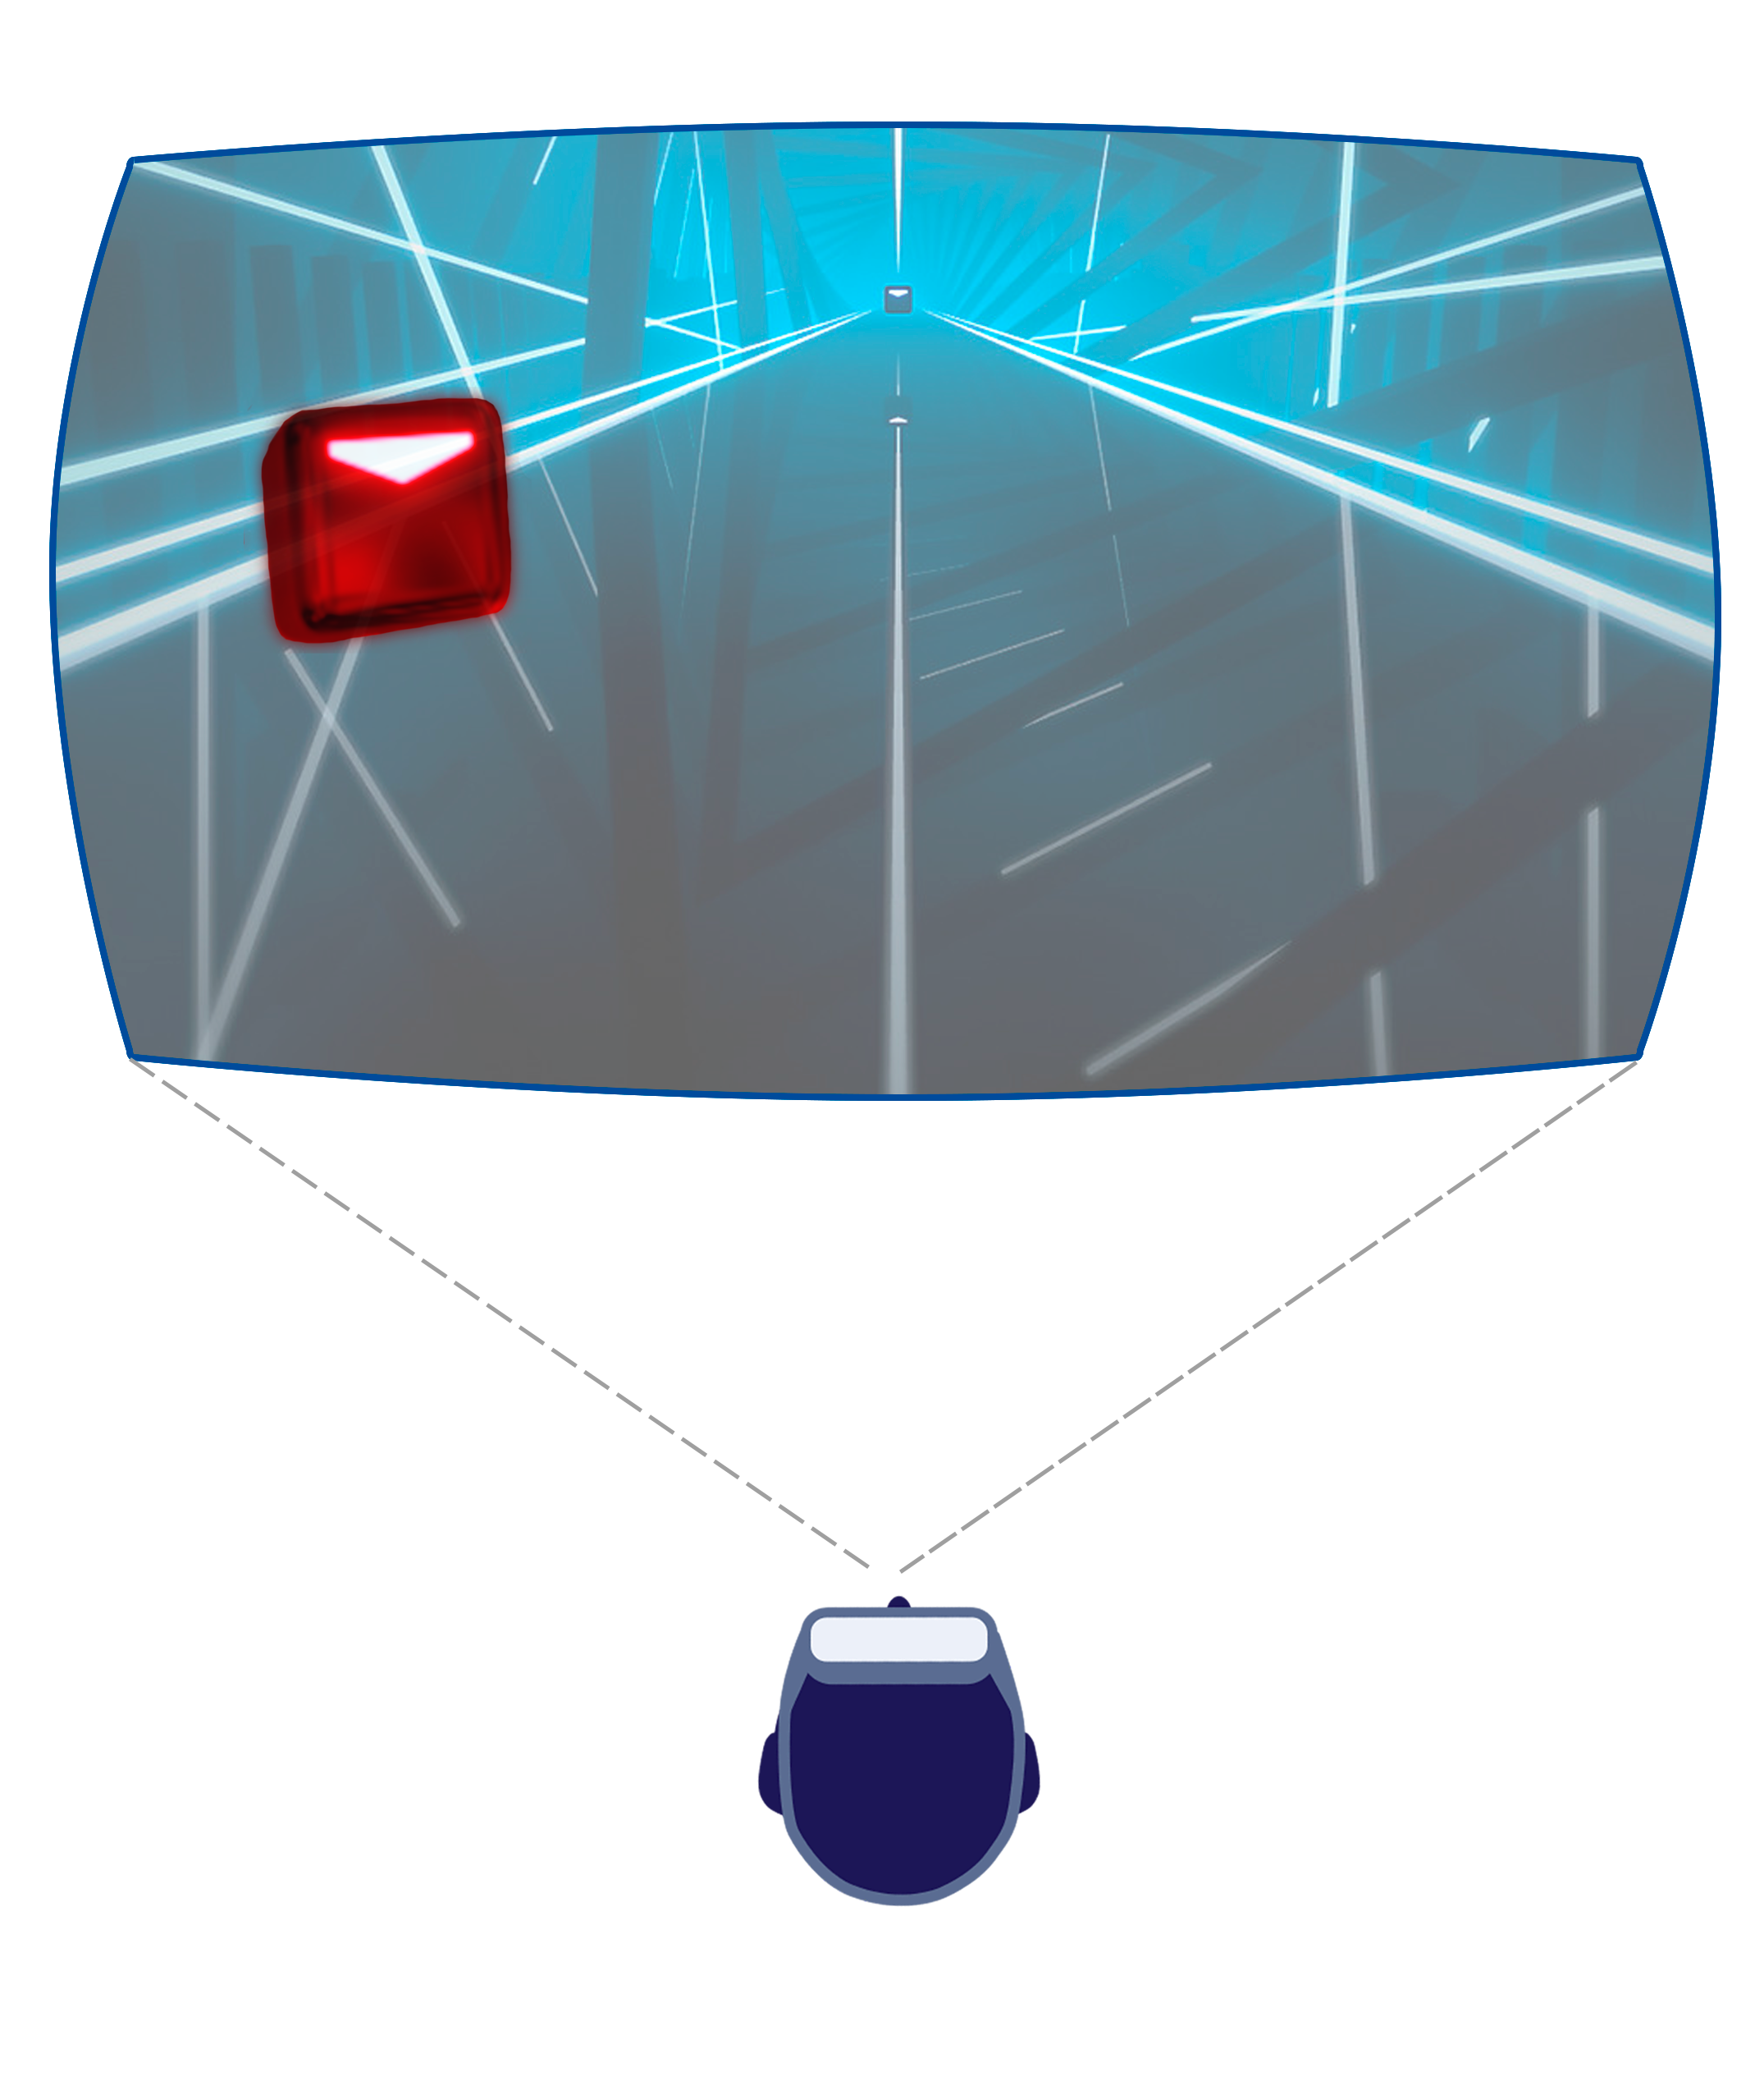
Motivation

Slide 14
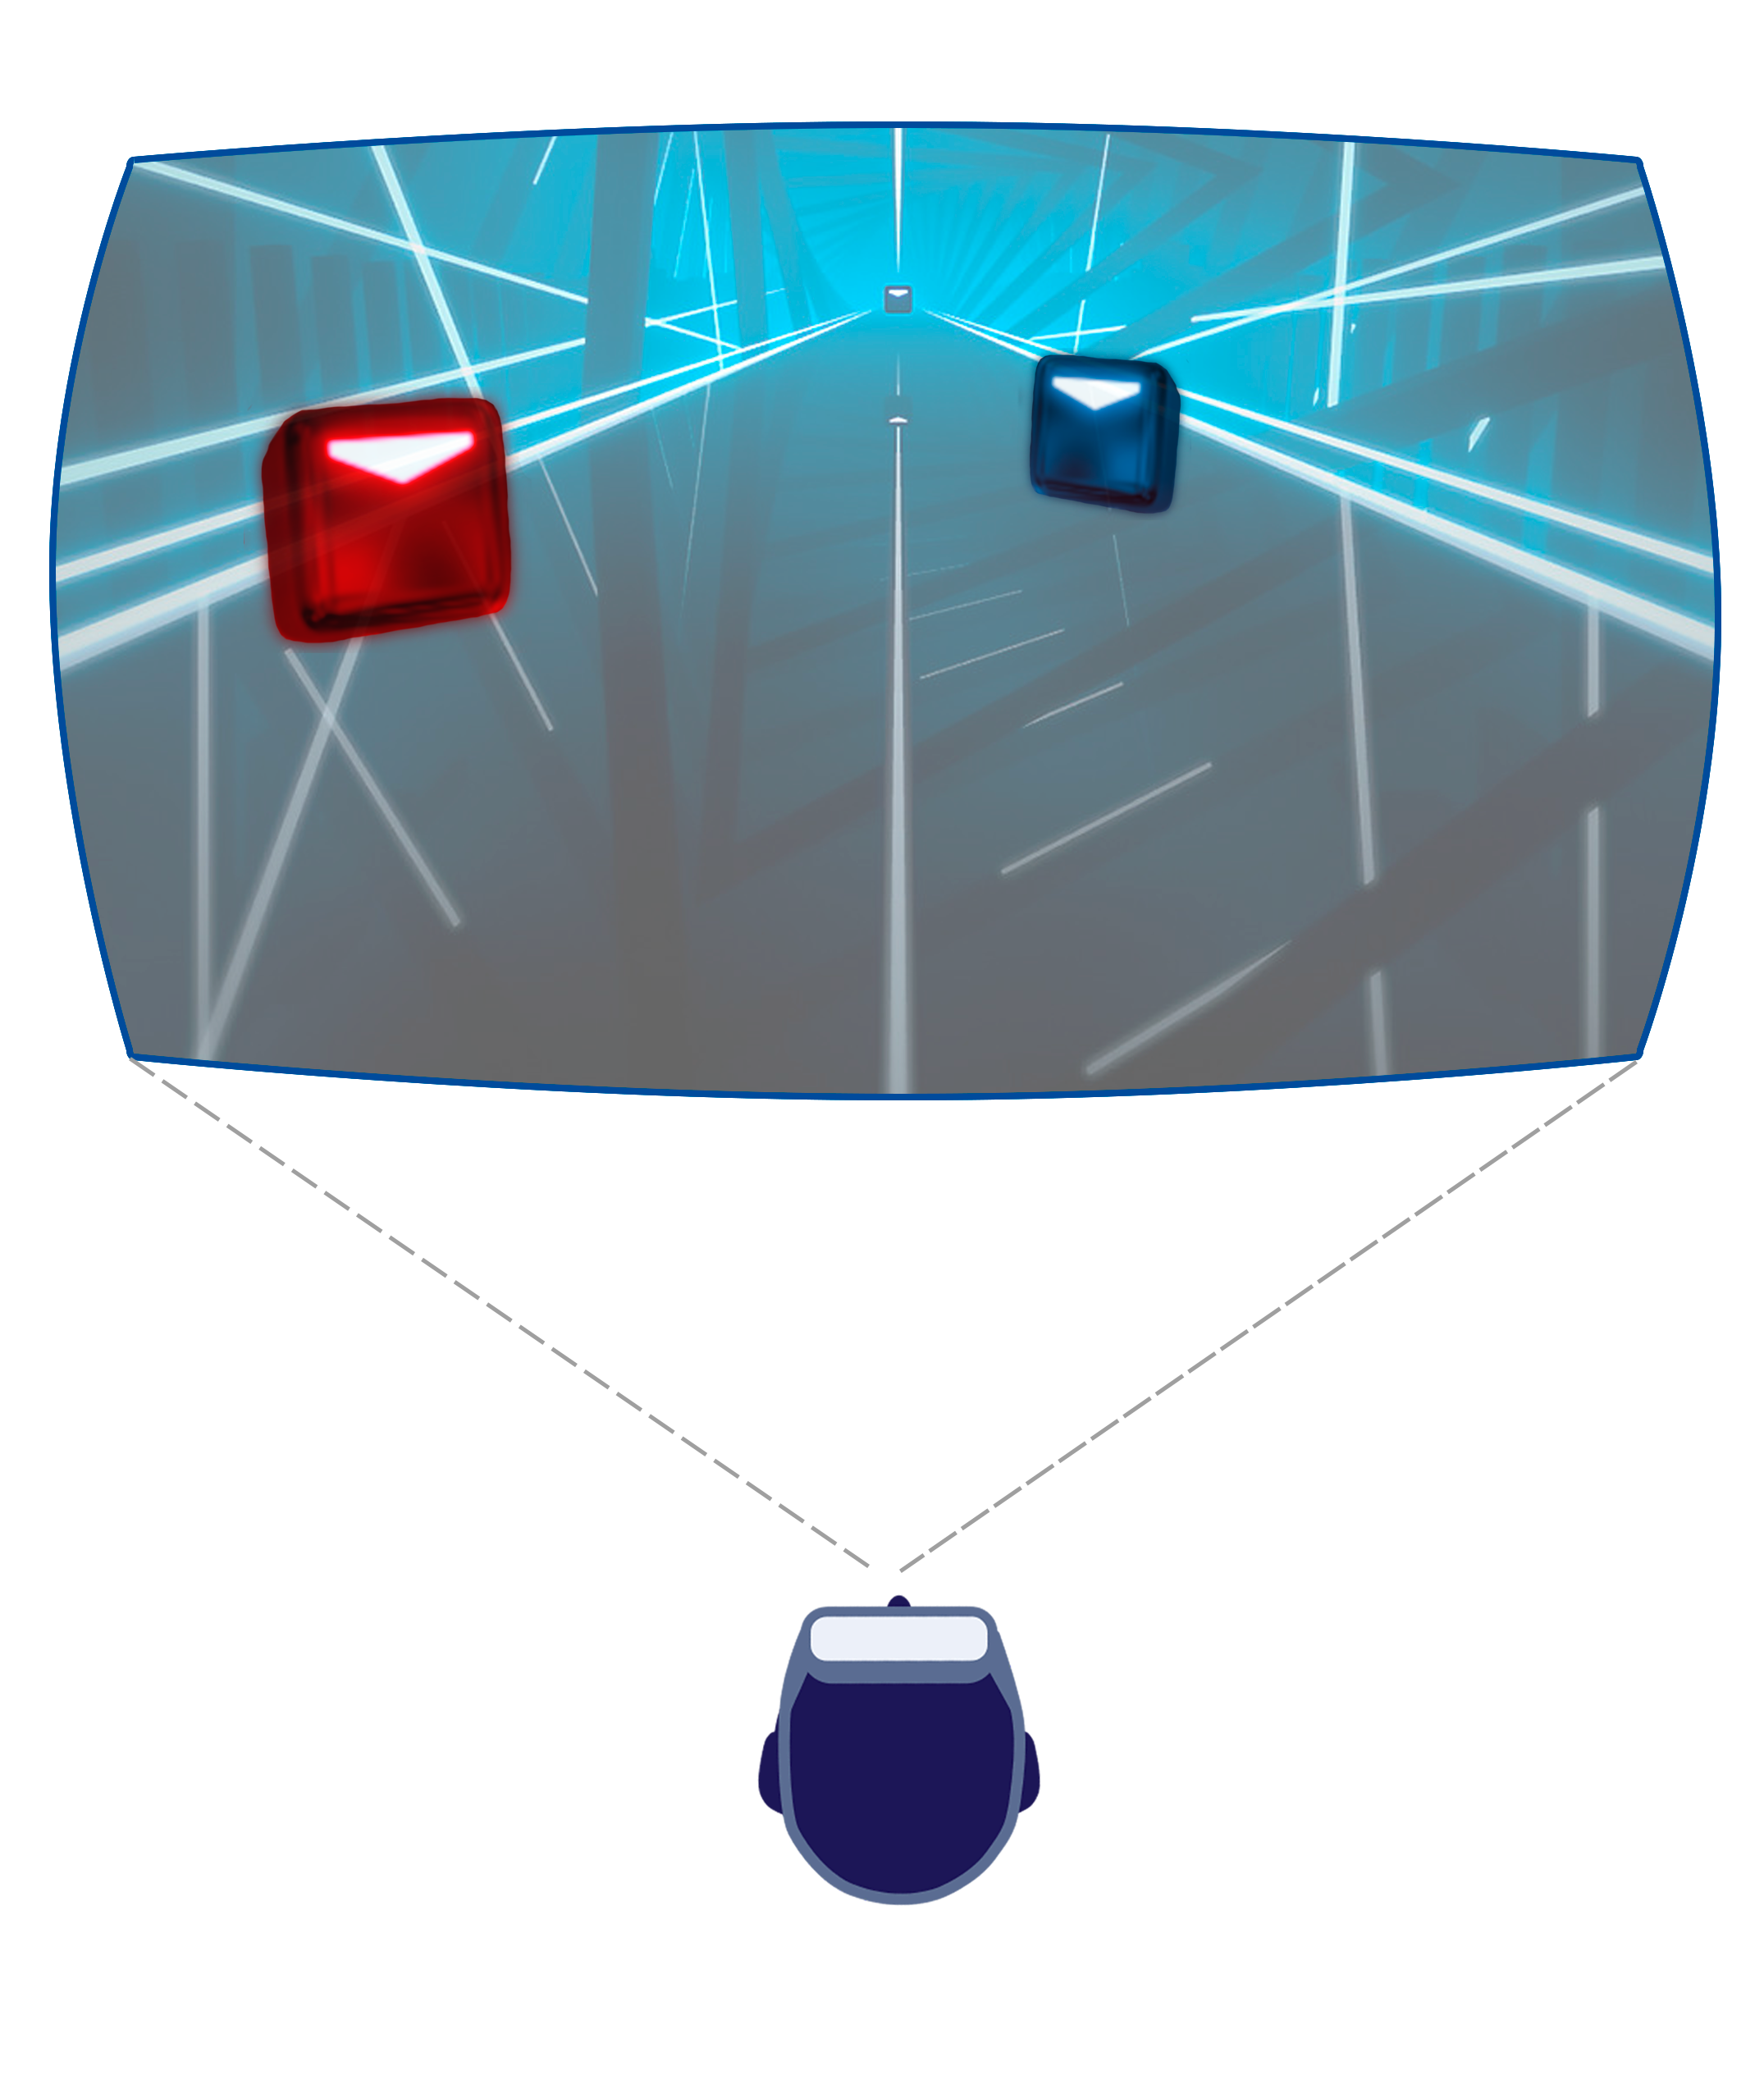
Motivation

Slide 15
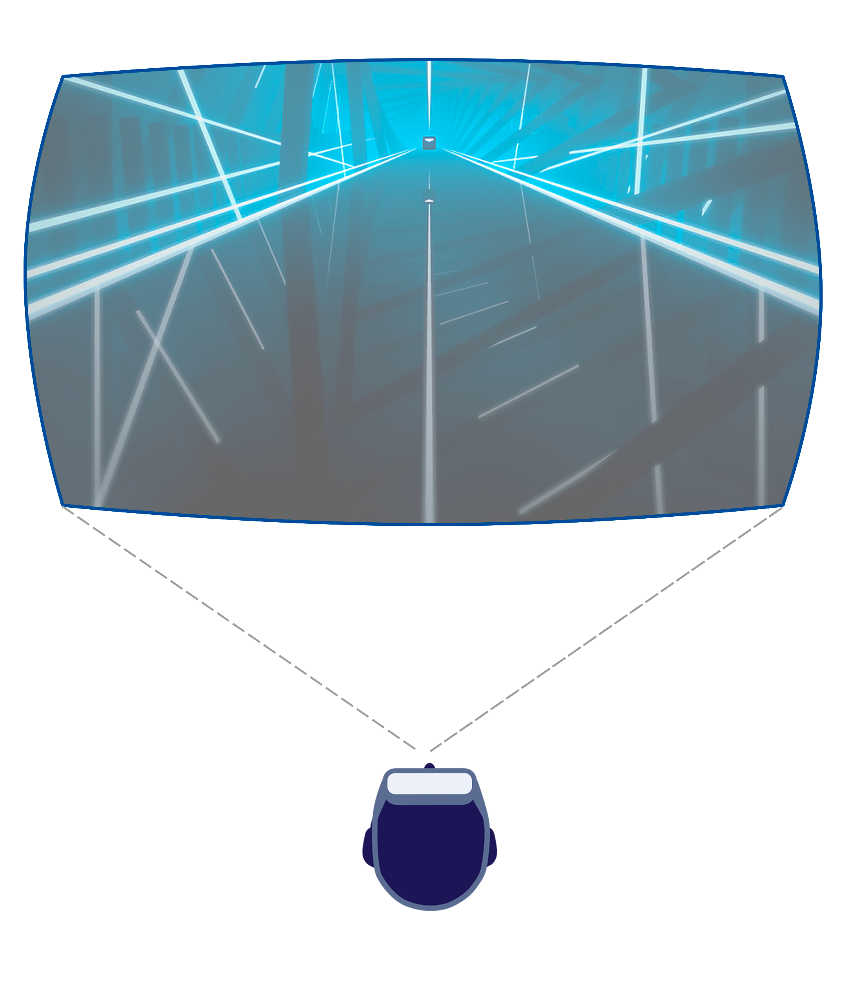
Motivation

Slide 16
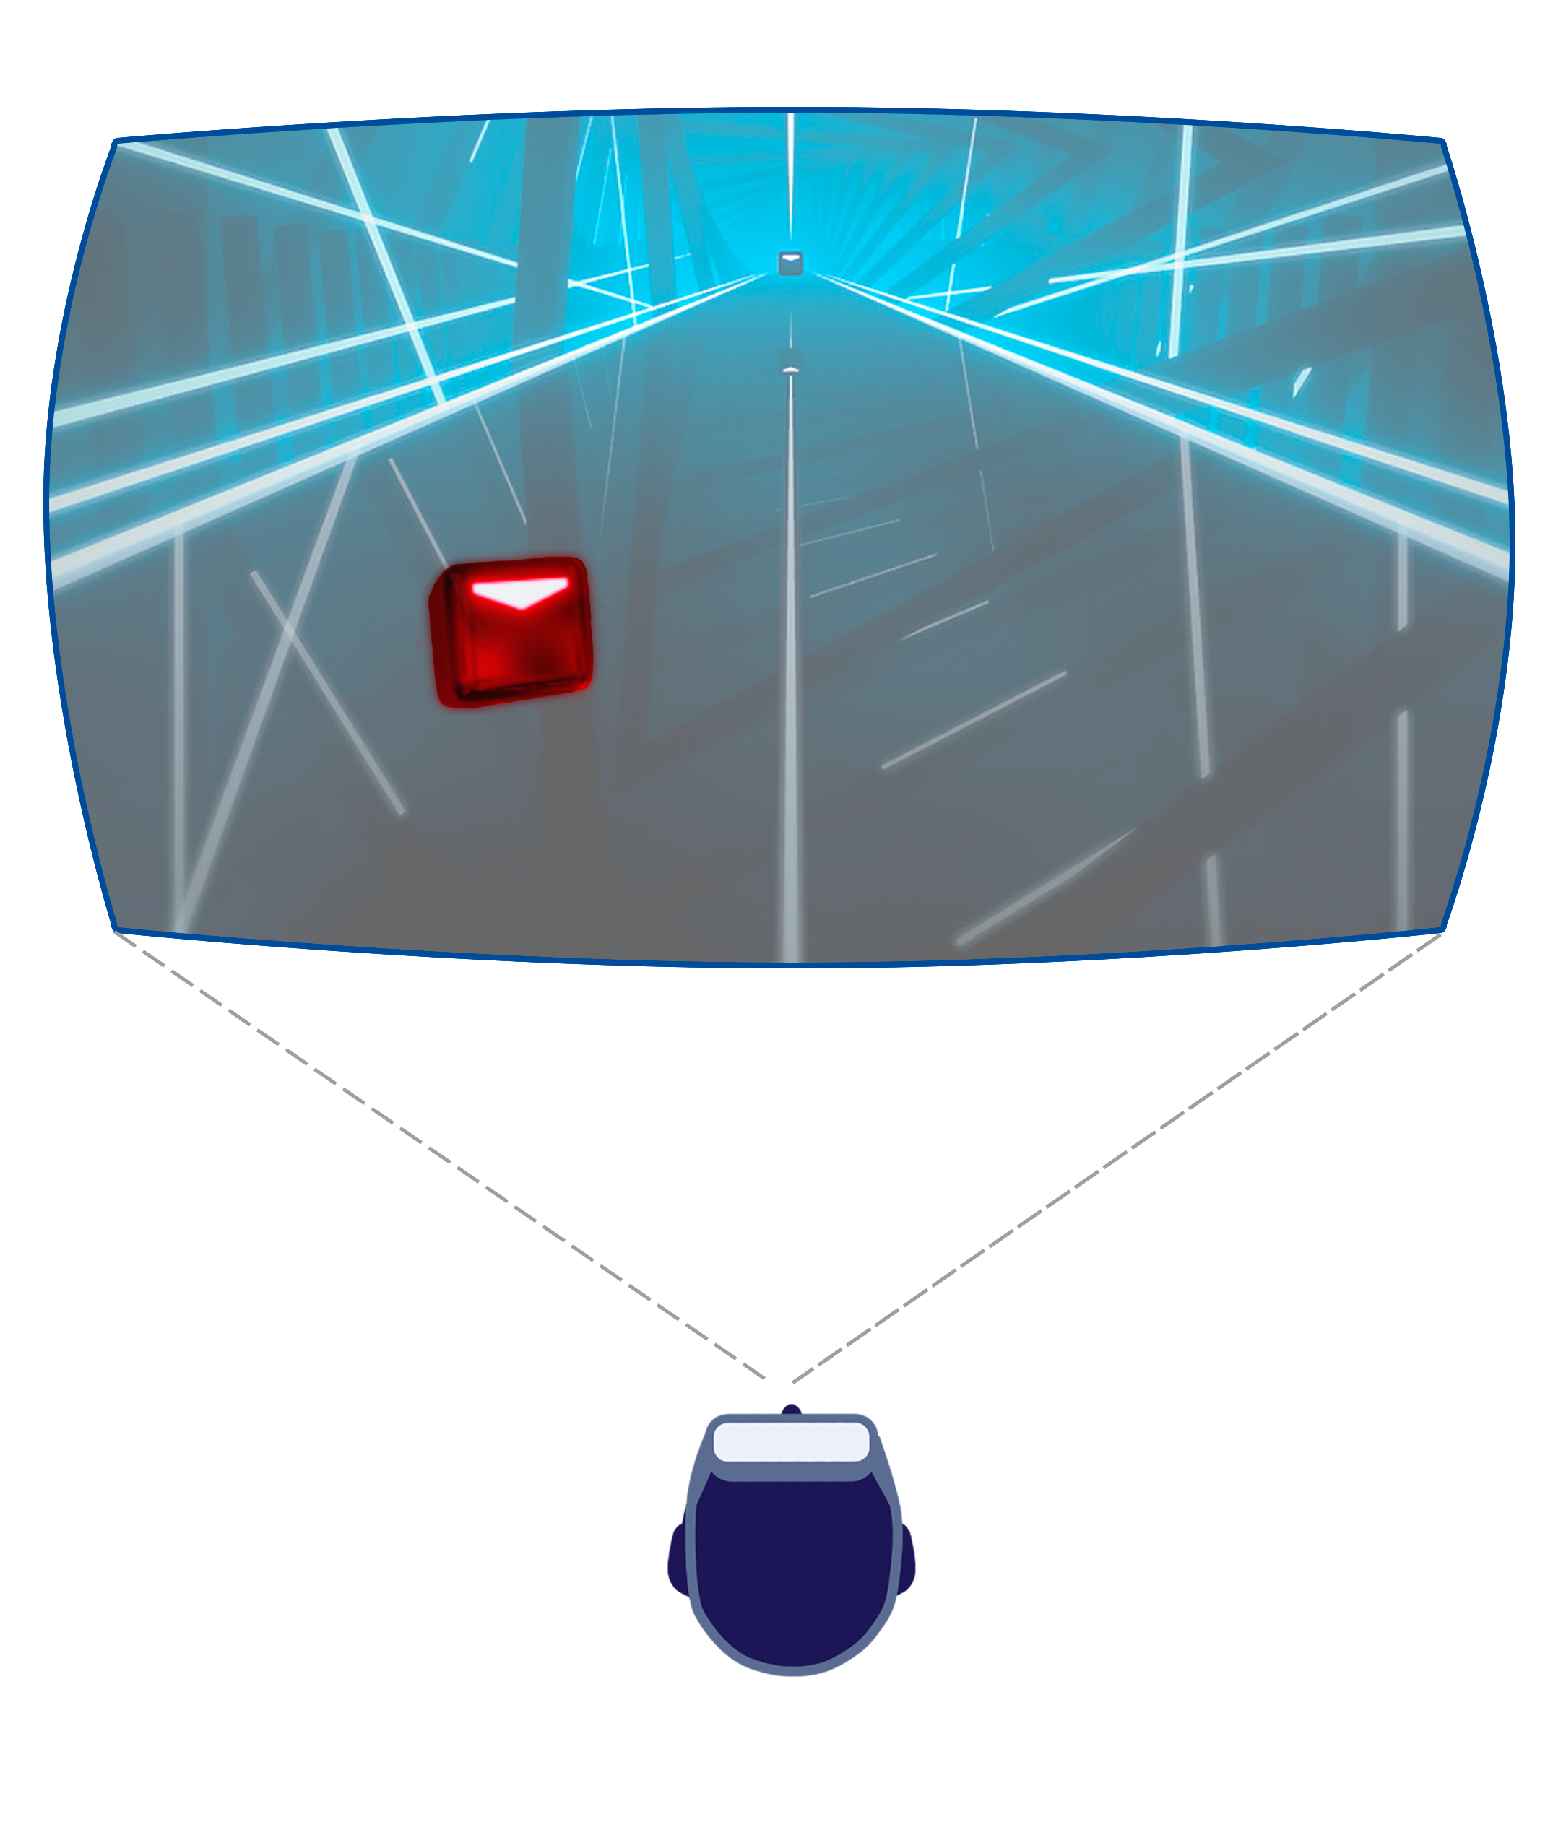
Motivation

Slide 17
Motivation

Slide 18
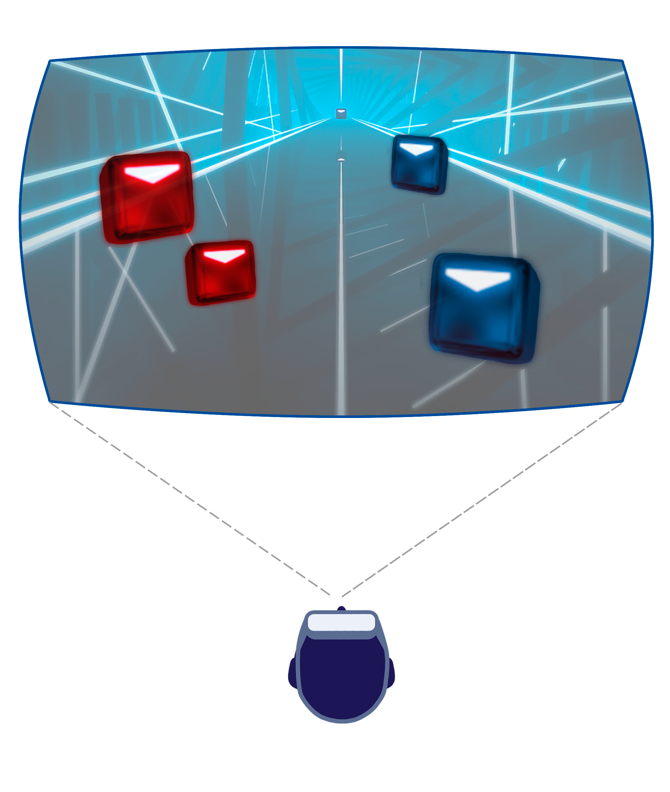
Motivation

Slide 19
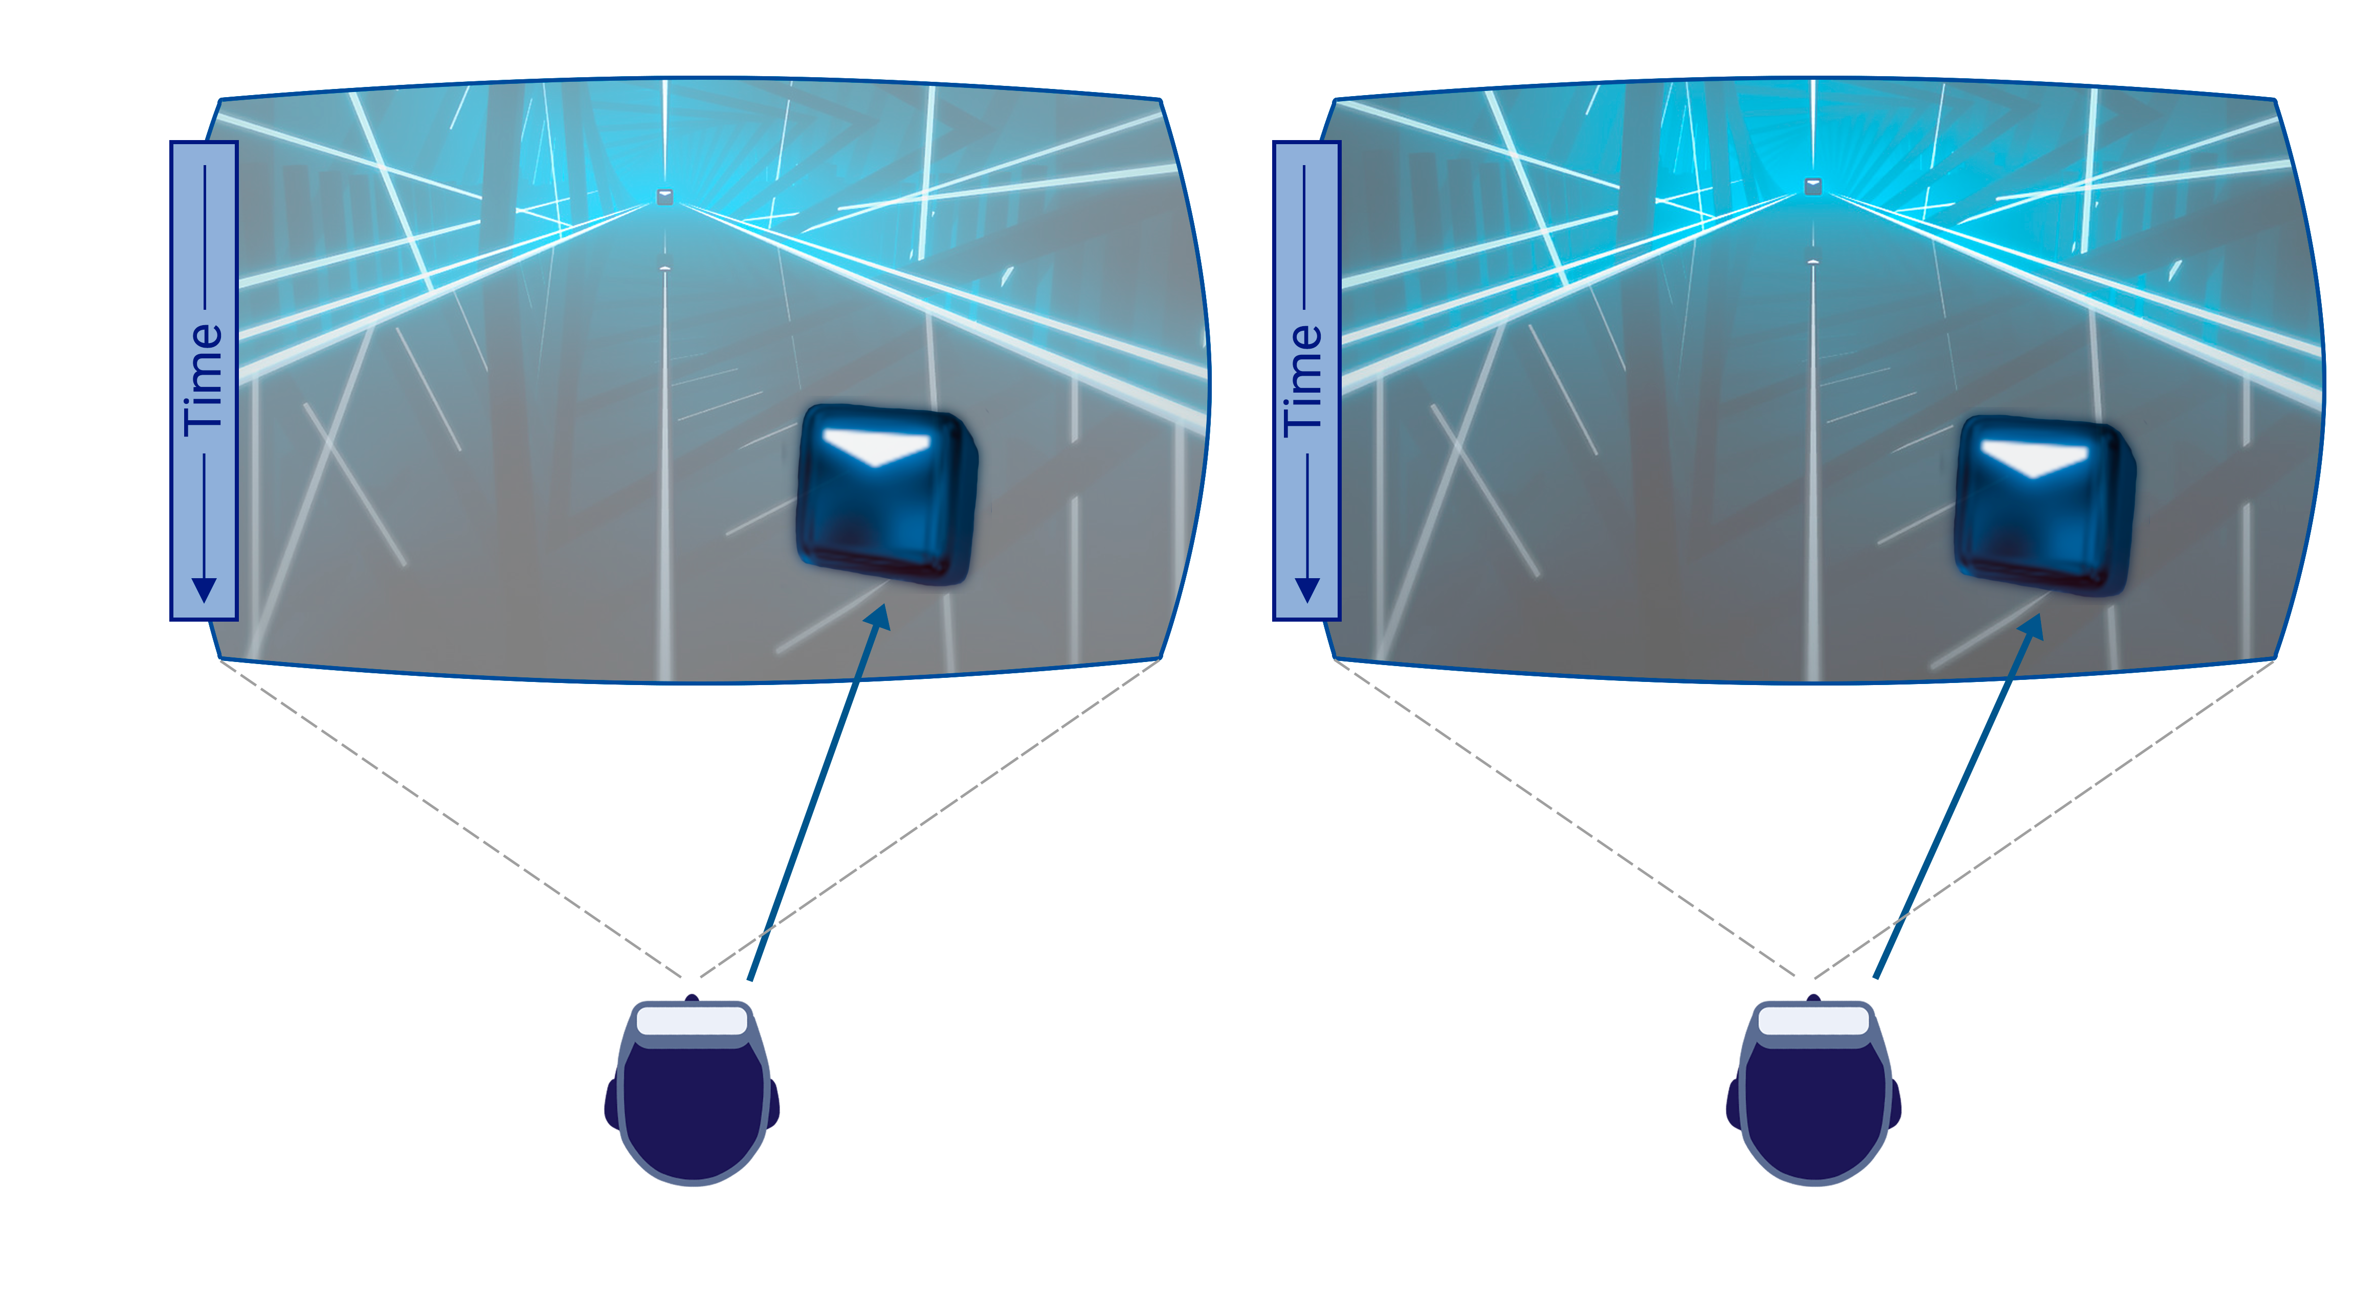
Goal
Model visual response latency reduction using the auditory modality

Slide 20
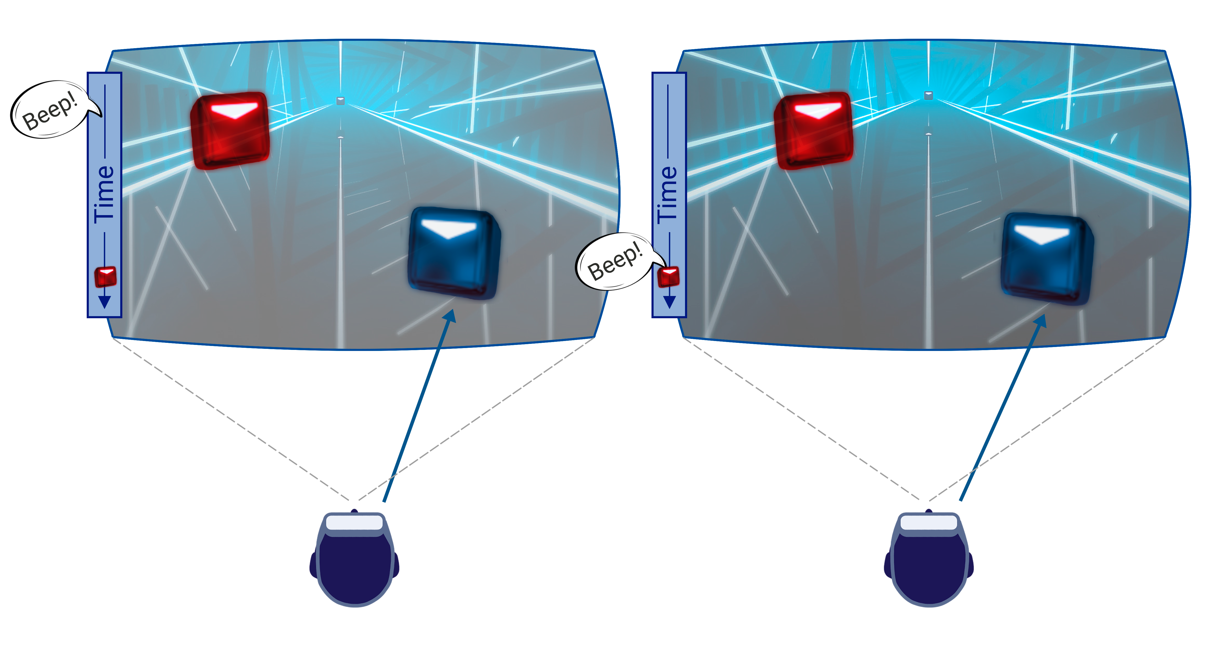
Goal
Model visual response latency reduction using the auditory modality

Slide 21
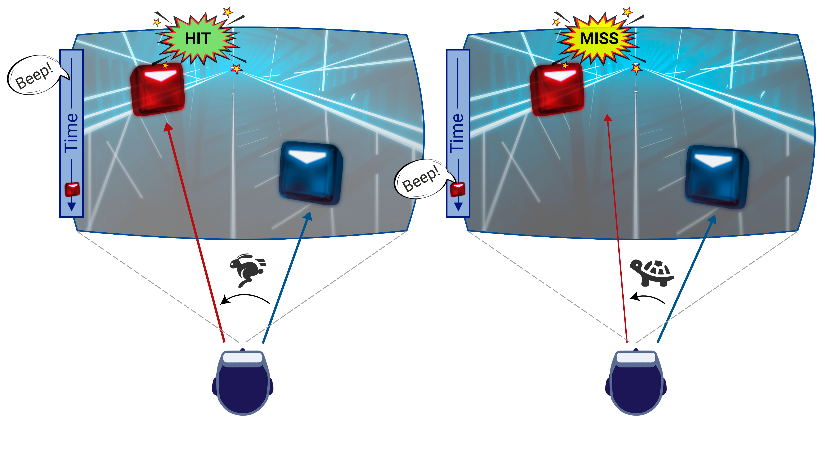
Goal
Model visual response latency reduction using the auditory modality

Slide 22

Visual saccades latency
Initial fixation

Slide 23
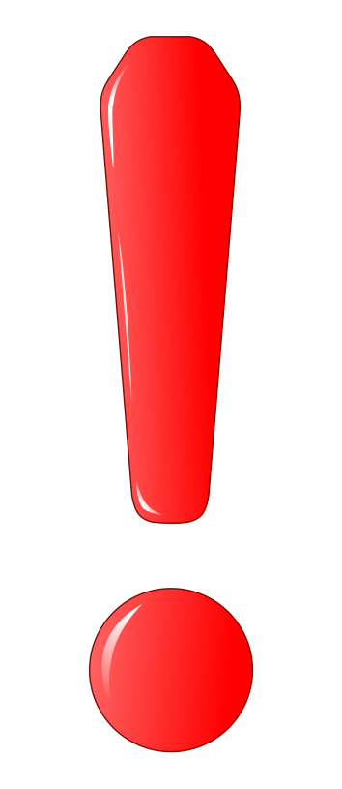
Visual saccades latency
Initial fixation

Slide 24
Visual saccades latency
Initial fixation
ω

Slide 25
Visual saccades latency
Initial fixation
Saccade performed
ω

Slide 26
Visual saccades latency
Initial fixation
Saccade performed
ω
Saccade latency

Slide 27
I. Accelerating Saccadic Response through Spatial and Temporal Cross-Modal Misalignments
User Study - Methodology

Slide 28
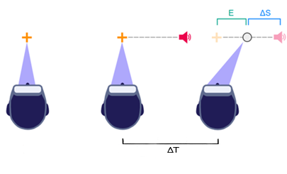
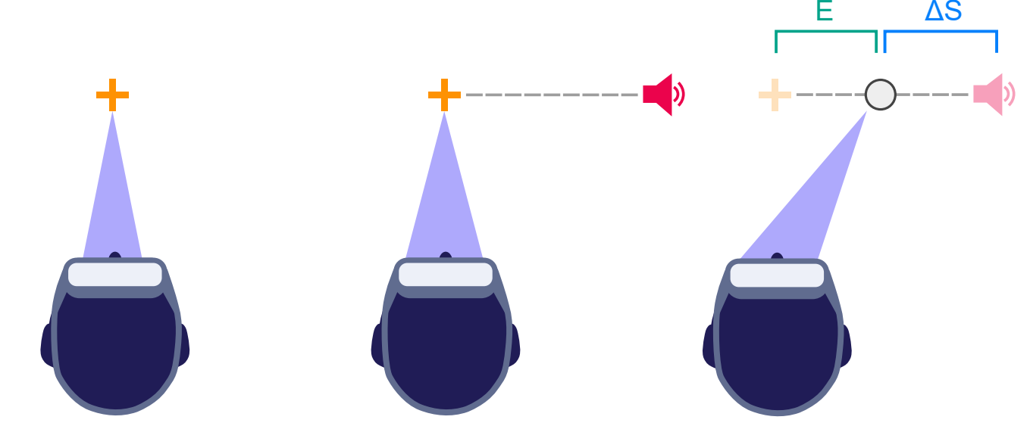

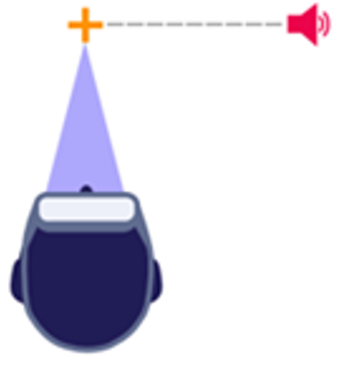



Spatiotemporal Setup
time

Slide 29
Spatiotemporal Setup
time

Slide 30
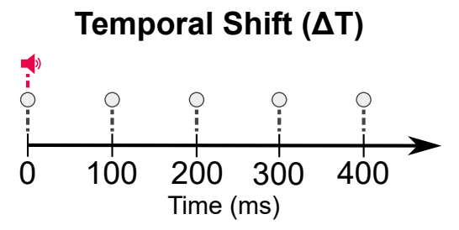
Study Variables
Temporal Shift (ΔT)
ΔT
time

Slide 31
Study Variables
Temporal Shift (ΔT)
ΔT
time
Temporal Simultaneity Threshold

Slide 32
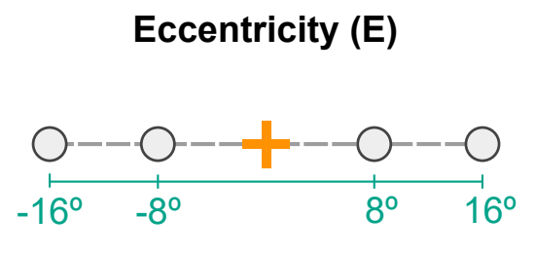
Study Variables
Eccentricity (E)
e
time

Slide 33
Study Variables
Eccentricity (E)
e
time
Saccades without head motion

Slide 34
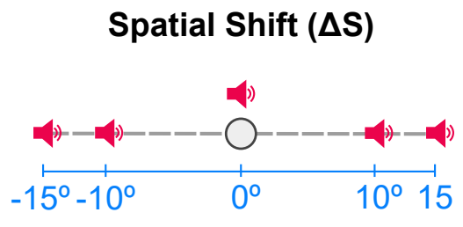

Study Variables
Spatial Shift (ΔS)
ΔS
time

Slide 35
Study Variables
Spatial Shift (ΔS)
ΔS
time
Spatial fusion window

Slide 36
I. Accelerating Saccadic Response through Spatial and Temporal Cross-Modal Misalignments
User Study - Results

Slide 37
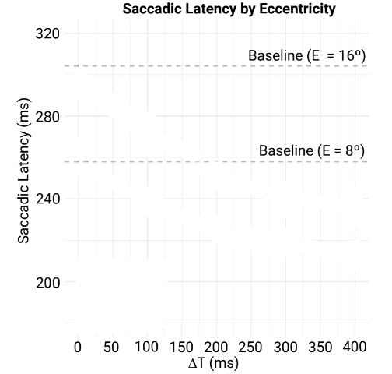
Results
Visual target only

Slide 38
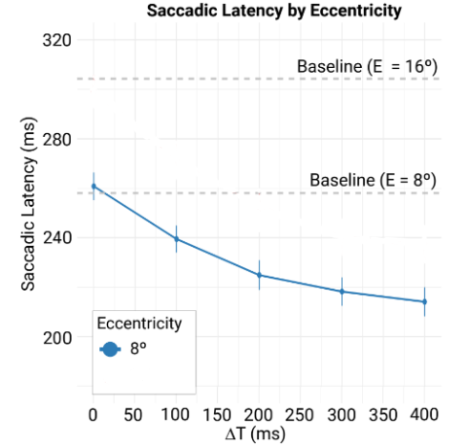
Results

Slide 39
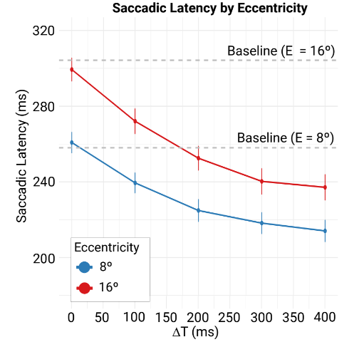
Results

Slide 40
Results
Temporal simultaneity threshold

Slide 41
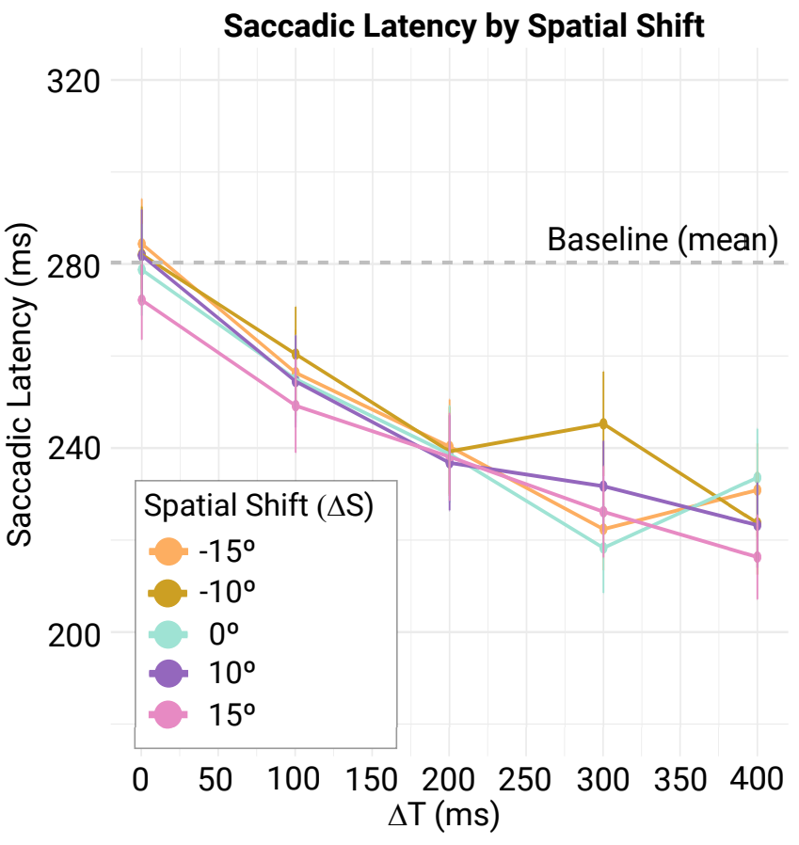

Results

Slide 42
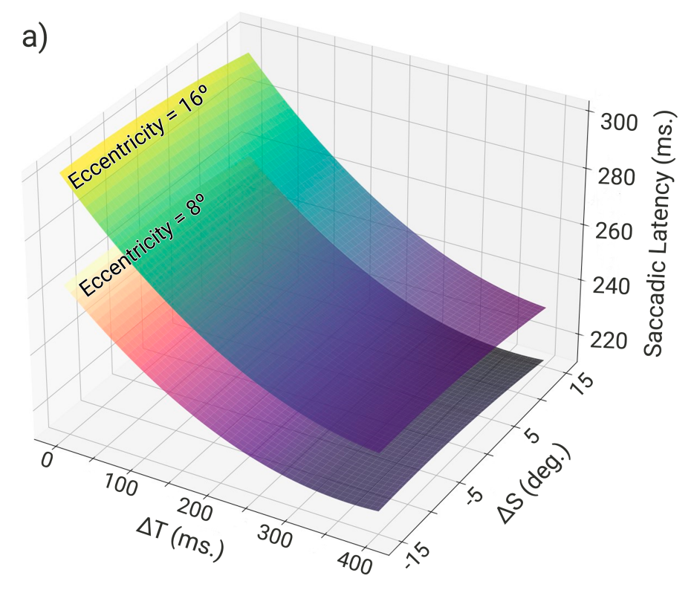

Saccade Latency Model
$$Saccadic Latency = f(E, ΔT, ΔS)$$

Slide 43
I. Accelerating Saccadic Response through Spatial and Temporal Cross-Modal Misalignments
Validation

Slide 44
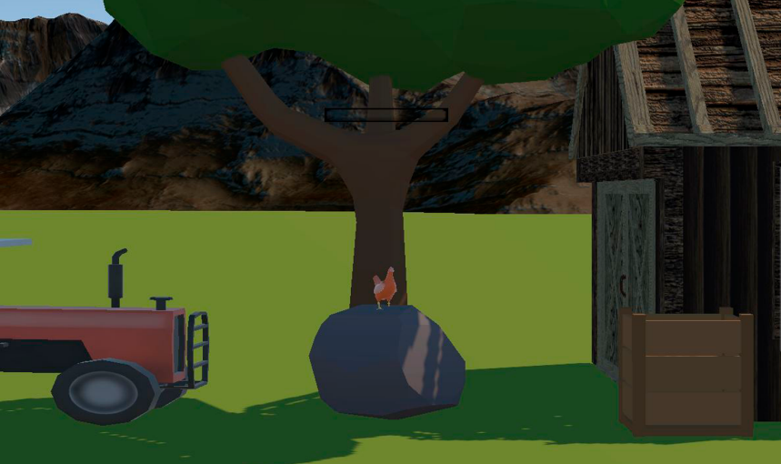

Interactive Application
Farm scenario
Meow!

Slide 45
Interactive Application
Farm scenario
New E values: 10°, 12°, 14°
Meow!

Slide 46
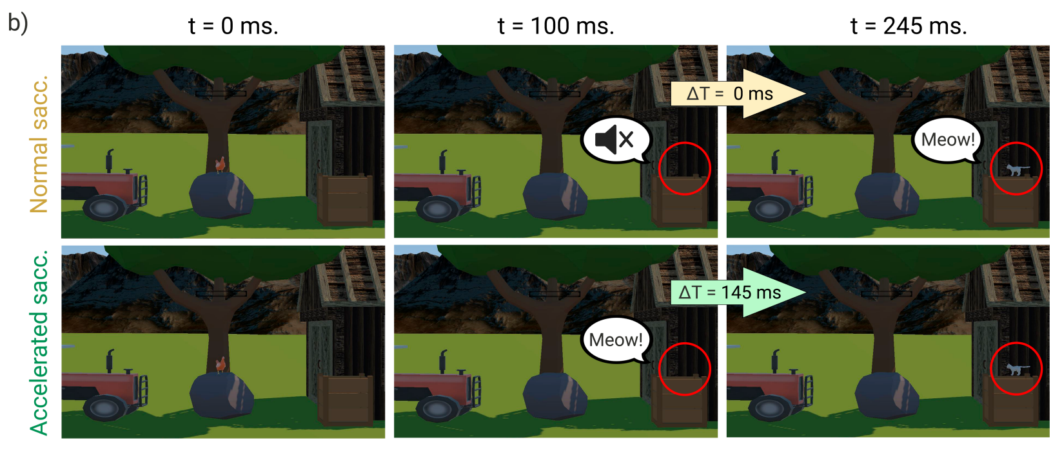

Interactive Application
Farm scenario
New E values: 10°, 12°, 14°
Acceleration goal: 20, 40, 60ms
  Temporal shift predicted
$$Saccadic Latency = f(E, ΔT, ΔS)$$

Slide 47
Interactive Application
Farm scenario
New E values: 10°, 12°, 14°
Acceleration goal: 20, 40, 60ms
  Temporal shift predicted
Average Latency Error
  8 ms

Slide 48
Conclusion
Accelerating saccadic latency through temporal modulation of the auditory cue
Spatiotemporally misaligned auditory cues can speed up visual saccade latency

Slide 49
Conclusion
Accelerating saccadic latency through temporal modulation of the auditory cue
Spatiotemporally misaligned auditory cues can speed up visual saccade latency
Latency reductions up to 50 ms
  [HPG 2026] Low-latency devices
    Atari 2600 (1977) – 10 ms
    VR Inputs (Friston et al. 2016) – 7 ms
    MR Passthrough (Penner et al. 2026) – 2 ms

Slide 50
Overview
Audiovisual Perception:
Accelerating saccadic latency through temporal modulation of the auditory cue
Enhancing depth perception through spatial modulation of the auditory cue
Visual Perception:
Improving foveation through a dynamic eye dominance characterization

Slide 51
II. Overdriving Visual Depth Perception via Sound Modulation in VR
Published at TVCG 2026
Presented at IEEE VR 2026

Slide 52
Motivation
Saccade Motion
Vergence Motion
Combined Motion
E
V
V
E
T_{s}
T_{v}
∼ 200 - 800ms
[T_{s}, T_{v}]
∼ 20 - 200ms

Slide 53
Motivation
Saccade Motion
Vergence Motion
Combined Motion
E
V
V
E
T_{s}
T_{v}
∼ 200 - 800ms
[T_{s}, T_{v}]
∼ 20 - 200ms

Slide 54
Motivation
Saccade Motion
Vergence Motion
Combined Motion
E
V
V
E
T_{s}
T_{v}
∼ 200 - 800ms
[T_{s}, T_{v}]
∼ 20 - 200ms

Slide 55
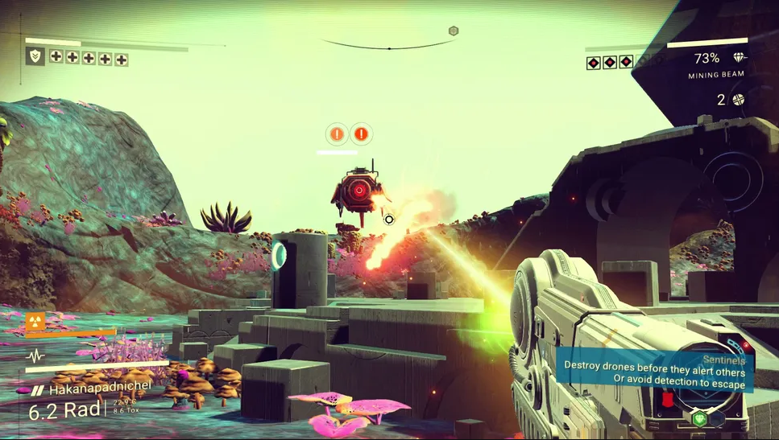
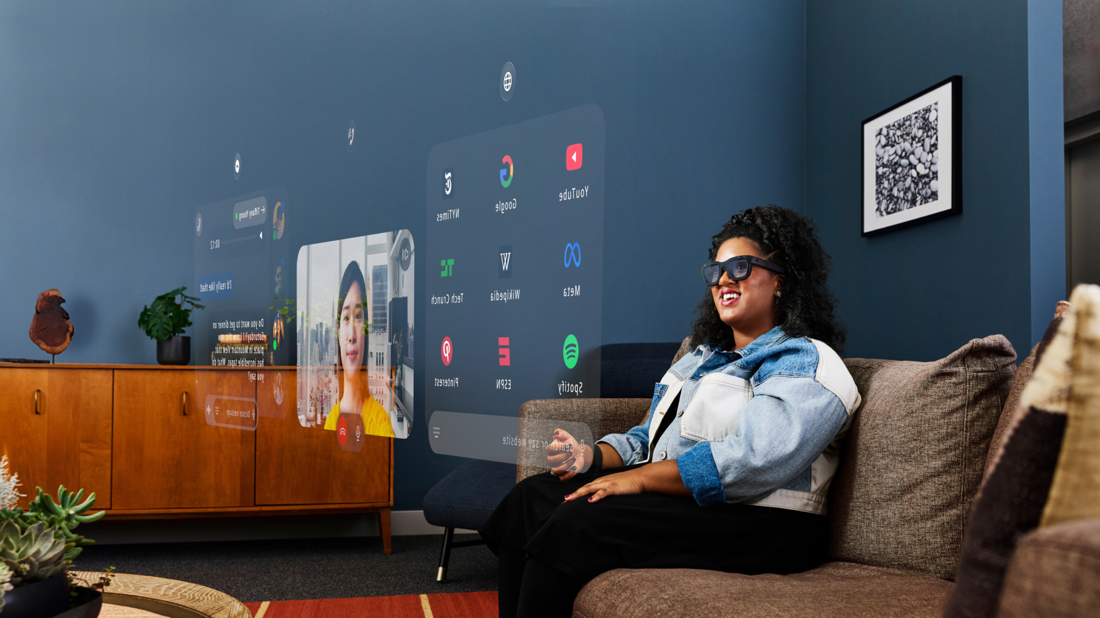


Motivation
No Man’s Sky (2016)
Meta Orion (2024)
Visual sequences now involve depth changes

Slide 56

Motivation
No Man’s Sky (2016)
Meta Orion (2024)
Faster visual motions by modulating auditory cues

Slide 57
II. Overdriving Visual Depth Perception via Sound Modulation in VR
User Study - Methodology

Slide 58

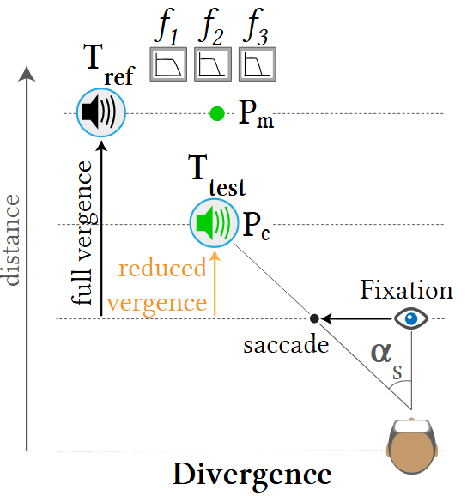

Method: Visual Convergence
Fixation
θ

Slide 59

Method: Visual Convergence
Fixation
Original
θ
α_{s}

Slide 60
Method: Visual Convergence
Fixation
Δθ
Original
Large depth change → Slow response
θ
α_{s}

Slide 61
Method: Visual Convergence
Fixation
Δθ
Proposed
Reduced depth change
→ Faster response
θ
Original
α_{s}

Slide 62
Method: Visual Convergence
Fixation
Δθ
Proposed
θ
Original
Recover Original’s
depth perception
α_{s}

Slide 63
Method: Visual Convergence
Fixation
Goal: Perceive Proposed closer, as Original
Modulate
Audio Source Spatial Location
Maximizing
Loudness Variation between Proposed and Original
Interaural Differences (IAD)
Proposed
Original

Slide 64
Method: Visual Divergence
Original
Goal: Perceive Proposed farther, as Original
Δθ
Δθ
Proposed
Fixation
θ

Slide 65
Method: Visual Divergence
Original
Goal: Perceive Proposed farther, as Original
Modulate
Audio Source Frequency Spectrum
Maximizing
Loudness Variation between Proposed and Original
Proposed
Fixation

Slide 66
User Study: Conditions
Eccentricity (α_{s}): 8° and 16°
Original
Proposed
Fixation
α_{s}

Slide 67
User Study: Conditions
Eccentricity (α_{s}): {8°, 16°}
Vergence Motions: Convergence and Divergence
Fixation
Original
Δθ
θ
Δθ
Δθ
Proposed
Δθ
Proposed
Fixation
Original
θ

Slide 68
User Study: Conditions
Eccentricity (α_{s}): {8°, 16°}
Vergence Motions: {Convergence, Divergence}
Sound Modulation
  Co-located (P_{C})
Fixation
Original
P_{C}
Proposed
P_{C}
Proposed
Original
Fixation

Slide 69
User Study: Conditions
Eccentricity (α_{s}): {8°, 16°}
Vergence Motions: {Convergence, Divergence}
Sound Modulation
  Co-located (P_{C})
  Original’s depth (P_{m})
Fixation
Original
P_{C}
P_{m}
Proposed
P_{C}
Proposed
Original
Fixation
P_{m}

Slide 70
User Study: Conditions
Eccentricity (α_{s}): {8°, 16°}
Vergence Motions: {Convergence, Divergence}
Sound Modulation
  Co-located (P_{C})
  Original’s depth (P_{m})
  Overdriving 1 (p₁ /f₁)
f₁
Fixation
Original
P_{C}
P_{m}
P_{C}
P_{C}
Proposed
P_{C}
Proposed
Original
Fixation
P_{m}
p₁

Slide 71
User Study: Conditions
Eccentricity (α_{s}): {8°, 16°}
Vergence Motions: {Convergence, Divergence}
Sound Modulation
  Co-located (P_{C})
  Original’s depth (P_{m})
  Overdriving 1 (p₁ /f₁)
  Overdriving 2 (p₂ /f₂)
f₁
f₂
Fixation
Original
P_{m}
P_{C}
P_{m}
P_{C}
P_{C}
Proposed
P_{C}
Proposed
Original
Fixation
P_{m}
P_{m}
p₁
p₂

Slide 72
User Study: Conditions
Eccentricity (α_{s}): {8°, 16°}
Vergence Motions: {Convergence, Divergence}
Sound Modulation
  Co-located (P_{C})
  Original’s depth (P_{m})
  Overdriving 1 (p₁ /f₁)
  Overdriving 2 (p₂ /f₂)
  Overdriving 3 (p₃ /f₃)
f₁
f₃
f₁
f₂
Fixation
Original
P_{m}
P_{C}
P_{m}
P_{C}
P_{C}
Proposed
P_{C}
Proposed
Original
Fixation
P_{m}
P_{m}
p₁
p₁
p₂
p₃

Slide 73
User Study: Conditions
Eccentricity (α_{s}): {8°, 16°}
Vergence Motions: {Convergence, Divergence}
Sound Modulation
  Co-located (P_{C})
  Original’s depth (P_{m})
  Overdriving 1 (p₁ /f₁)
  Overdriving 2 (p₂ /f₂)
  Overdriving 3 (p₃ /f₃)
  No Sound (baseline)
f₁
f₃
f₁
f₂
Fixation
Original
P_{m}
P_{C}
P_{m}
P_{C}
P_{C}
Proposed
P_{C}
Proposed
Original
Fixation
P_{m}
P_{m}
p₁
p₁
p₂
p₃

Slide 74
User Study: Conditions
Eccentricity (α_{s}): {8°, 16°}
Vergence Motions: {Convergence, Divergence}
Sound Modulation: {Baseline, P_{C}, P_{m}, p₁ /f₁, p₂ /f₂, p₃ /f₃)
f₁
f₂
f₃
Fixation
Original
P_{C}
P_{m}
Proposed
P_{C}
Task: Which target looks closer?
Proposed
Original
Fixation
P_{m}
p₁
p₂
p₃

Slide 75
II. Overdriving Visual Depth Perception via Sound Modulation in VR
User Study - Results

Slide 76
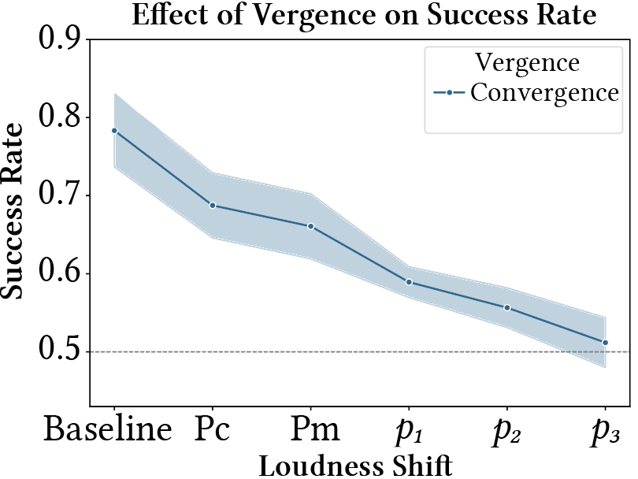
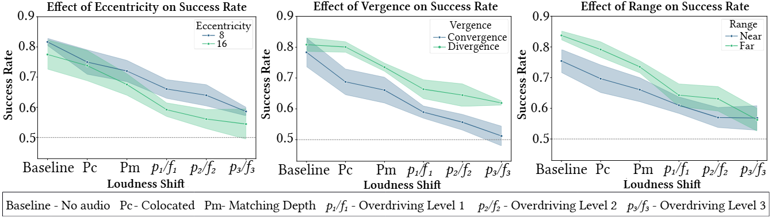
Results
Which target looks closer?
Success Rate: Target visually closer selected
P_{C}
Proposed
Original
P_{m}
p₁
Chance Level
p₂
p₃

Slide 77
Results
Which target looks closer?
Success Rate: Target visually closer selected
P_{C}
Proposed
Original
P_{m}
Stronger overdriving effect
p₁
Chance Level
p₂
p₃
Stronger sound modulation

Slide 78
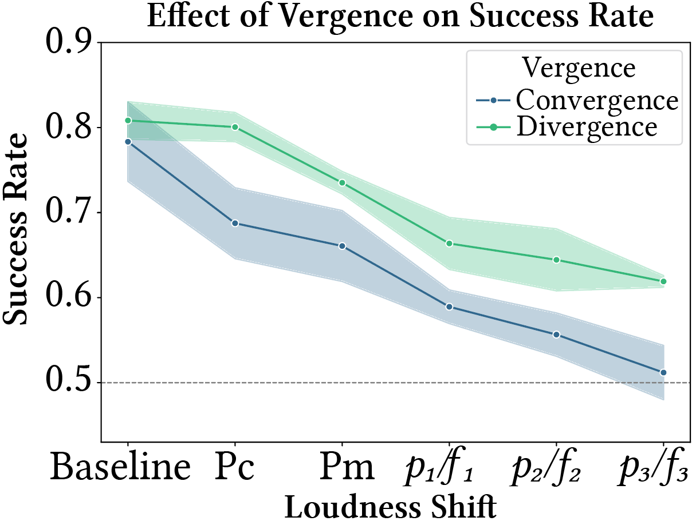
Results
Which target looks closer?
Success Rate: Target visually closer selected
f₁
f₂
f₃
Original
P_{C}
P_{m}
Proposed
P_{C}
Proposed
Original
P_{m}
p₁
Chance Level
p₂
p₃

Slide 79
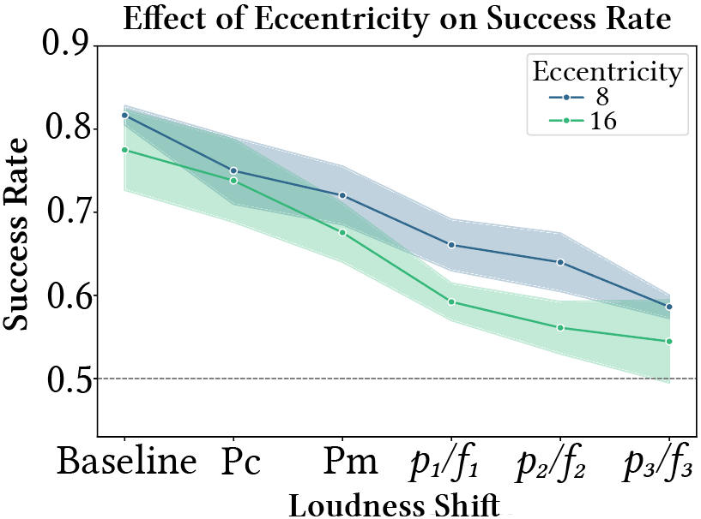
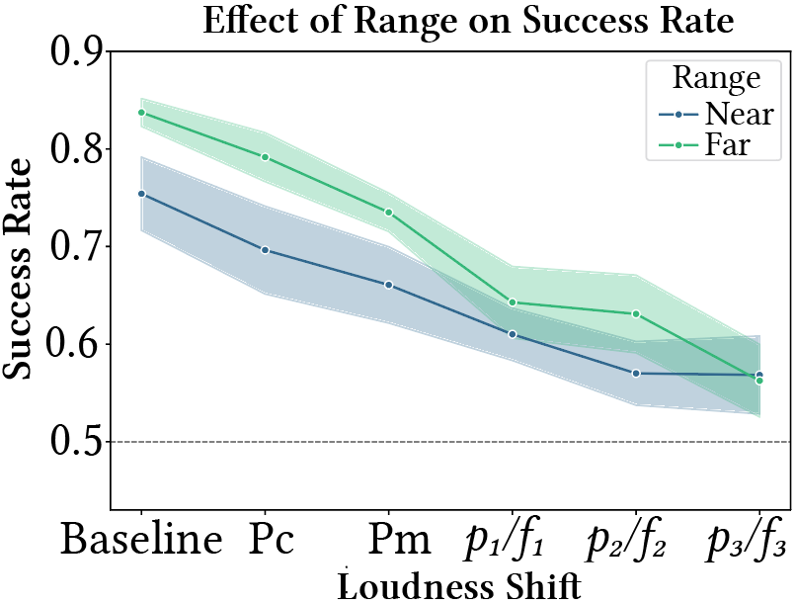
Results
Baseline: 80%
Overdriving Level 3: Close to chance level
Chance Level
Chance Level
Chance Level
Chance Level
Chance Level

Slide 80
Results
Baseline: 80%
Overdriving Level 3: Close to chance level
Faster Visual Response
Chance Level
Chance Level
Chance Level
Chance Level
Chance Level

Slide 81
II. Overdriving Visual Depth Perception via Sound Modulation in VR
Validation

Slide 82
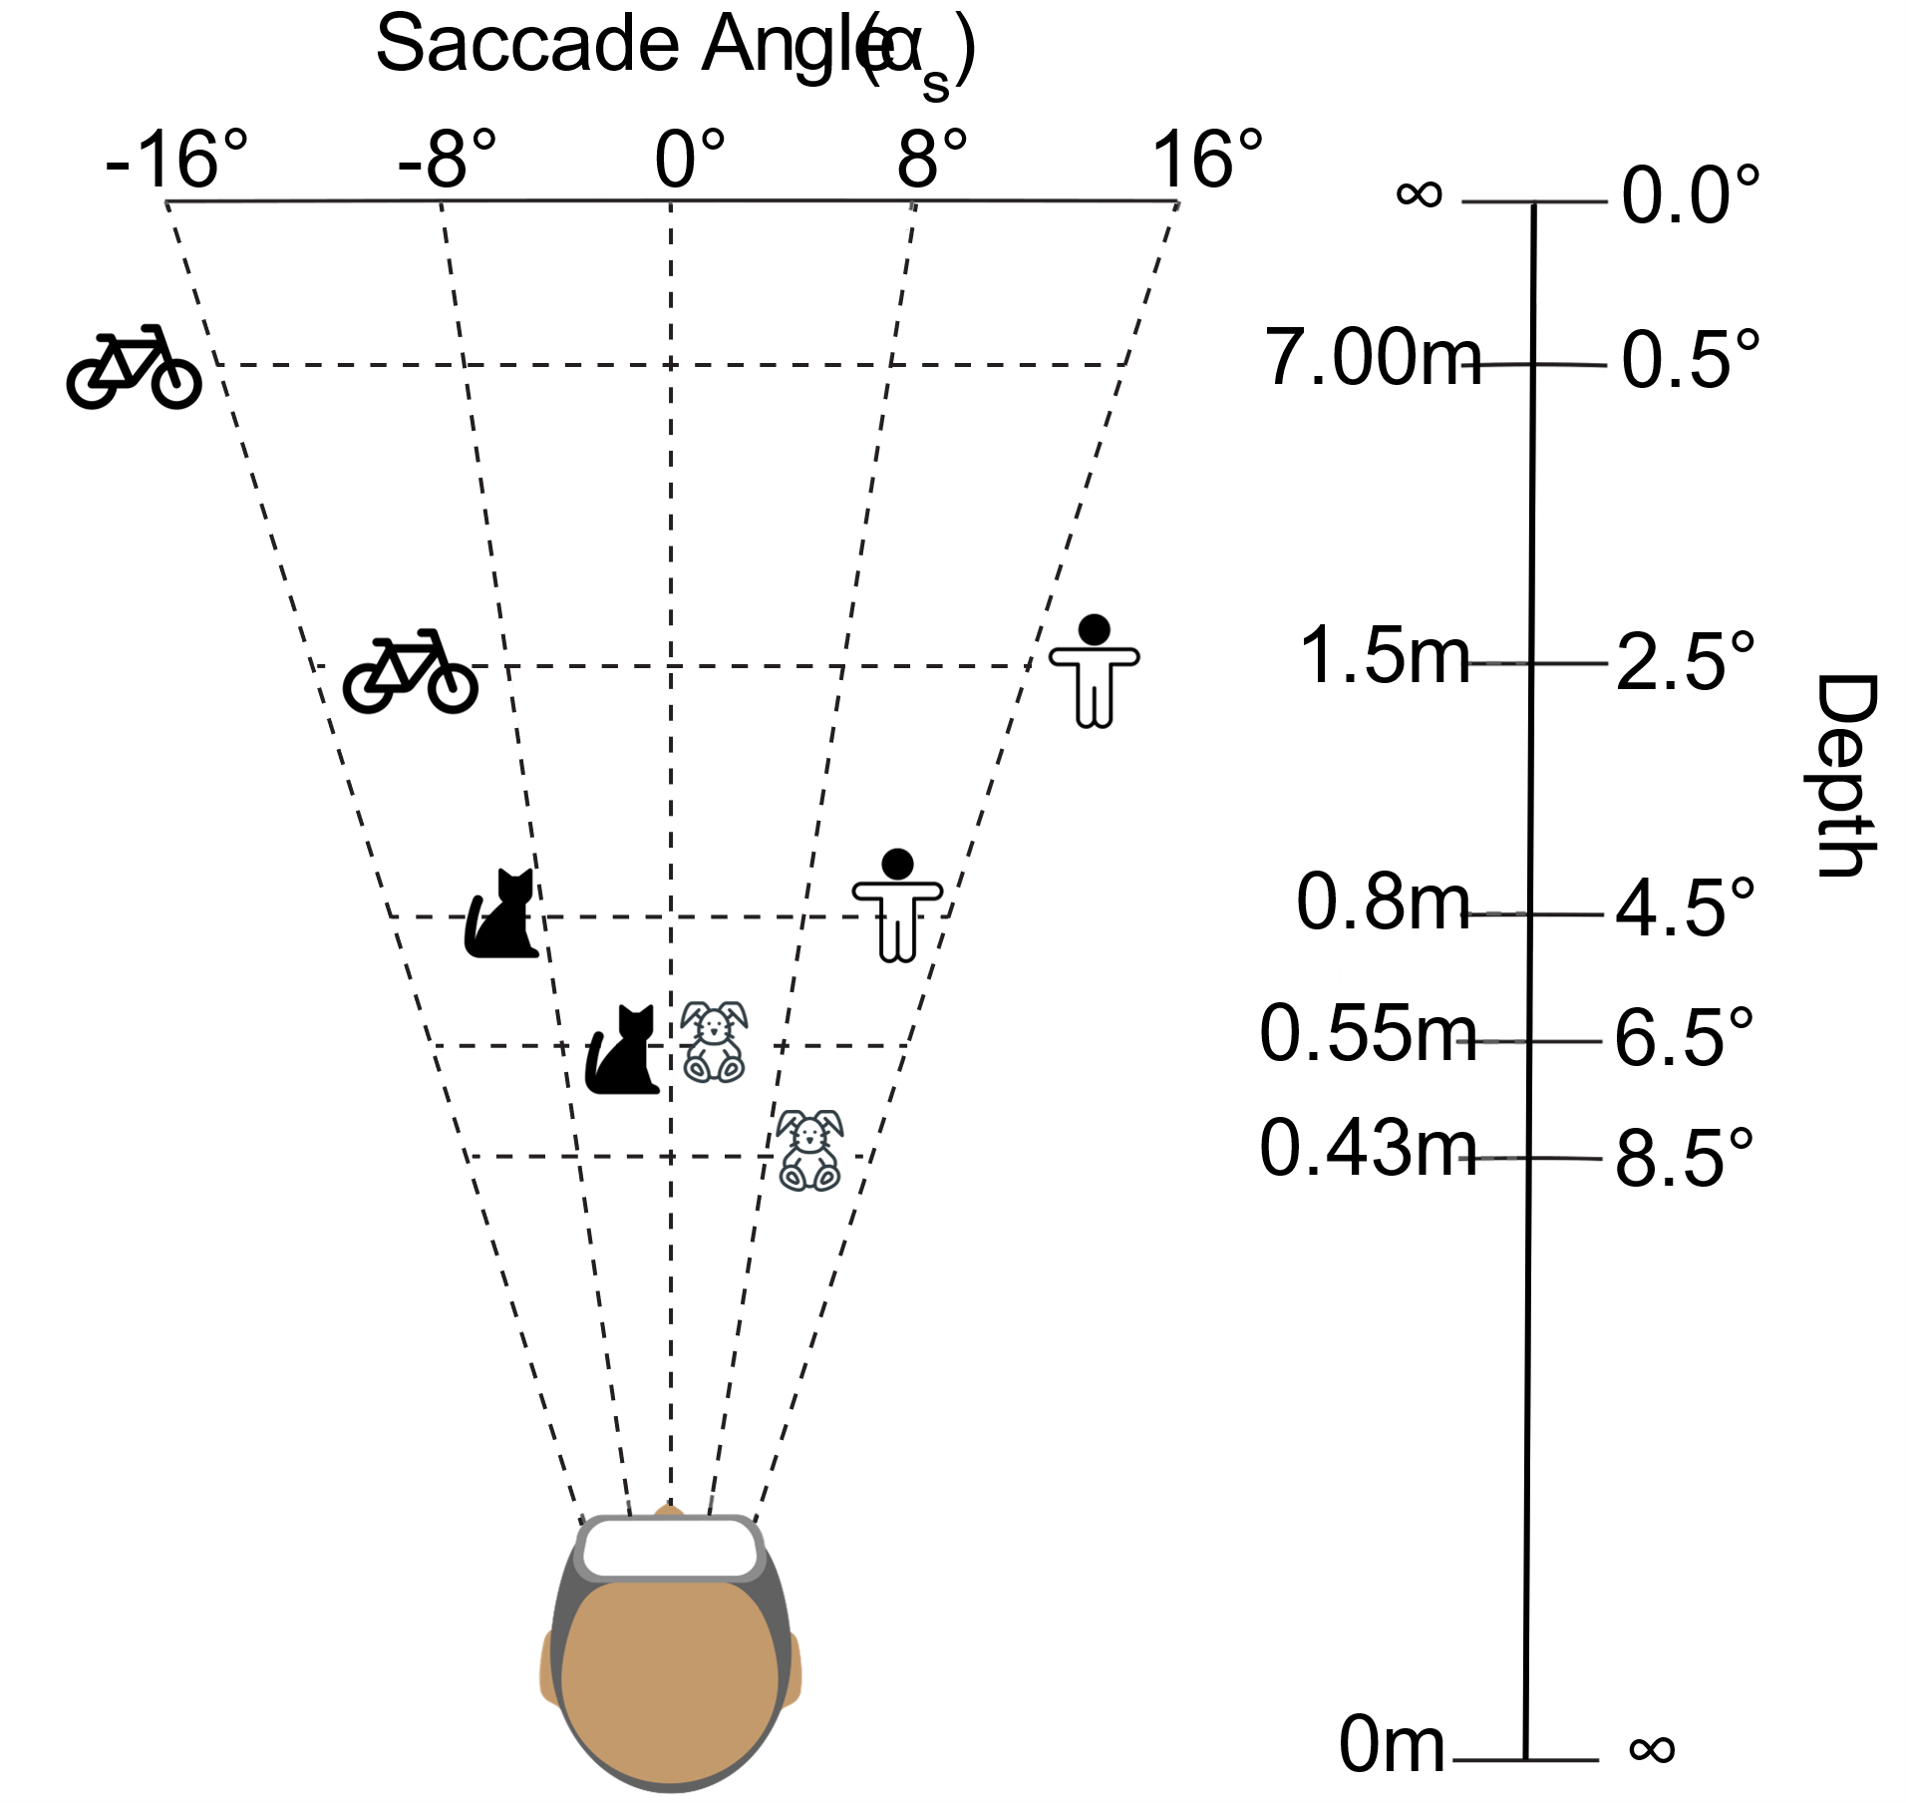
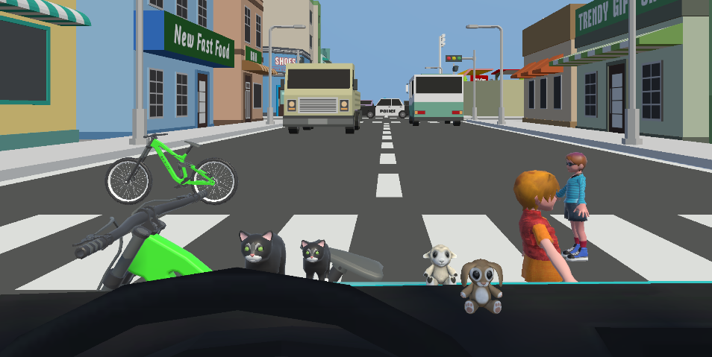
VR Application
Participant’s Point of View
Scene Setup

Slide 83


VR Application
Participant’s Point of View
Scene Setup
Audiovisual Target:
Visual Annotation: BIKE

Slide 84
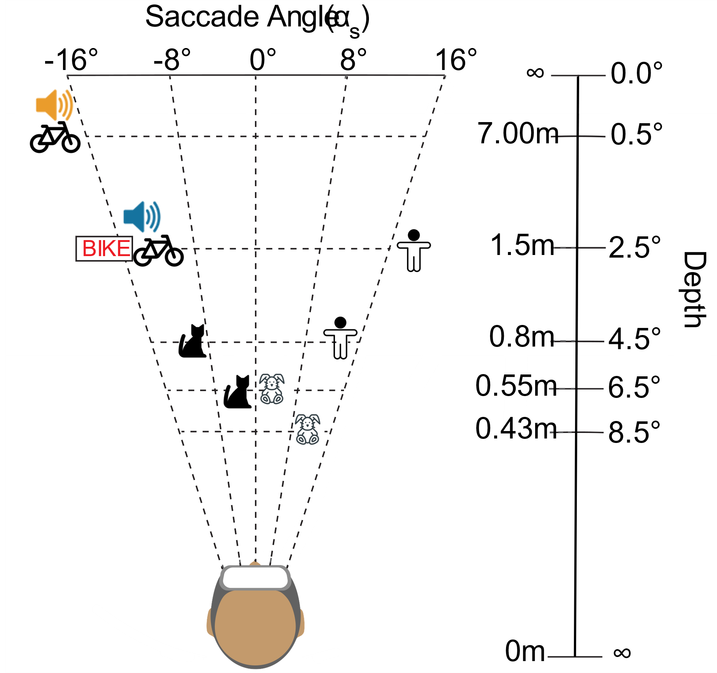
VR Application
Participant’s Point of View
Scene Setup
Audiovisual Target:
Visual Annotation: BIKE
Audio: Colocated or Overdriven

Slide 85
VR Application
Participant’s Point of View
Scene Setup
Task: Which item is the annotation related to?
Audiovisual Target:
Visual Annotation: BIKE
Audio: Colocated or Overdriven

Slide 86
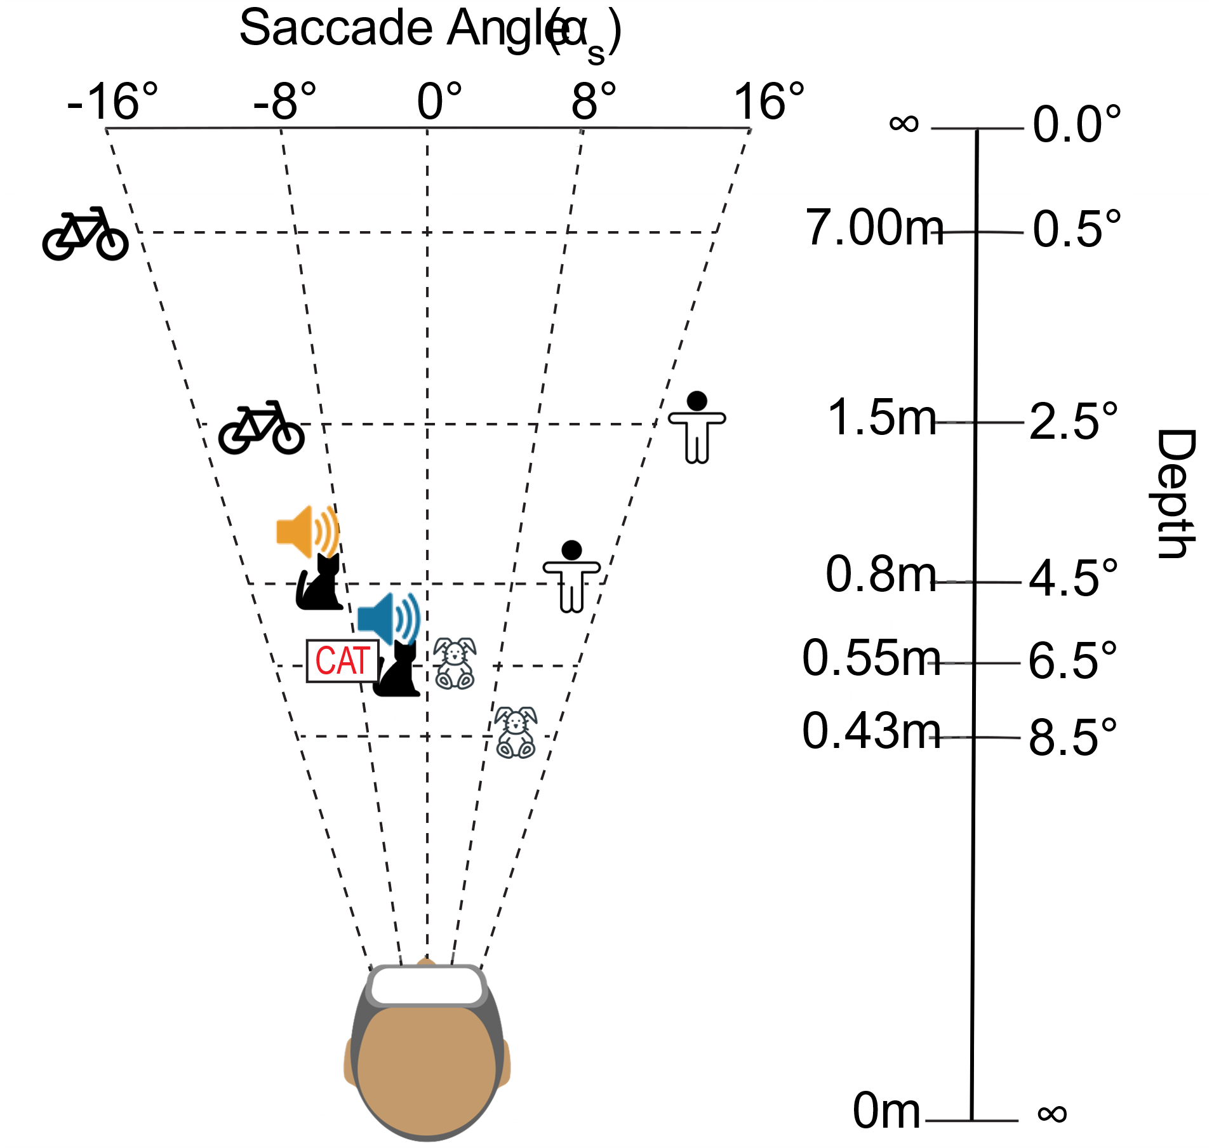

VR Application
Participant’s Point of View
Scene Setup
Task: Which item is the annotation related to?
Audiovisual Target:
Visual Annotation: CAT
Audio: Colocated or Overdriven

Slide 87
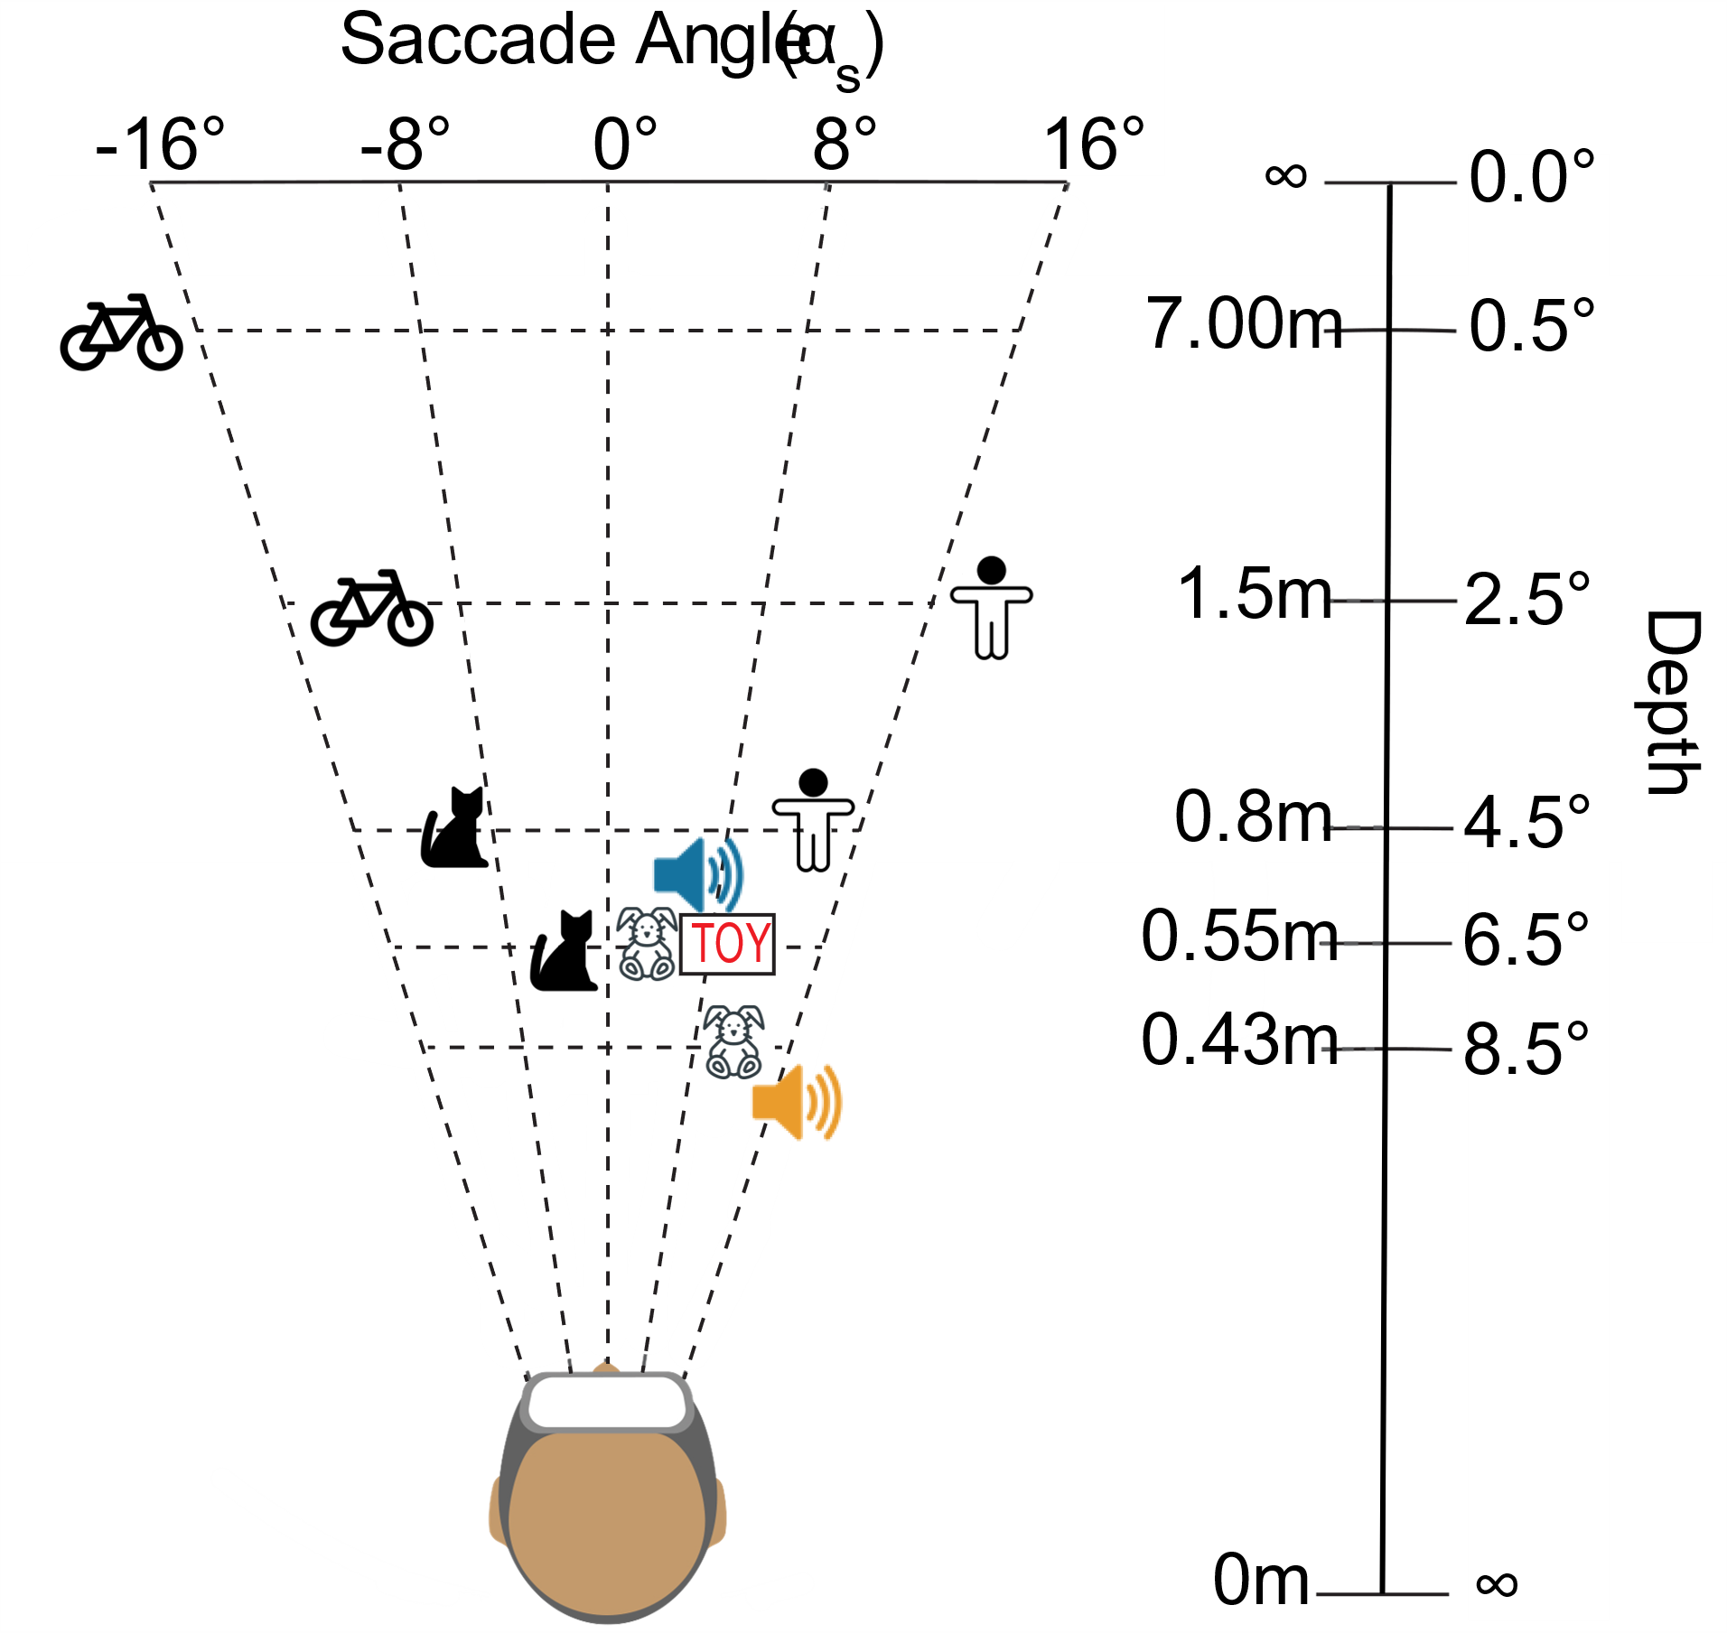
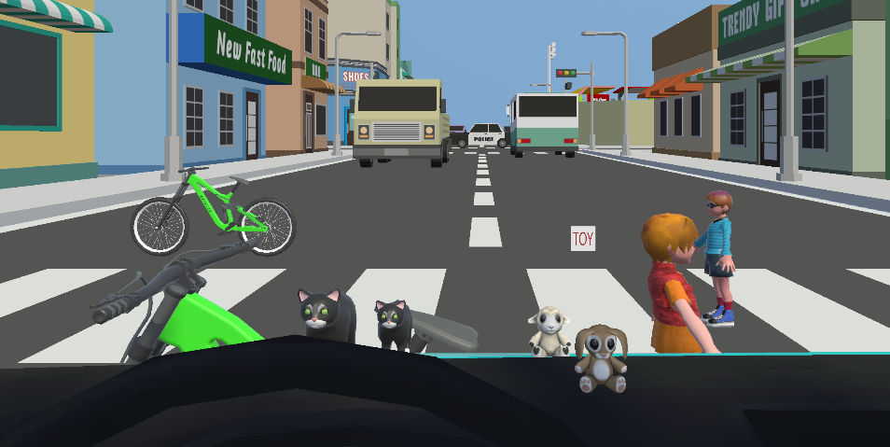
VR Application
Participant’s Point of View
Scene Setup
Task: Which item is the annotation related to?
Audiovisual Target:
Visual Annotation: TOY
Audio: Colocated or Overdriven

Slide 88
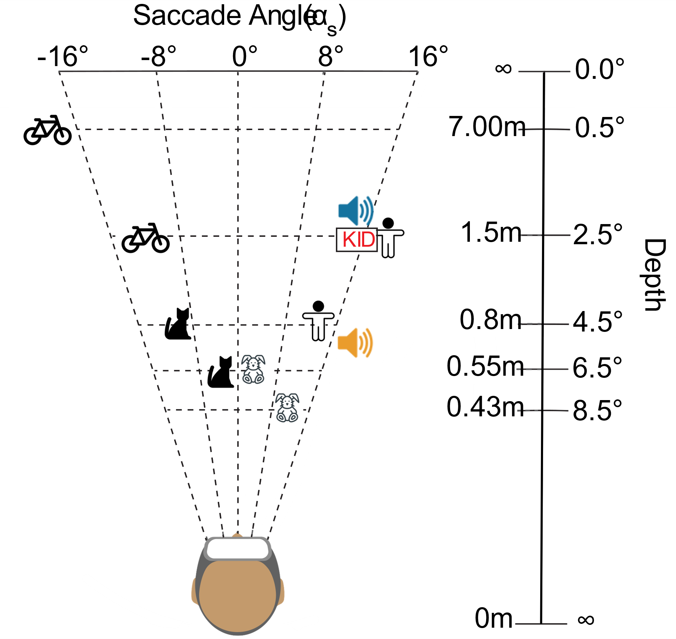
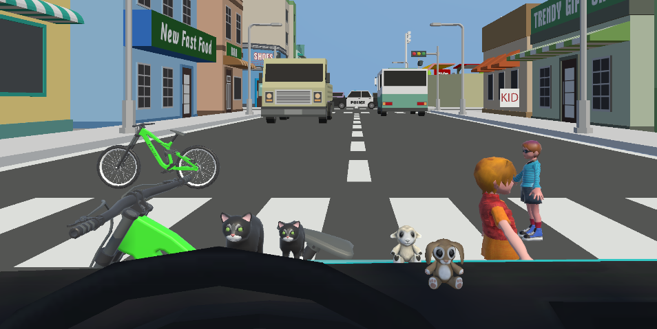
VR Application
Participant’s Point of View
Scene Setup
Task: Which item is the annotation related to?
Audiovisual Target:
Visual Annotation: KID
Audio: Colocated or Overdriven

Slide 89
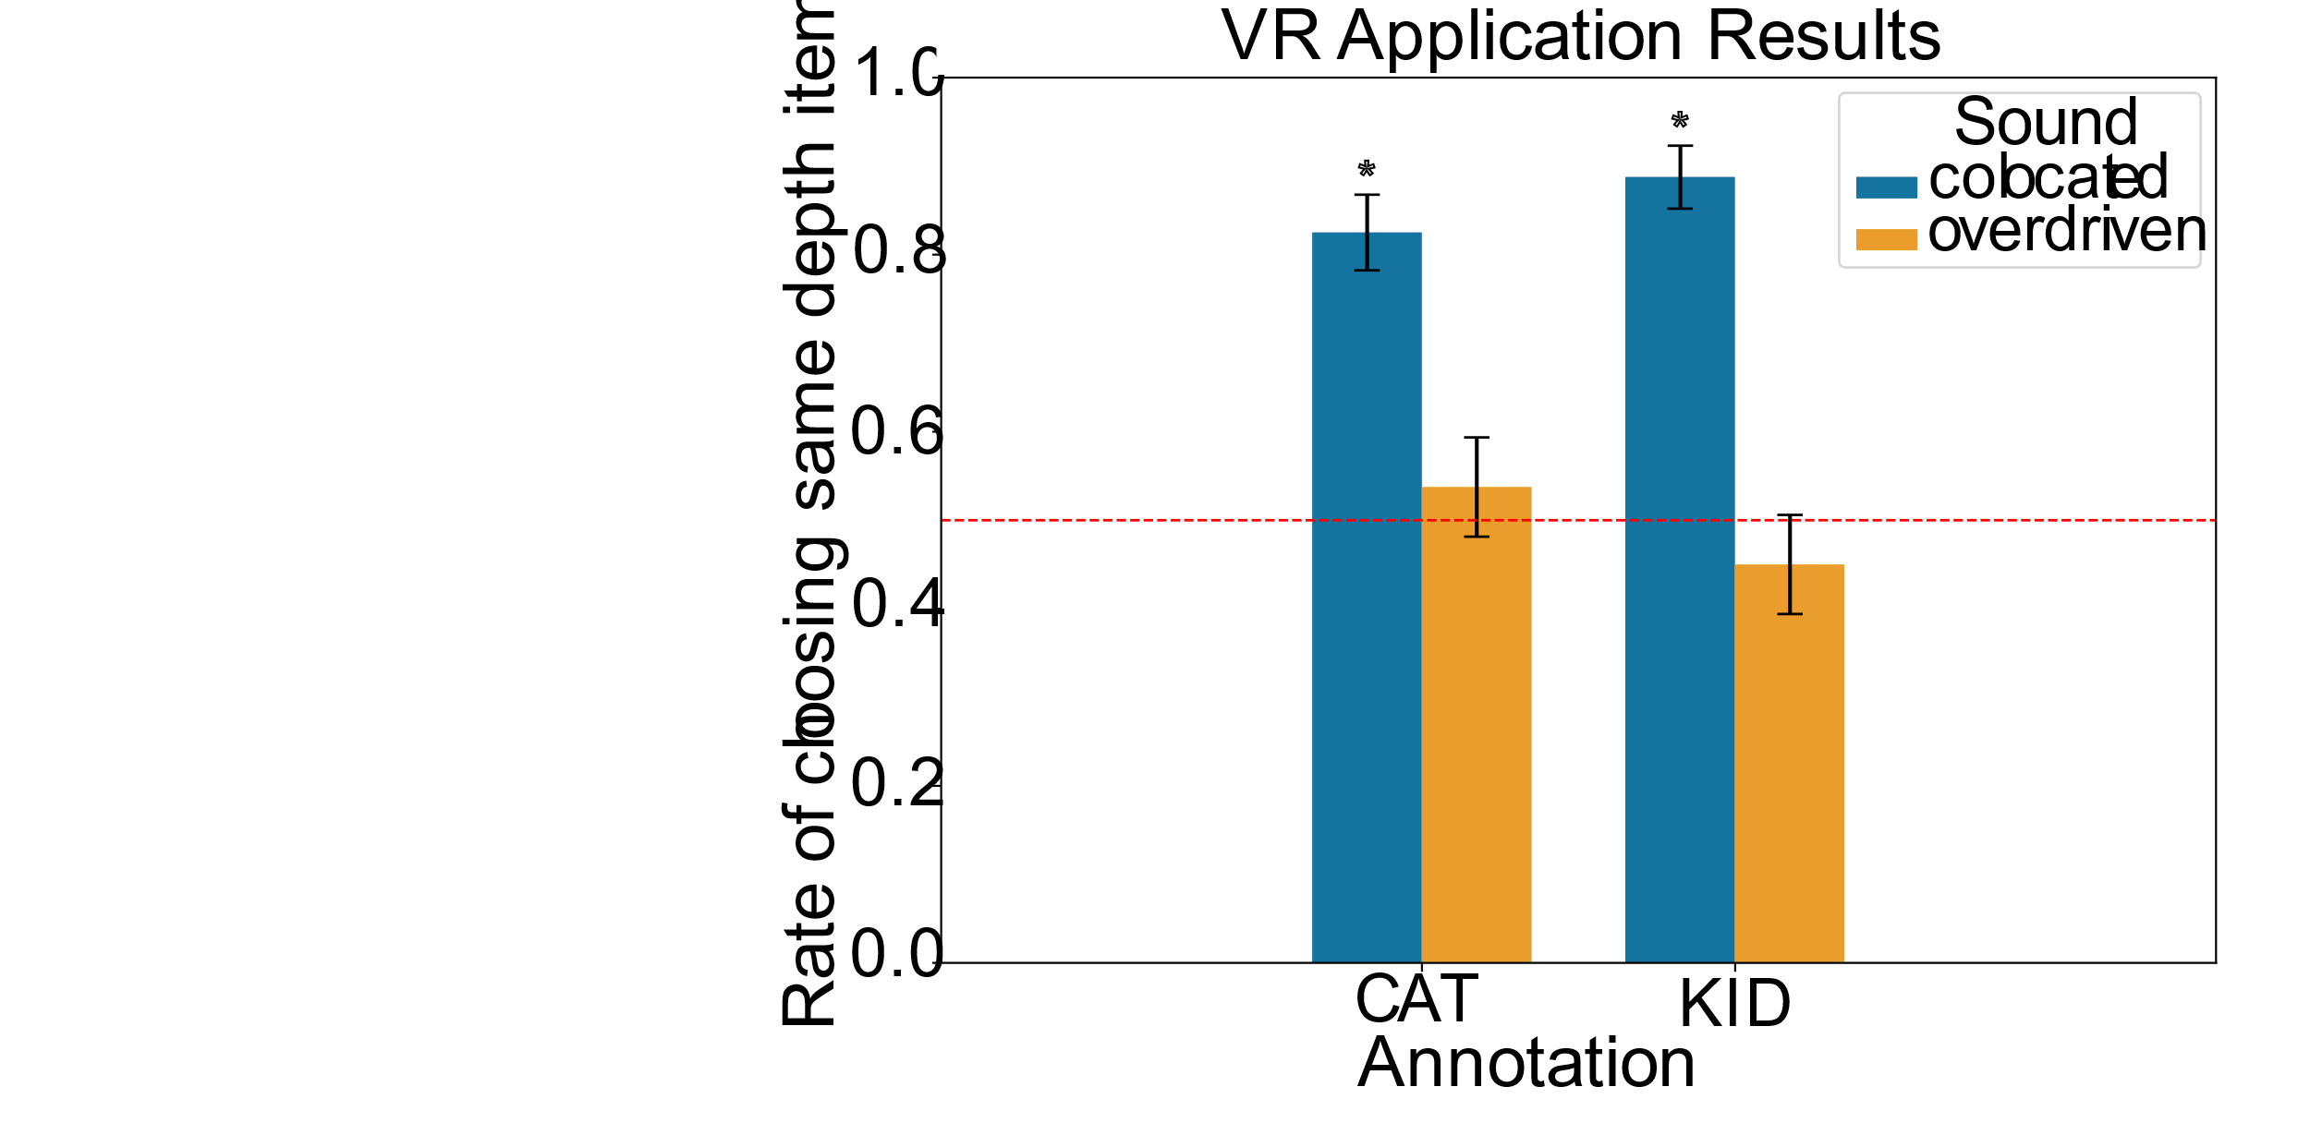

VR Application: Results
Ratio of selecting scene item at same visual depth of the annotation
Same-visual-depth
item selected
1.0
0.8
0.6
Chance Level
Ratio of choosing same depth item
0.4
0.2
0.0
Different-visual-depth item selected

Slide 90
VR Application: Results
Ratio of selecting scene item at same visual depth of the annotation
Colocated audio: >80%
Same-visual-depth
item selected
1.0
colocated
0.8
0.6
Chance Level
Ratio of choosing same depth item
0.4
0.2
0.0
Different-visual-depth item selected

Slide 91
VR Application: Results
Ratio of selecting scene item at same visual depth of the annotation
Colocated audio: >80%
Overdriven audio: Chance Level
Same-visual-depth
item selected
1.0
colocated
0.8
overdriven
0.6
Chance Level
Ratio of choosing same depth item
0.4
0.2
0.0
Different-visual-depth item selected

Slide 92
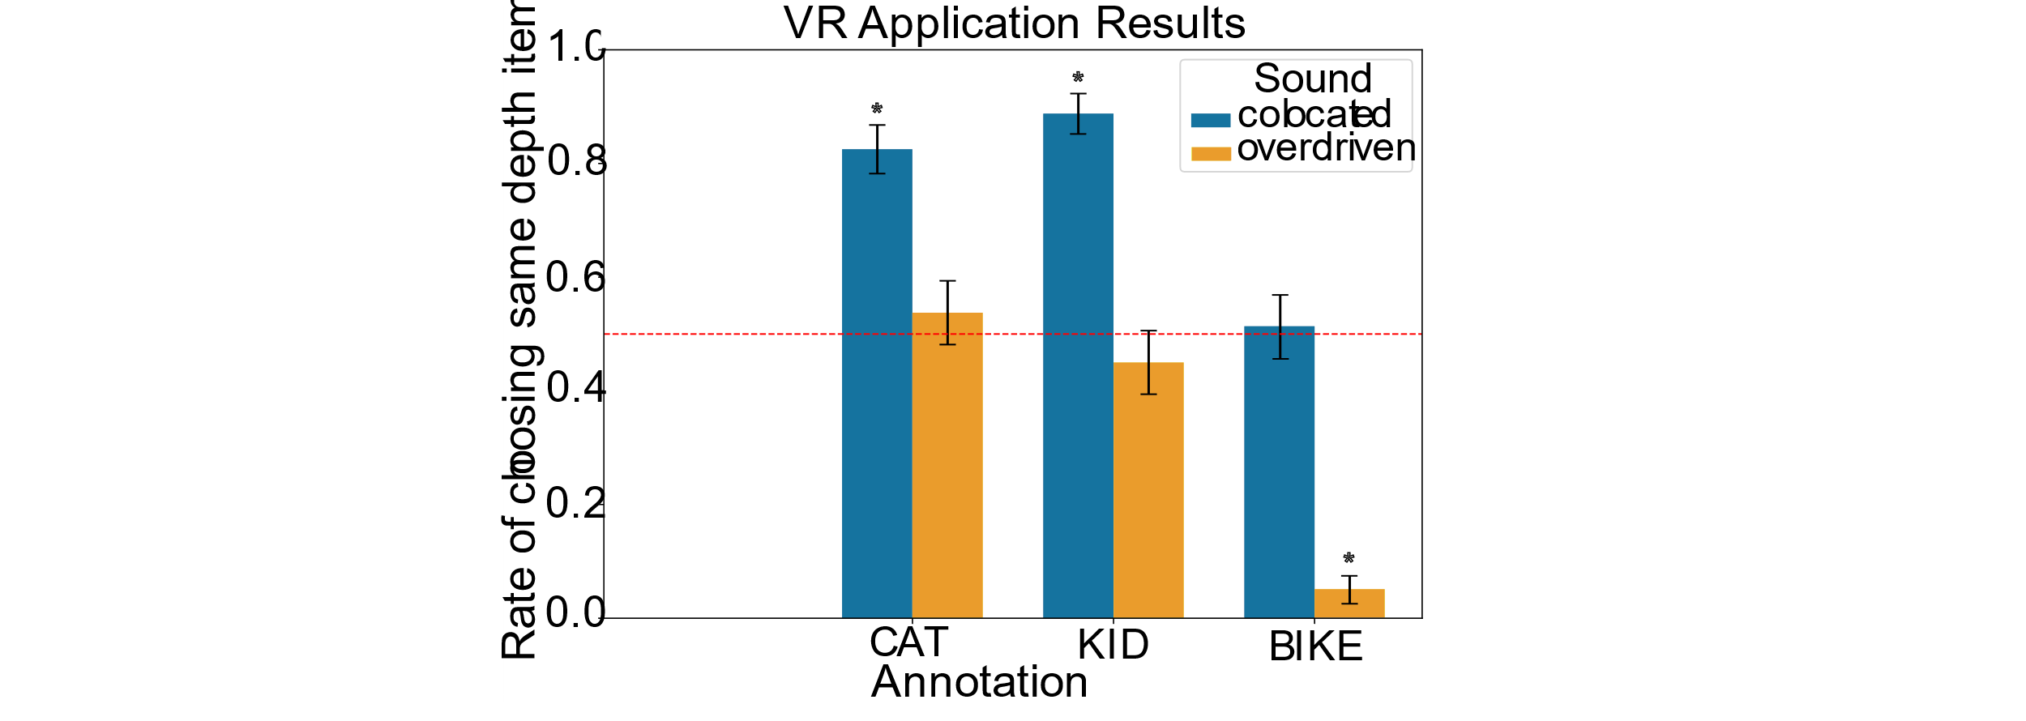
VR Application: Results
Ratio of selecting scene item at same visual depth of the annotation
Colocated audio: Chance Level
Overdriven audio: <10%
Same-visual-depth
item selected
1.0
colocated
0.8
overdriven
0.6
Chance Level
Chance Level
Ratio of choosing same depth item
0.4
0.2
0.0
Different-visual-depth item selected

Slide 93
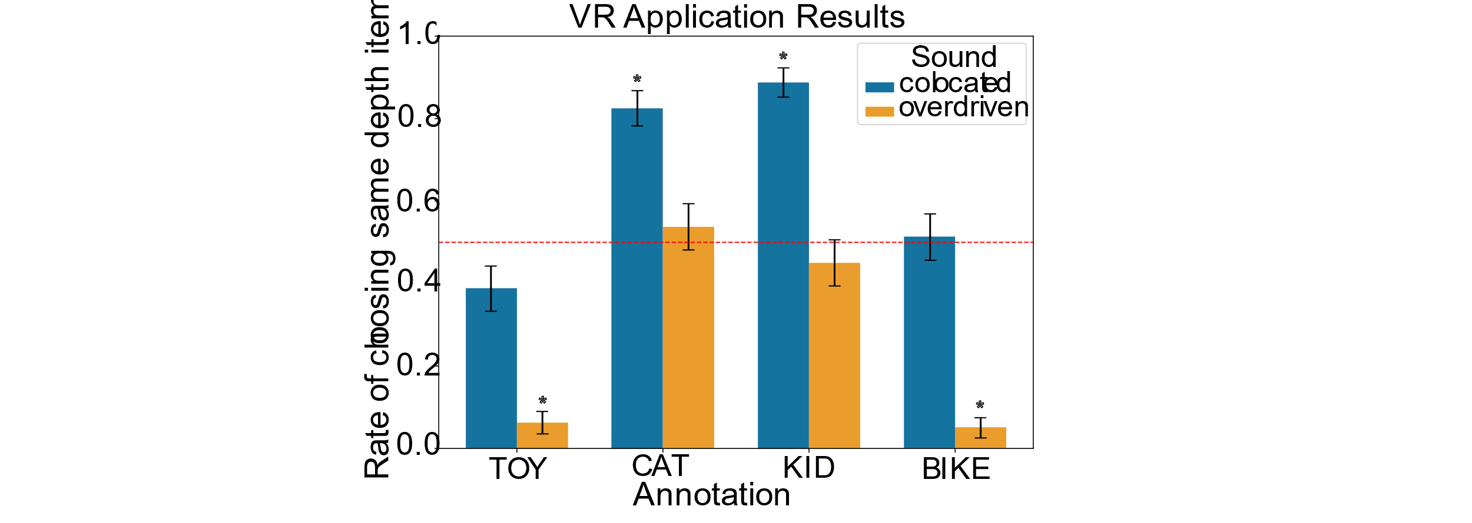
VR Application: Results
Ratio of selecting scene item at same visual depth of the annotation
Colocated audio: Chance Level
Overdriven audio: <10%
Same-visual-depth
item selected
1.0
colocated
0.8
overdriven
0.6
Chance Level
Chance Level
Chance Level
Ratio of choosing same depth item
0.4
0.2
0.0
Different-visual-depth item selected

Slide 94
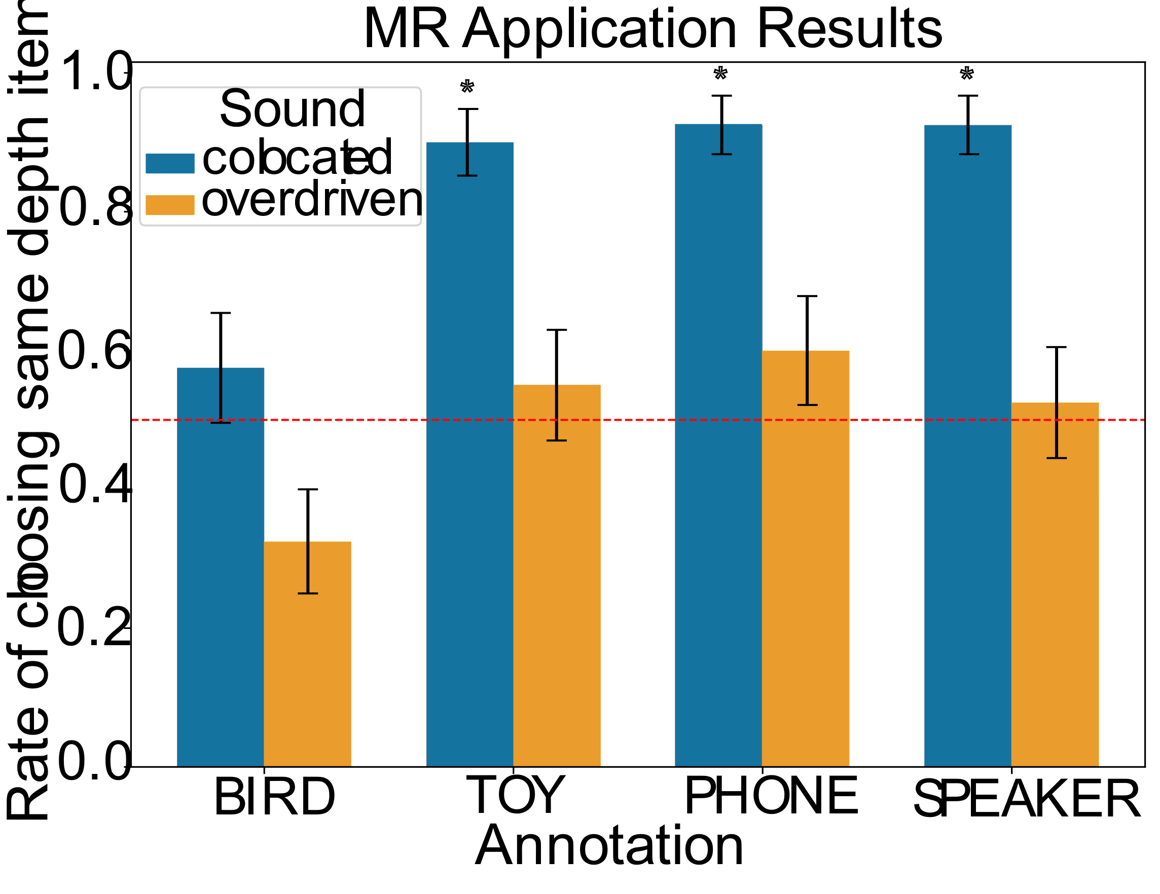
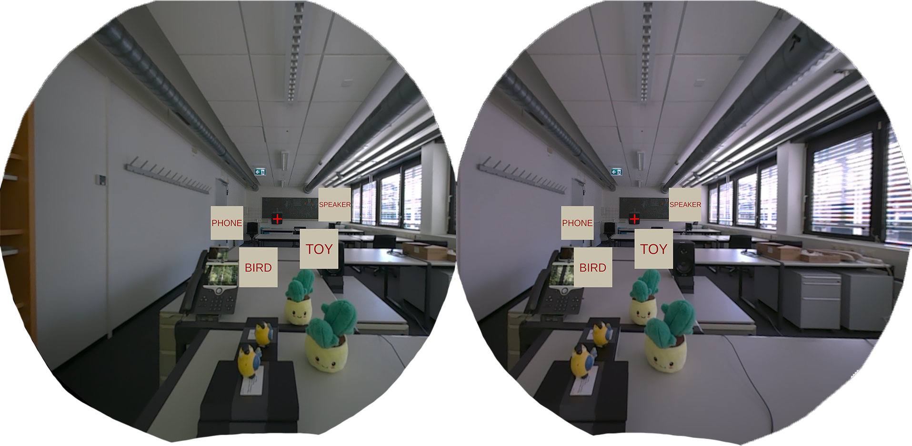
MR Application: Results
Qualitatively similar results as those obtained in the VR Application
1.0
colocated
0.8
overdriven
0.6
Ratio of choosing same depth item
0.4
0.2
0.0

Slide 95
Conclusion
Enhancing depth perception through spatial modulation of the auditory cue
Auditory-based depth cues can overdrive veridical, visually-driven depth perception

Slide 96
Conclusion
Enhancing depth perception through spatial modulation of the auditory cue
Auditory-based depth cues can overdrive veridical, visually-driven depth perception
Speed up user response

Slide 97
Conclusion
Enhancing depth perception through spatial modulation of the auditory cue
Auditory-based depth cues can overdrive veridical, visually-driven depth perception
Speed up user response
Mitigate the Vergence-Accommodation Conflict (VAC)

Slide 98
Overview
Audiovisual Perception:
Accelerating saccadic latency through temporal modulation of the auditory cue
Enhancing depth perception through spatial modulation of the auditory cue
Visual Perception:
Improving foveation through a dynamic eye dominance characterization

Slide 99
III. Dynamic Visual Dominance in Stereoscopic Foveation
Published and presented at SIGGRAPH 2026

Slide 100

Motivation
Images from Pixabay
Visual Dominance
  Static human feature

Slide 101
Motivation
Images from Pixabay
Visual Dominance
  Static human feature
  More blur on the non-dominant view

Slide 102
Motivation
Images from Pixabay
Visual Dominance
  Static human feature
  More blur on the non-dominant view
Dynamic eye dominance in the fovea [Prummer et al. CHI’25]
  Gaze direction

Slide 103
Motivation
Images from Pixabay
Visual Dominance
  Static human feature
  More blur on the non-dominant view
Dynamic eye dominance in the fovea [Prummer et al. CHI’25]
  Gaze direction
What about eye dominance at the periphery?

Slide 104
III. Dynamic Visual Dominance in Stereoscopic Foveation
User Study - Methodology

Slide 105

Setup
Visual Stimulus:
5°

Slide 106


Setup
Visual Stimulus:
Dichoptically Blurred:
5°
left view
right view

Slide 107
Setup
Contrast Sensitivity Function (CSF)
  Applied Blur > CSF Thresholds ∀ Eccentricity
    Ensure blur visibility

Slide 108
Conditions
Contrast Sensitivity Function (CSF)
  Applied Blur > CSF Thresholds ∀ Eccentricity
Blur Mode:
    Left Eye
left view
right view
Applied Blur

Slide 109
Conditions
Contrast Sensitivity Function (CSF)
  Applied Blur > CSF Thresholds ∀ Eccentricity
Blur Mode:
    Left Eye
    Right Eye
left view
right view
Applied Blur

Slide 110
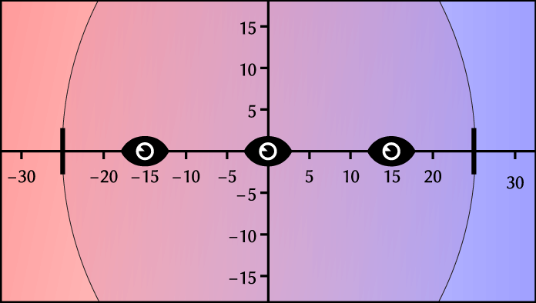
Conditions
Fixation Points
  Horizontal: -15°, 0°, +15°
    Common visual saccade ranges

Slide 111

Conditions
Fixation Points
  Horizontal: -15°, 0°, +15°
Stimulus Location
  Horizontal: ±5°, ±10°, ±15°, ±20°

Slide 112

Conditions
Fixation Points
  Horizontal: -15°, 0°, +15°
Stimulus Location
  Horizontal: ±5°, ±10°, ±15°, ±20°
  Vertical: ±5°, ±10°, ±15°

Slide 113

Conditions
Fixation Points
  Horizontal: -15°, 0°, +15°
Stimulus Location
  Horizontal: ±5°, ±10°, ±15°, ±20°
  Vertical: ±5°, ±10°, ±15°
  Diagonal: (±5°, ±5°), (±10°, ±10°)

Slide 114
User Study: Procedure
Reference → Case 1 → Reference → Case 2
  Reference
  Case 1 → Left Eye Blur
  Case 2 → Right Eye Blur
left view
right view

Slide 115
User Study: Procedure
Reference → Case 1 → Reference → Case 2
  Reference
  Case 1 → Left Eye Blur
  Case 2 → Right Eye Blur
left view
right view

Slide 116
User Study: Procedure
Reference → Case 1 → Reference → Case 2
  Reference
  Case 1 → Left Eye Blur
  Case 2 → Right Eye Blur
left view
right view

Slide 117
User Study: Procedure
Reference → Case 1 → Reference → Case 2
  Reference
  Case 1 → Left Eye Blur
  Case 2 → Right Eye Blur
left view
right view

Slide 118
User Study: Procedure
Reference → Case 1 → Reference → Case 2
  Reference
  Case 1 → Left Eye Blur
  Case 2 → Right Eye Blur
left view
right view
Task:
Which Case looks closer to Reference?

Slide 119
III. Dynamic Visual Dominance in Stereoscopic Foveation
User Study - Results

Slide 120
User Study: Results
Blur Mode Selection Ratio: [1, -1]

Slide 121
User Study: Results
Blur Mode Selection Ratio: [1, -1]
Right Eye Blur 1
  Left Eye Dominance
left view
right view

Slide 122
User Study: Results
Blur Mode Selection Ratio: [1, -1]
Right Eye Blur 1
  Left Eye Dominance
Left Eye Blur -1
  Right Eye Dominance
left view
right view

Slide 123


User Study: Results
Blur Mode Selection Ratio: [1, -1]
Right Eye Blur 1
  Left Eye Dominance
Left Eye Blur -1
  Right Eye Dominance
left view
right view

Slide 124
User Study: Results
Fixation at (0,0)

Slide 125
User Study: Results
Fixation at (0,0)
Around fovea
  Slight Right Eye Dominance

Slide 126
User Study: Results
Fixation at (0,0)
Around fovea
  Slight Right Eye Dominance
At E = +15°
  Right Eye Blind Spot

Slide 127
User Study: Results
Fixation at (0,0)
Around fovea
  Slight Right Eye Dominance
At E = +15°
  Right Eye Blind Spot
At E = -15°
  Left Eye Blind Spot

Slide 128

User Study: Results
Fixation at (15°,0)

Slide 129
User Study: Results
Fixation at (15°,0)
Near fovea until E = -20°
  Right Eye Dominance
    Left Eye Blind Spot

Slide 130
User Study: Results
Fixation at (15°,0)
Near fovea until E = -20°
  Right Eye Dominance
Over E = -20°
  Left Eye Dominance
    Temporal over nasal

Slide 131

User Study: Results
Fixation at (-15°,0)

Slide 132
User Study: Results
Fixation at (-15°,0)
Near fovea until E = 20°
  Left Eye Dominance
    Right Eye Blind Spot

Slide 133
User Study: Results
Fixation at (-15°,0)
Near fovea until E = 20°
  Left Eye Dominance
Over E = 20°
  Right Eye Dominance
    Temporal over nasal

Slide 134

User Study: Results
Horizontal Eccentricities

Slide 135
User Study: Results
Vertical Eccentricities

Slide 136
User Study: Results
Diagonal Eccentricities

Slide 137
User Study: Results
Consistent results along viewing conditions

Slide 138

Retinal Map
Gaze-Independent Retinal Dominance Map
fovea

Slide 139
III. Dynamic Visual Dominance in Stereoscopic Foveation
Validation

Slide 140




Application Case
Left Eye Dominance Map
Right Eye Dominance Map
+
-
+
-

Slide 141





Application Case

Slide 142
Application Case

Slide 143
Application Case

Slide 144

Application Case
Standard Foveation (CSF):

Slide 145


Application Case
Static Eye Dominance: ;
non-dominant
dominant

Slide 146





Application Case
Our Method - Dynamic Eye Dominance: ;
non-dominant
dominant

Slide 147
Application Case
Our Method - Dynamic Eye Dominance: ;
non-dominant
dominant

Slide 148
Application Case
Our Method - Dynamic Eye Dominance: ;
non-dominant
dominant

Slide 149
Application Case
Task: Which dominance approach (Static or Dynamic) is closer to baseline (Foveated Rendering)?

Slide 150



Application Case
Sponza
Nature
2D Image

Slide 151

Application Case: Results

Slide 152
Application Case: Results

Slide 153
Application Case: Results
stronger foveation

Slide 154
Application Case: Results
stronger foveation

Slide 155
Conclusion
Improving foveation through a dynamic eye dominance characterization
Eye dominance in the periphery
  Dynamic behavior
fovea

Slide 156
Conclusion
Improving foveation through a dynamic eye dominance characterization
Eye dominance in the periphery
  Dynamic behavior
Stronger foveation
  Less perceptible artifacts
fovea

Slide 157
Closing Remarks
What can we do from the user’s side?
Reduce visual response latency times
  Temporally misaligned audiovisual cues

Slide 158
Closing Remarks
What can we do from the user’s side?
Reduce visual response latency times
  Temporally misaligned audiovisual cues
Reduce visual response execution times
  Spatially misaligned audiovisual cues

Slide 159
Closing Remarks
What can we do from the user’s side?
Reduce visual response latency times
  Temporally misaligned audiovisual cues
Reduce visual response execution times
  Spatially misaligned audiovisual cues
Reduce computational resources and improve experience
  Dichoptically misaligned visual cues

Slide 160

Future Work
Sound to (I) speed up saccade latency while (II) recovering initial depth percept
  Temporal setups are different
P_{C}
Proposed
Original
P_{m}
p₁
p₂
p₃

Slide 161
Future Work
Sound to (I) speed up saccade latency while (II) recovering initial depth cues
  Temporal setups are different
Peripheral Dominance Map applicability to other visual features
  Dichoptic Color
left view
right view
fovea

Slide 162
References – Own Work
Thesis-related publications:
  Accelerating saccadic response through spatial and temporal cross-modal misalignments.
  Daniel Jiménez-Navarro, Xi Peng, Yunxiang Zhang, Karol Myszkowski, Hans-Peter Seidel, Qi Sun, and Ana Serrano. ACM SIGGRAPH 2024.
  Overdriving Visual Depth Perception via Sound Modulation in VR.
  Daniel Jiménez-Navarro, Colin Groth, Xi Peng, Jorge Pina, Qi Sun, Praneeth Chakravarthula, Karol Myszkowski, Hans-Peter Seidel, and Ana Serrano. IEEE Transactions on Visualization and Computer Graphics 2026.
  Dynamic Visual Dominance in Stereoscopic Foveation.
  Daniel Jiménez-Navarro, Colin Groth, Kenneth Chen, Qi Sun, Karol Myszkowski, Hans-Peter Seidel, and Ana Serrano. ACM SIGGRAPH 2026.
Additional publications during PhD time:
  Why Slow Feels Fast and Fast Feels Slow: Evaluating and Predicting Speed Misperception.
  Xi Peng, Colin Groth, Daniel Jiménez-Navarro, Zihao Zou, Yan Zhu, Ana Serrano, Karol Myszkowski, Qi Sun, and Praneeth Chakravarthula. IEEE International Symposium on Mixed and Augmented Reality (ISMAR) 2025.
  Measuring and predicting multisensory reaction latency: A probabilistic model for visual-auditory integration.
  Xi Peng, Yunxiang Zhang, Daniel Jiménez-Navarro, Ana Serrano, Karol Myszkowski, and Qi Sun. IEEE Transactions on Visualization and Computer Graphics 2024.
  Minimally disruptive auditory cues: their impact on visual performance in virtual reality.
  Daniel Jiménez-Navarro, Ana Serrano, and Sandra Malpica. The Visual Computer 2024.

Slide 163











Thank you!

Slide 164
PhD Thesis Defense Date: 09/21/2026
Active Modulation of Audio-Visual Perception to Enhance Human Performance and Experience
in Immersive Environments
Daniel Jiménez Navarro

