Slide 1
Accelerating SACCADIC RESPONSE THROUGH SPATIAL AND TEMPORAL CROSS-MODAL MISALIGNMENTS
Daniel Jiménez-Navarro, Xi Peng, Yunxiang Zhang, Karol Myszkowski, Hans-Peter Seidel, Qi Sun and Ana Serrano

Slide 2
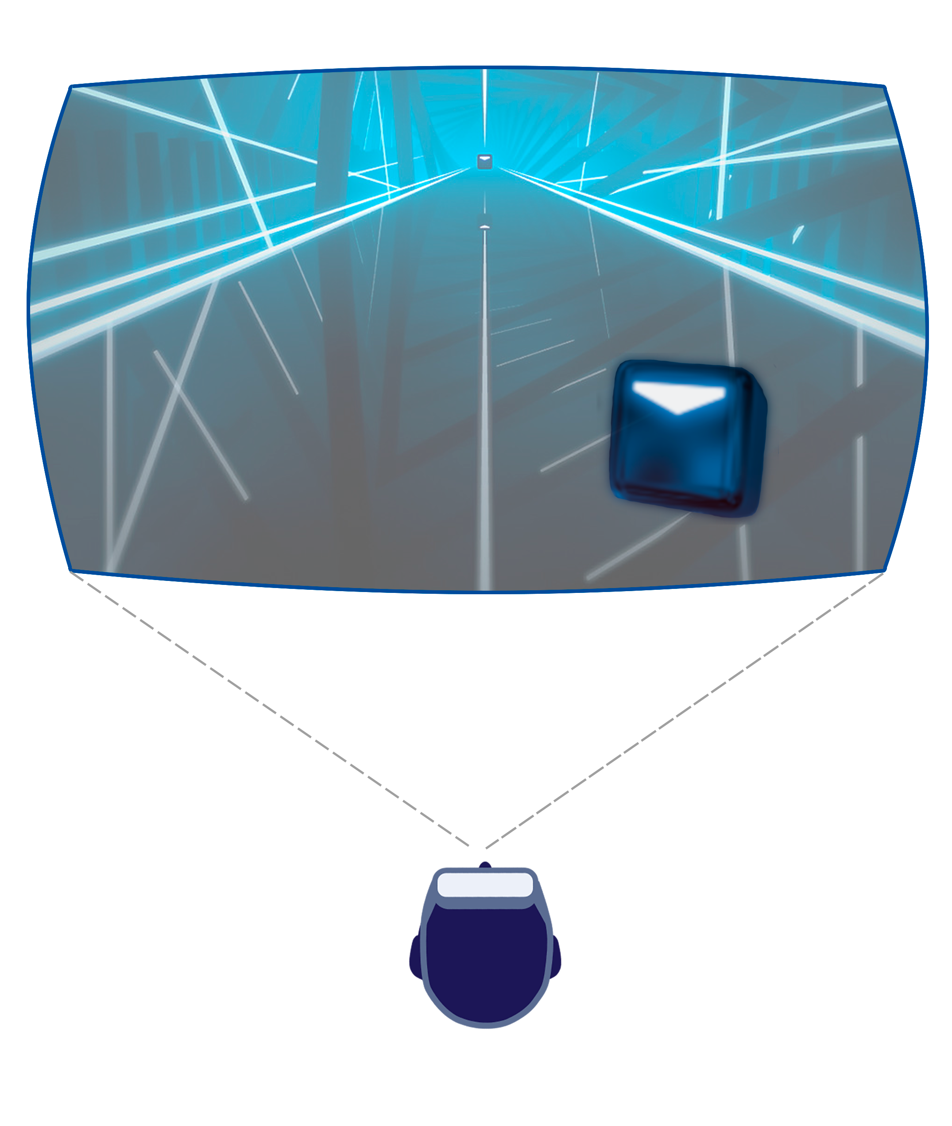
PROBLEM MOTIVATION

Slide 3
PROBLEM MOTIVATION

Slide 4
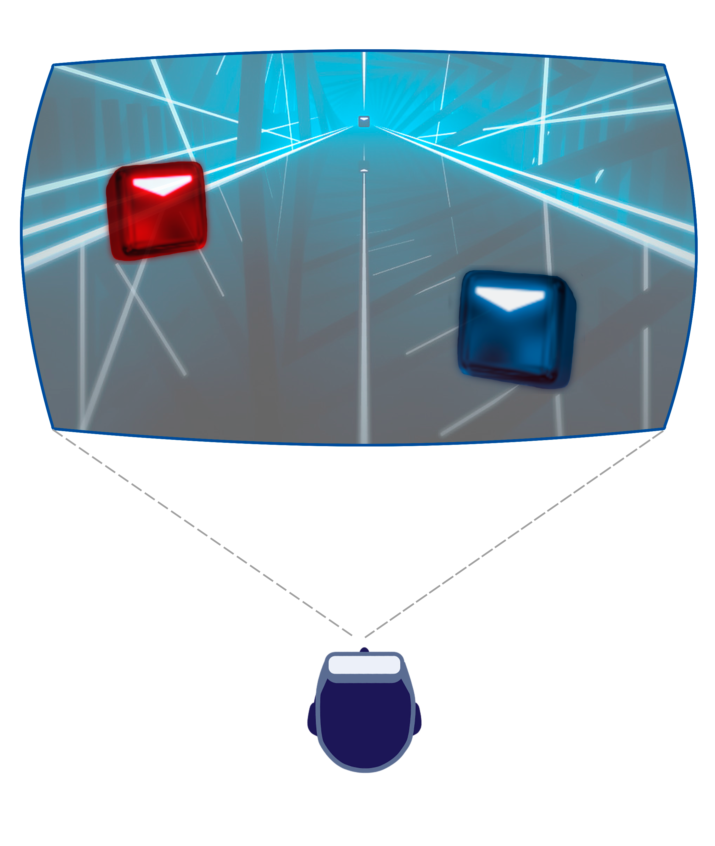
PROBLEM MOTIVATION

Slide 5
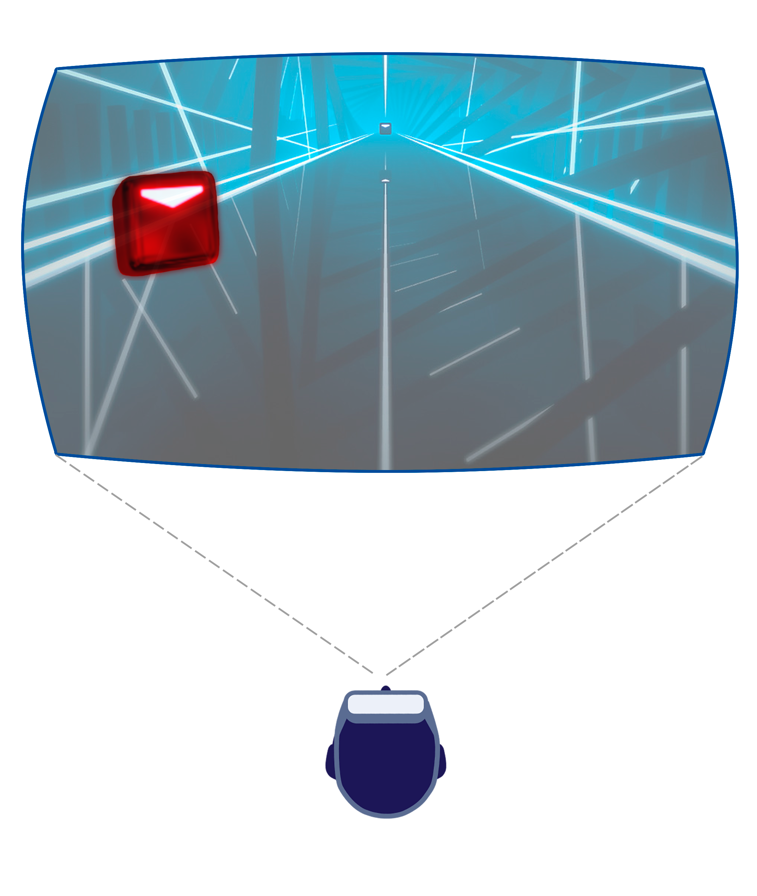
PROBLEM MOTIVATION

Slide 6
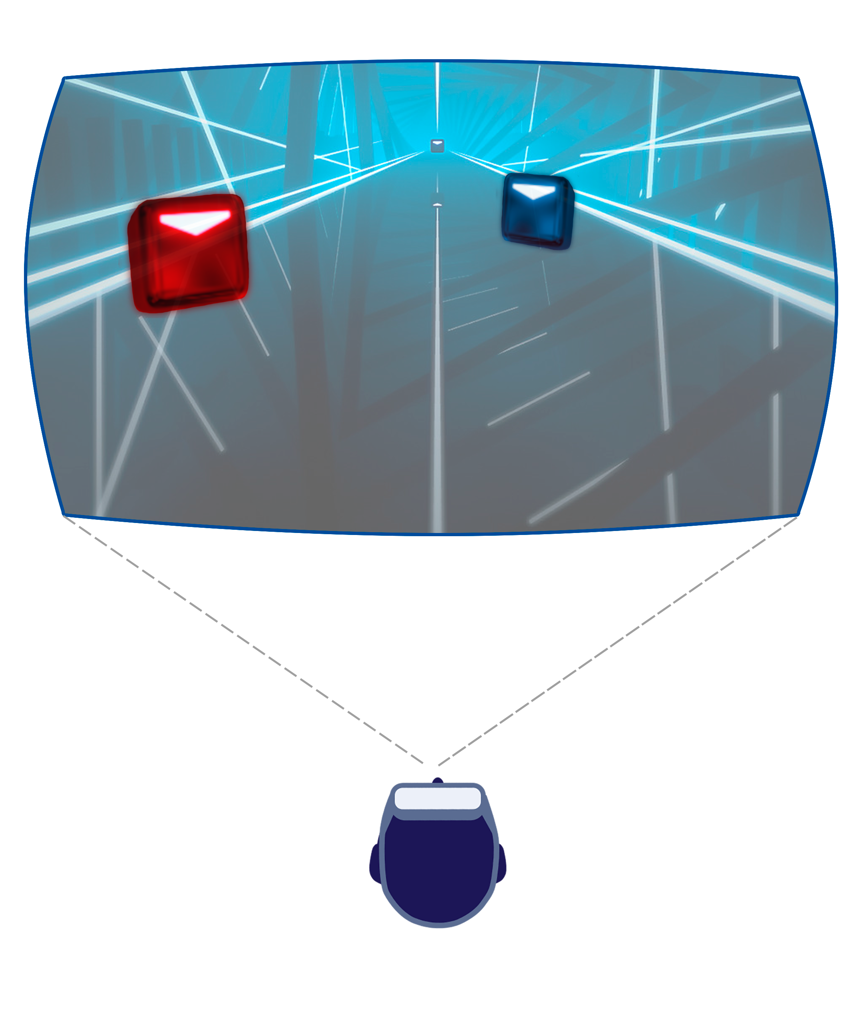
PROBLEM MOTIVATION

Slide 7
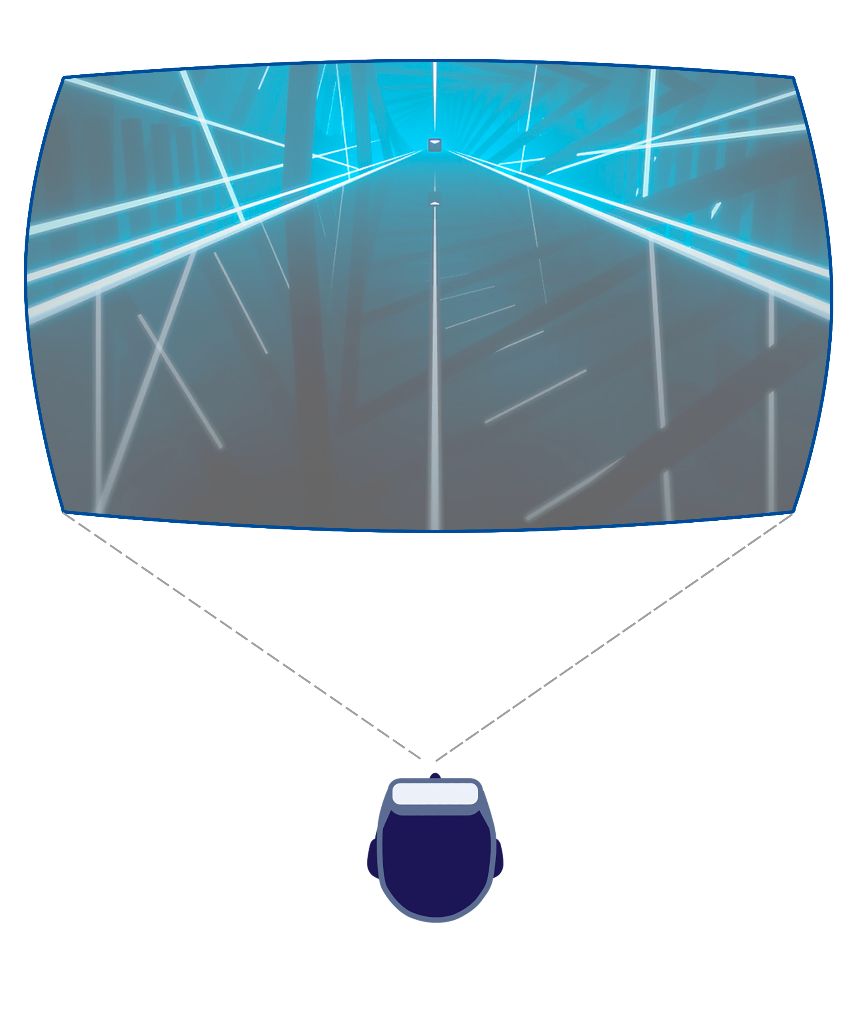
PROBLEM MOTIVATION

Slide 8
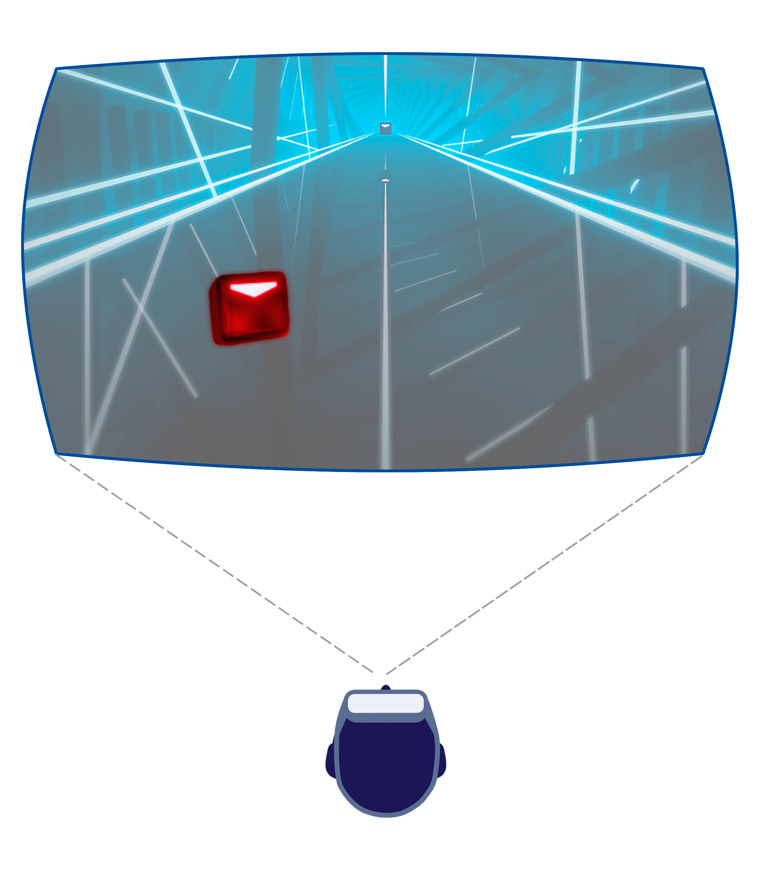
PROBLEM MOTIVATION

Slide 9
PROBLEM MOTIVATION

Slide 10
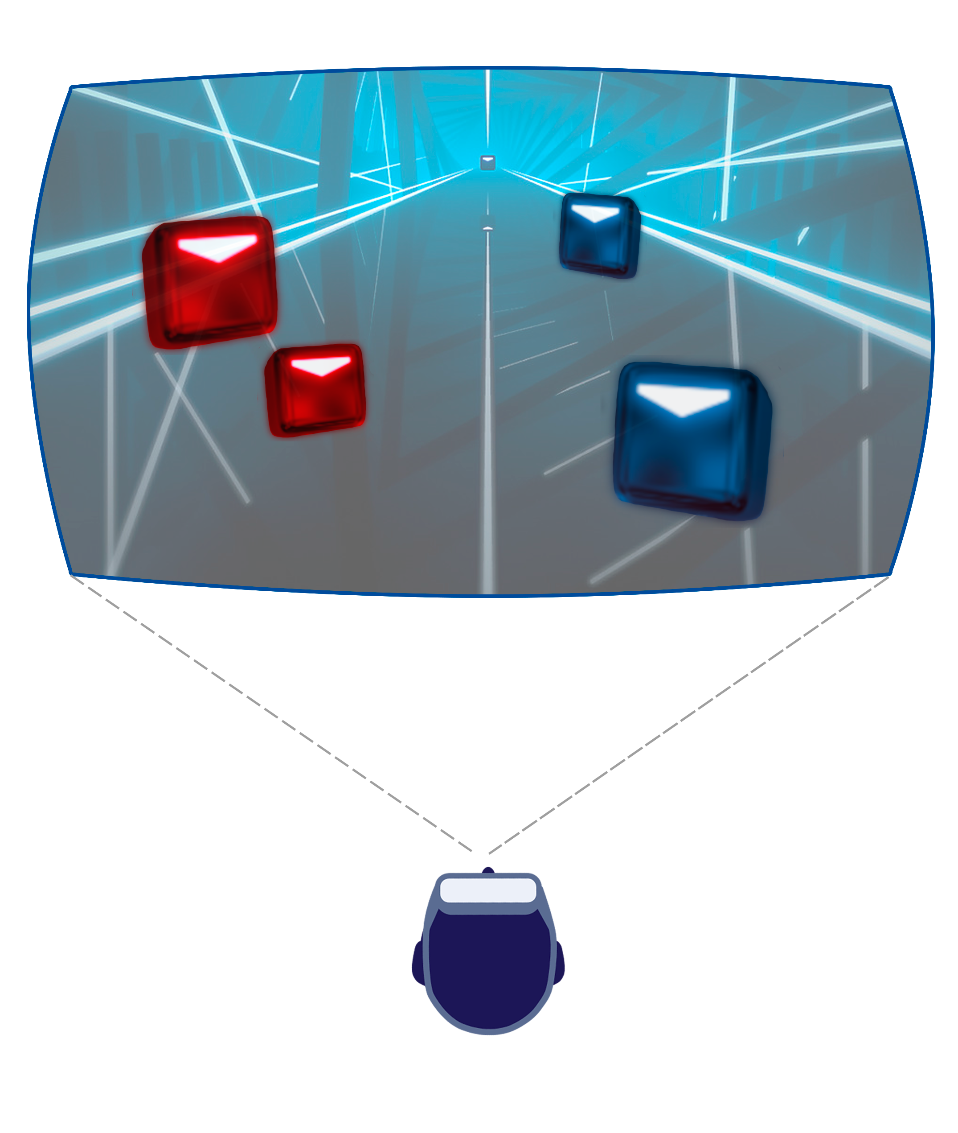
PROBLEM MOTIVATION

Slide 11
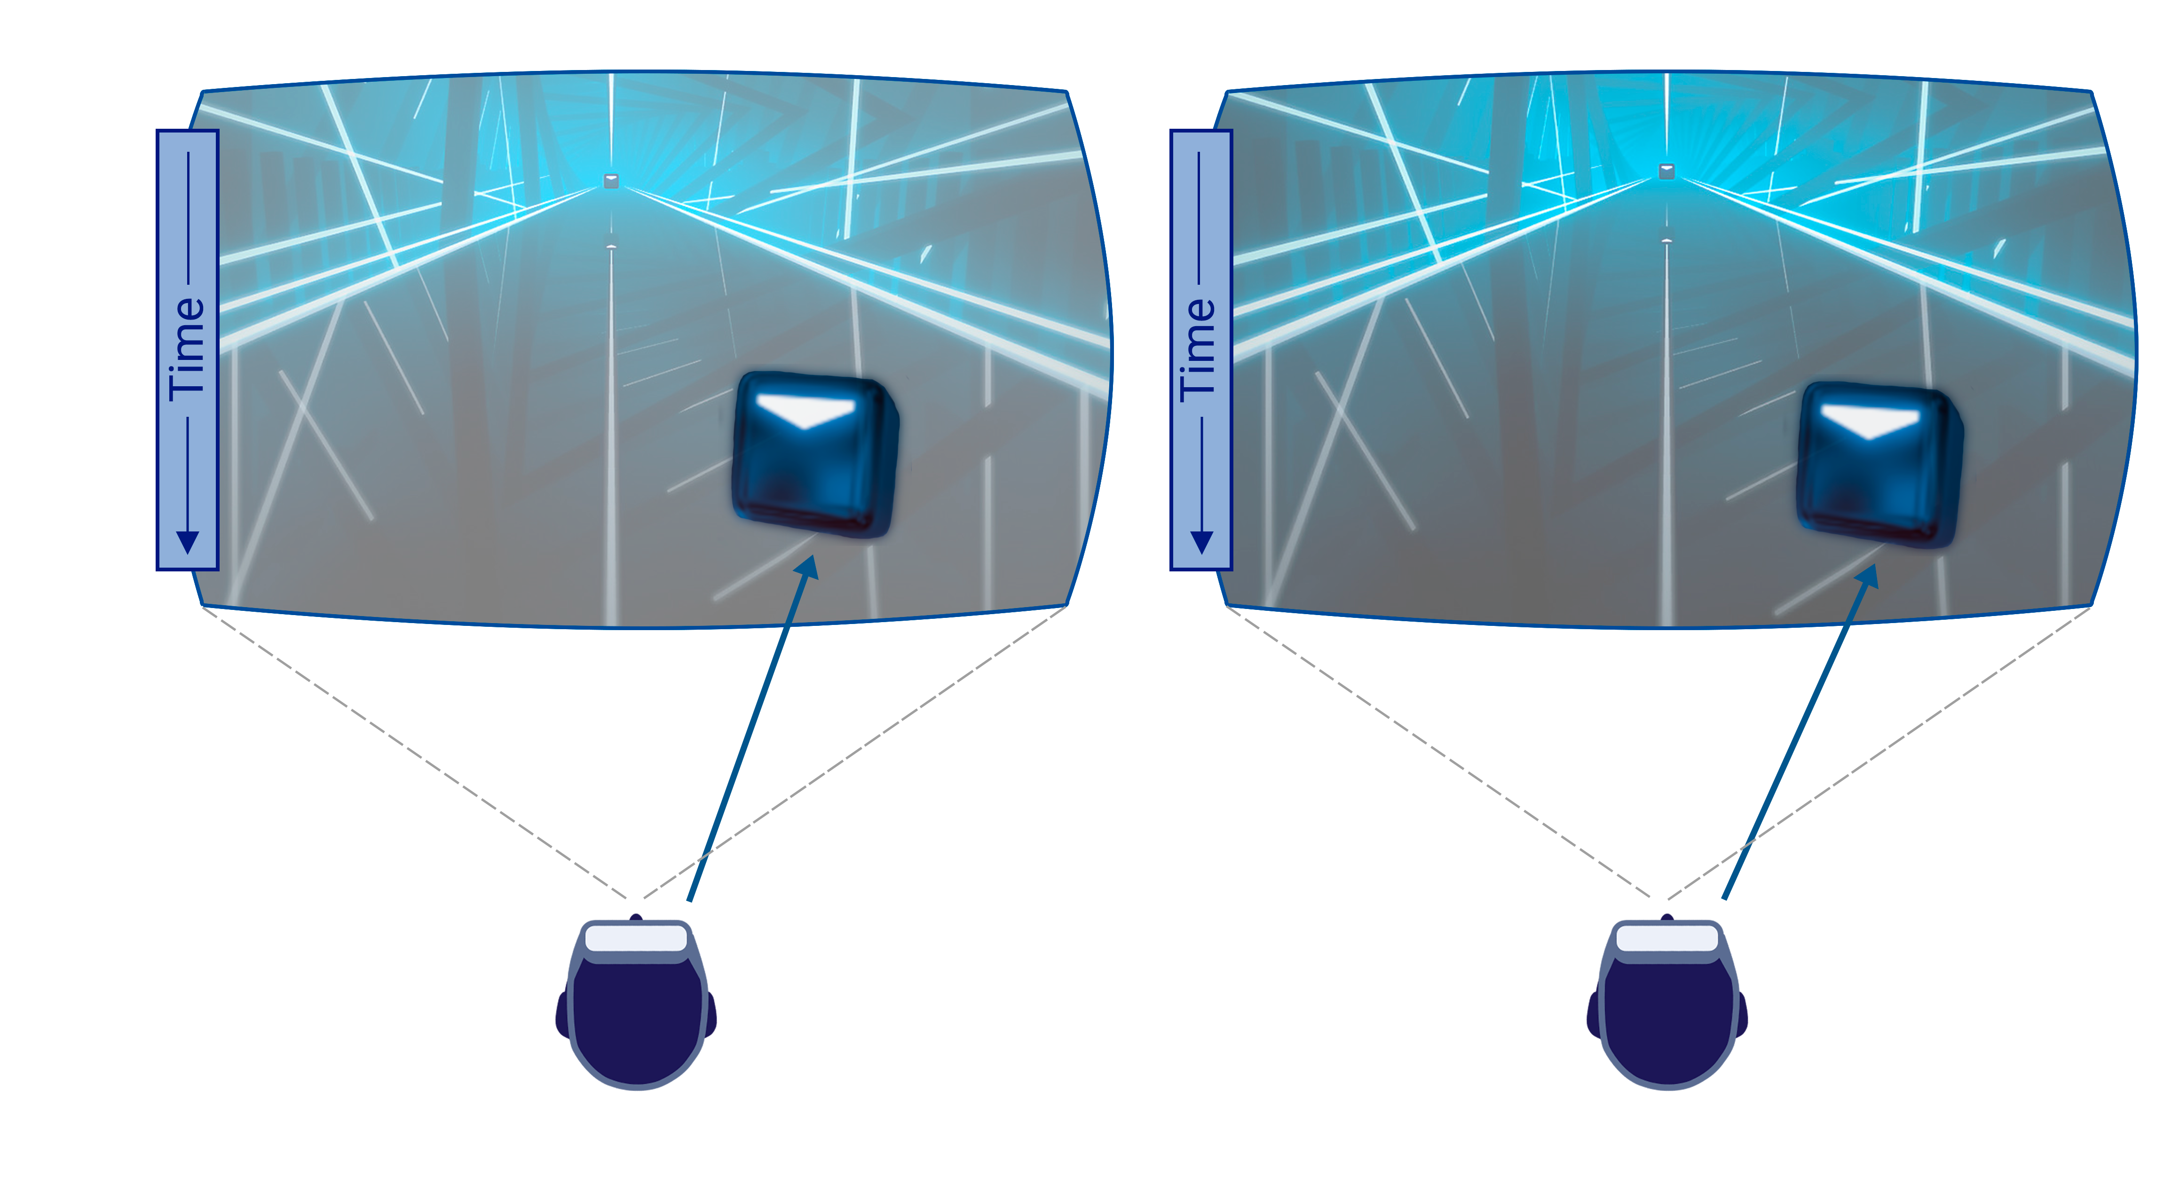
GOAL
Model visual response acceleration using auditory modality

Slide 12
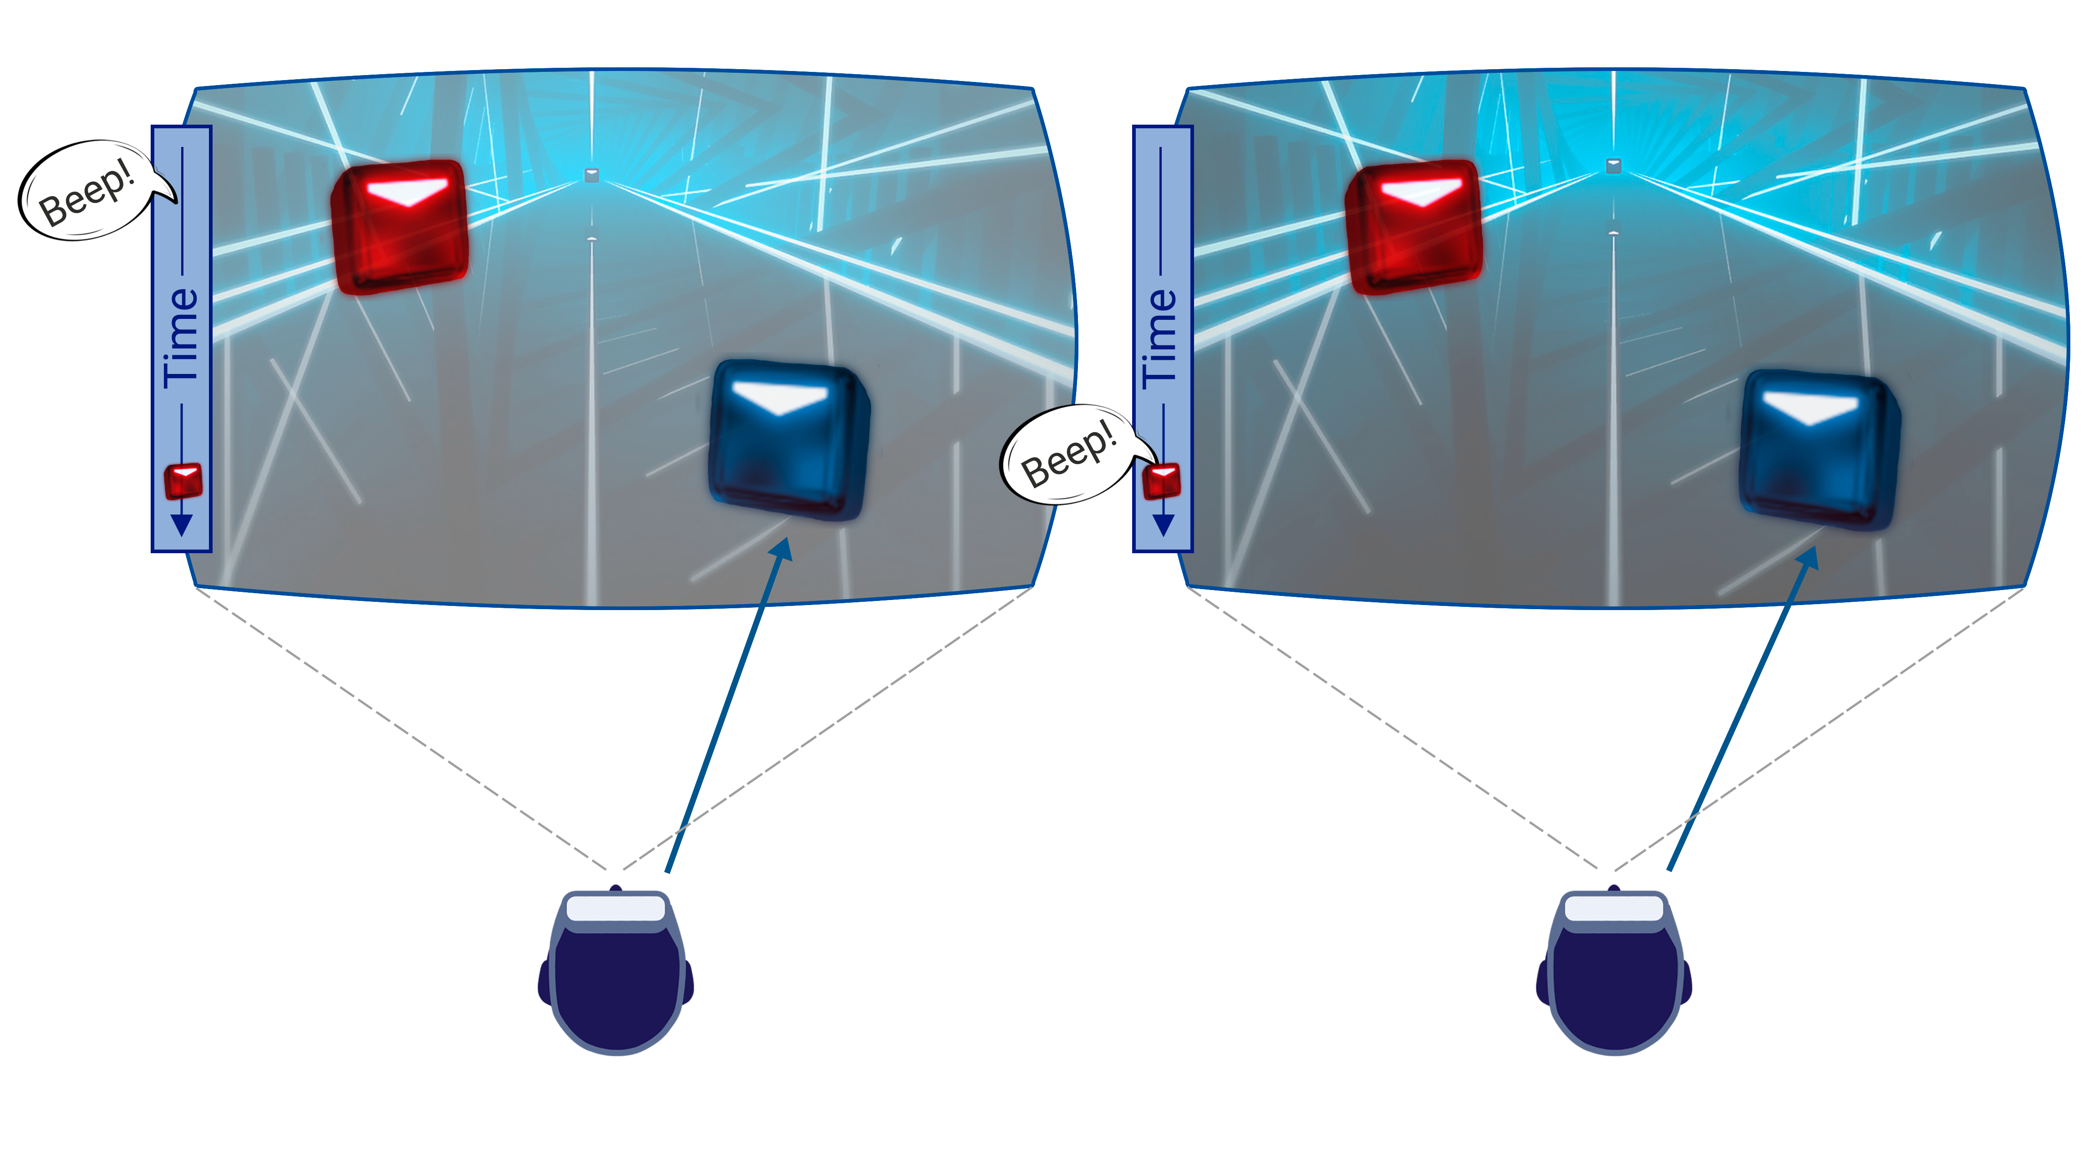
GOAL
Model visual response acceleration using auditory modality

Slide 13
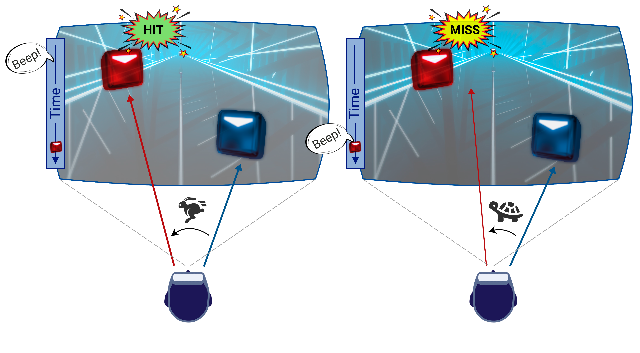
GOAL
Model visual response acceleration using auditory modality

Slide 14
Visual saccades latency
Initial fixation

Slide 15
Visual saccades latency
Initial fixation

Slide 16
Visual saccades latency
Initial fixation
ω

Slide 17
Visual saccades latency
Initial fixation
Saccade performed
ω

Slide 18
Visual saccades latency
Initial fixation
Saccade performed
ω
Saccade latency

Slide 19
MAIN USER STUDY

Slide 20
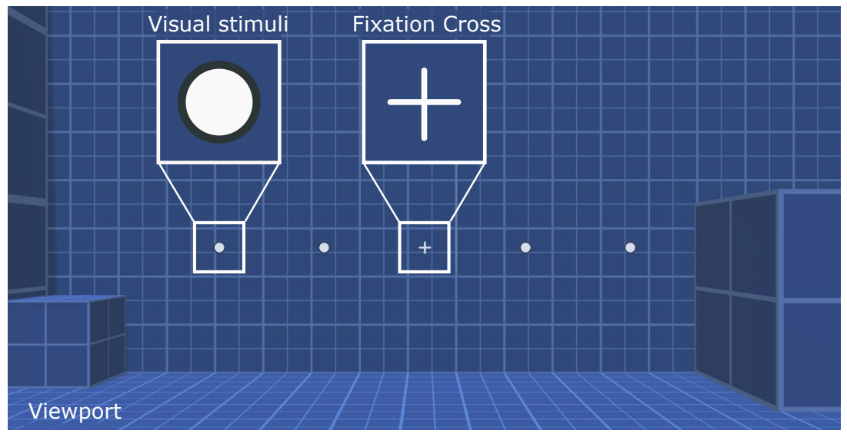
SCENE and AUDIOVISUAL STIMULI
Visual Target → Simple Shapes
Auditory Cue → Pure Frequency Beep

Slide 21
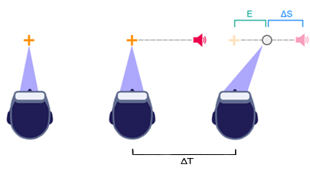
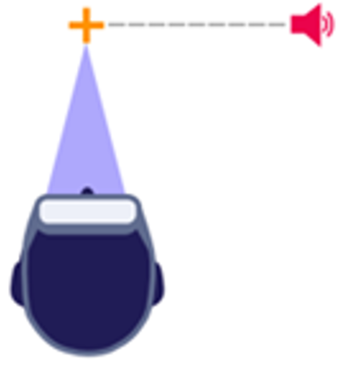
spatiotemporal setup
t

Slide 22
spatiotemporal setup
t

Slide 23
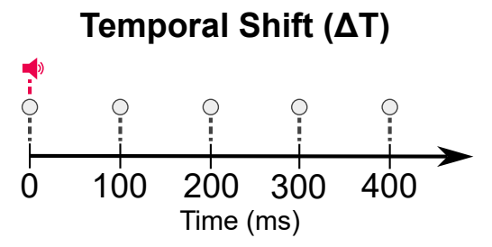
MAIN EXPERIMENT VARIABLES
TEMPORAL SHIFT (ΔT)
ΔT
t

Slide 24
MAIN EXPERIMENT VARIABLES
TEMPORAL SHIFT (ΔT)
ΔT
Temporal simultaneity threshold
t

Slide 25
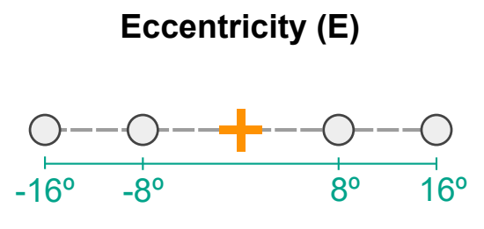
MAIN EXPERIMENT VARIABLES
ECCENTRICITY (e)
e
t

Slide 26
MAIN EXPERIMENT VARIABLES
ECCENTRICITY (e)
e
Most saccades inside 15° range
t

Slide 27
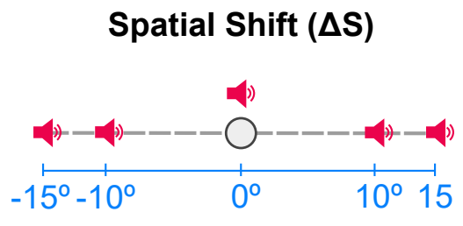
MAIN EXPERIMENT VARIABLES
Spatial shift (ΔS)
ΔS
t

Slide 28
MAIN EXPERIMENT VARIABLES
Spatial shift (ΔS)
ΔS
Fusion Windows ±15°
t

Slide 29
MAIN EXPERIMENT VARIABLES
TEMPORAL SHIFT (ΔT)
ECCENTRICITY (e)
t
Spatial shift (ΔS)

Slide 30
RESULTS

Slide 31
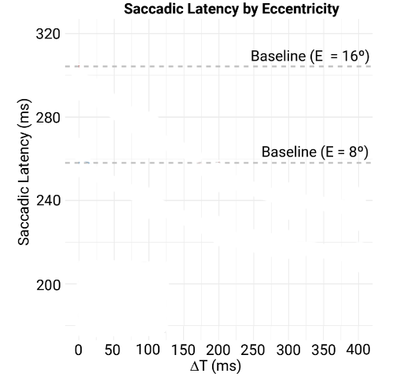
MAIN EXPERIMENT RESULTS
Visual target only

Slide 32
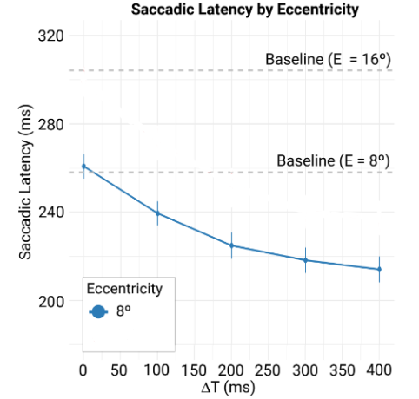
MAIN EXPERIMENT RESULTS

Slide 33
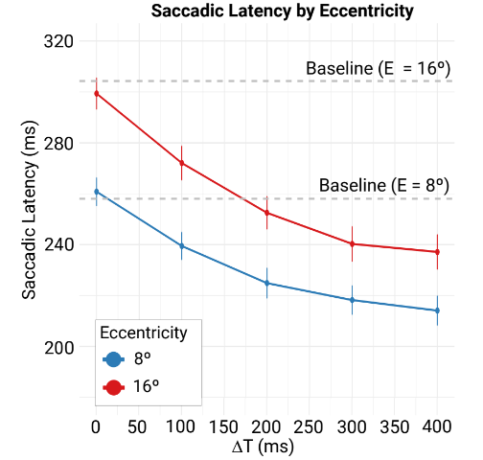
MAIN EXPERIMENT RESULTS

Slide 34
MAIN EXPERIMENT RESULTS
Temporal simultaneity threshold

Slide 35
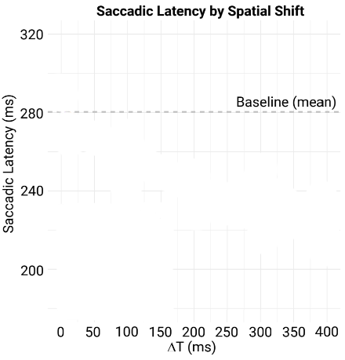
MAIN EXPERIMENT RESULTS

Slide 36
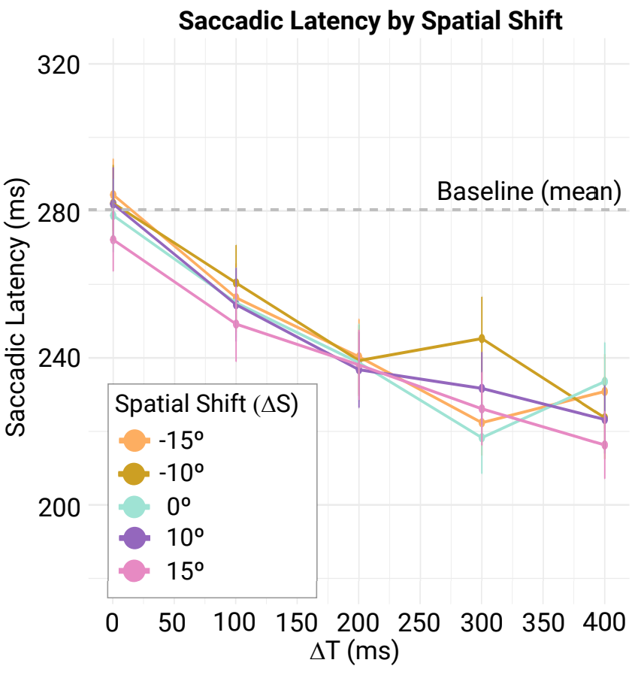
MAIN EXPERIMENT RESULTS

Slide 37
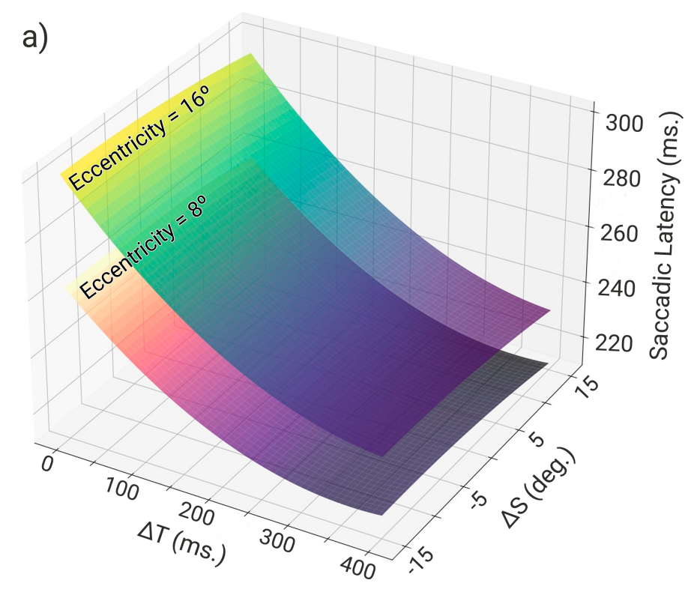
SACCADe LATENCY MODEL
$$Saccadic Latency = f(E, ΔT, ΔS)$$

Slide 38
SACCADE LATENCY MODEL
$$Saccadic Latency = f(E, ΔT, ΔS)$$
Conclusions
Latency decreases with temporal shift

Slide 39
SACCADE LATENCY MODEL
$$Saccadic Latency = f(E, ΔT, ΔS)$$
Conclusions
Latency decreases with temporal shift
Spatial mismatch does not limit the effect

Slide 40
SACCADE LATENCY MODEL
$$Saccadic Latency = f(E, ΔT, ΔS)$$
Conclusions
Latency decreases with temporal shift
Spatial mismatch does not limit the effect
Uniform effect for different eccentricities

Slide 41
SACCADE LATENCY MODEL
$$Saccadic Latency = f(E, ΔT, ΔS)$$
Conclusions
Latency decreases with temporal shift
Spatial mismatch does not limit the effect
Uniform effect for different eccentricities
Landing errors below ET resolution

Slide 42
VALIDATION

Slide 43
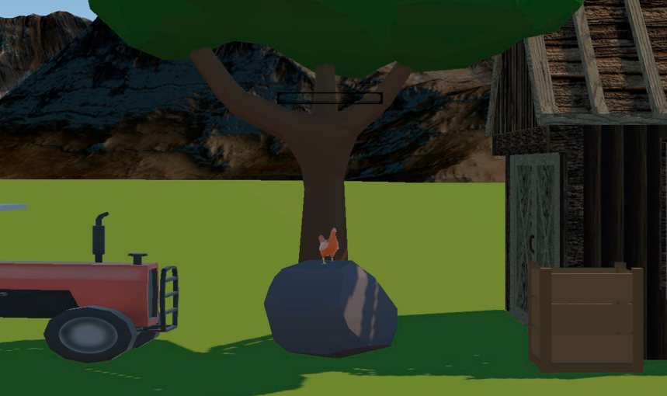
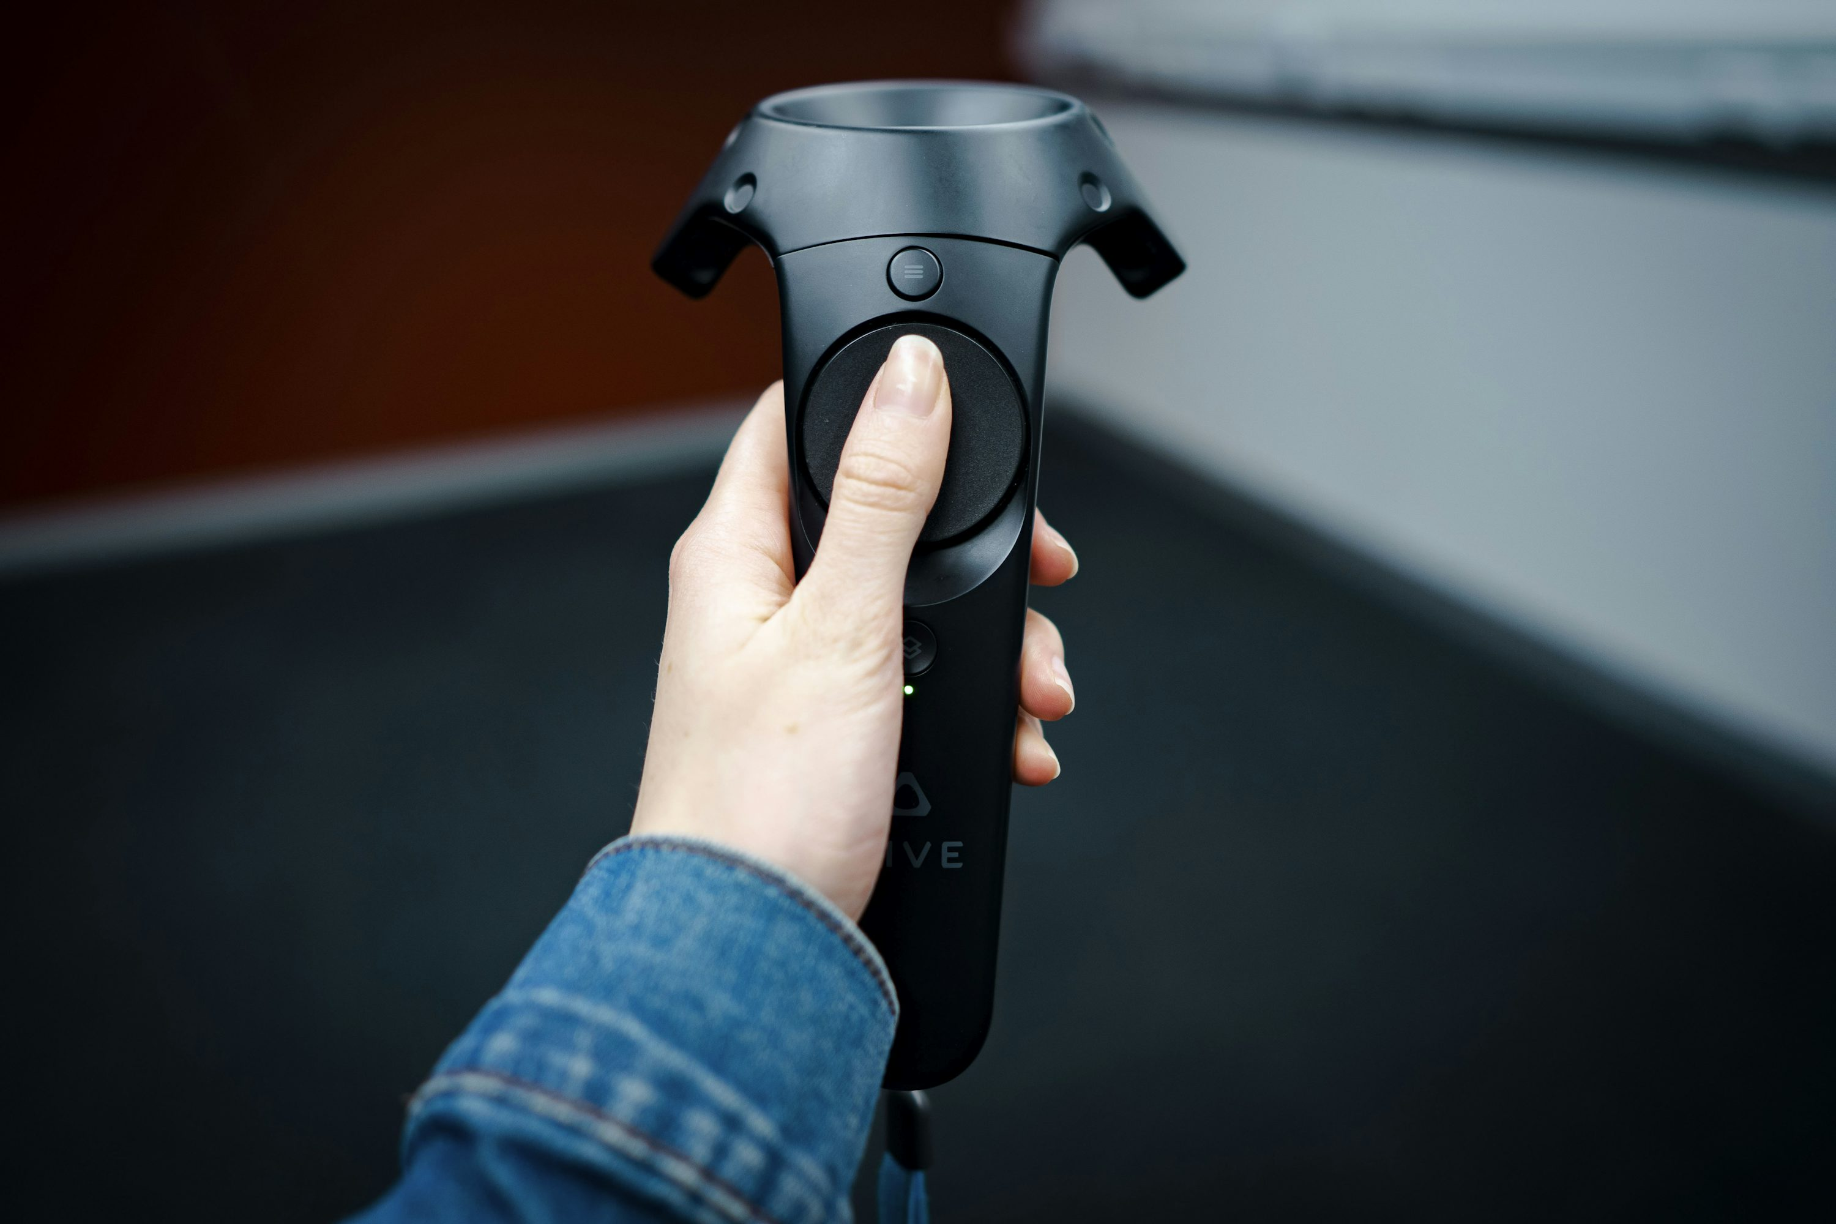
INTERACTIVE gaming Application
Farm scenario
Fixation Point → Rooster
Visual Target → Cat
Auditory Cue → Cat’s meow

Slide 44
INTERACTIVE gaming Application
Farm scenario
New E values: 10°, 12°, 14°

Slide 45
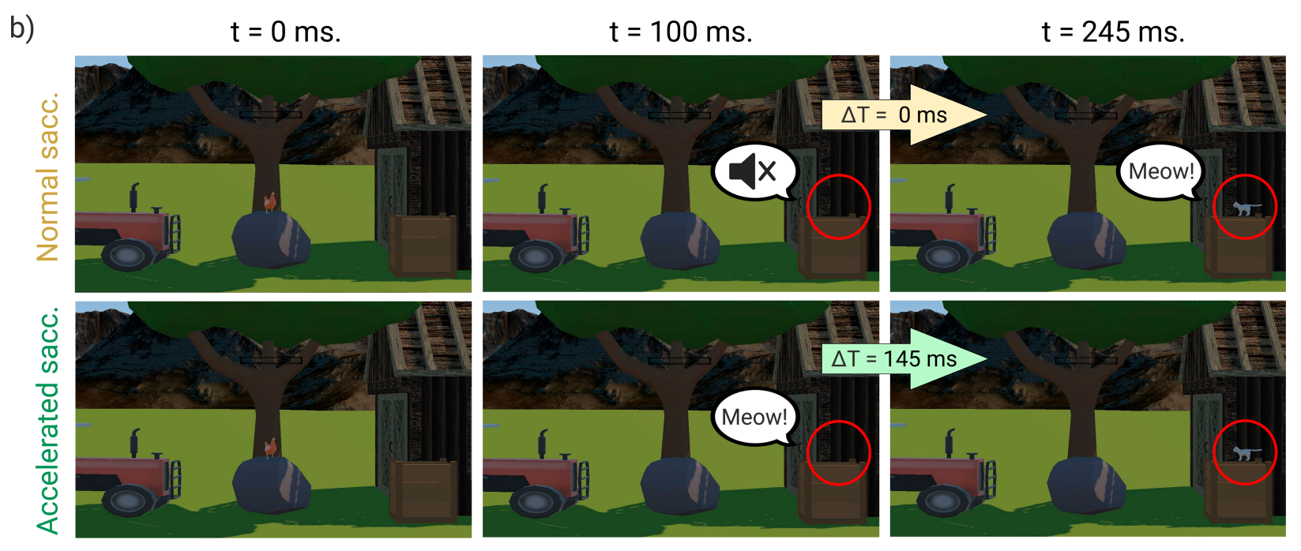
INTERACTIVE gaming Application
Farm scenario
New E values: 10°, 12°, 14°
Acceleration goal: 20, 40, 60ms
Temporal shift predicted
$$Saccadic Latency = f(E, ΔT, ΔS)$$

Slide 46
INTERACTIVE gaming Application
Farm scenario
New E values: 10°, 12°, 14°
Acceleration goal: 20, 40, 60ms
Temporal shift predicted
Average Latency Error
8 ms

Slide 47
FUTURE WORK
Larger values for experiment variables
Eccentricity, temporal delay and spatial mismatch

Slide 48
FUTURE WORK
Larger values for experiment variables
Eccentricity, temporal delay and spatial mismatch
Depth cues
Vergence-Accommodation conflict

Slide 49
FUTURE WORk
Larger values for experiment variables
Eccentricity, temporal delay and spatial mismatch
Depth cues
Vergence-Accommodation conflict
Motion and scene complexity

Slide 50
Thank you!
PROJECT WEBSITE
https://avsaccadeaccel.mpi-inf.mpg.de/

